Slide 1
Funding Supportive Housing in North Carolina

Slide 2
Funding Sources available in all parts of the State
SHDP from NCHFA
CDBG – small cities program through Department of Commerce or entitlement city
Federal Home Loan Bank of Atlanta or Pittsburgh or other
Local foundations

Slide 3
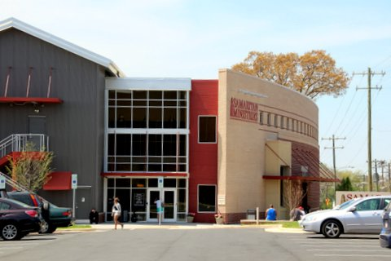
Supportive Housing Development Program (SHDP)
Funds housing with supportive services for households with special needs earning less than 50% of area median income.
Samaritan Inn, Winston-Salem
80 bed shelter for homeless men

Slide 4
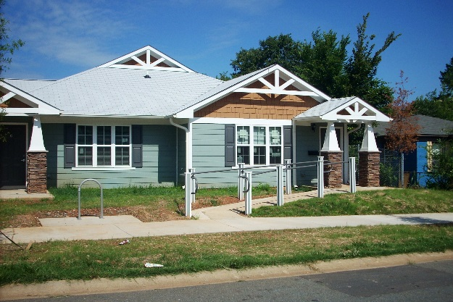
Eligible Applicants
Nonprofit organizations (in operation at least three years)
Local Governments
For-profits for Olmstead compliant projects
Friendship Gardens, Charlotte
12 apartments for persons with special needs

Slide 5
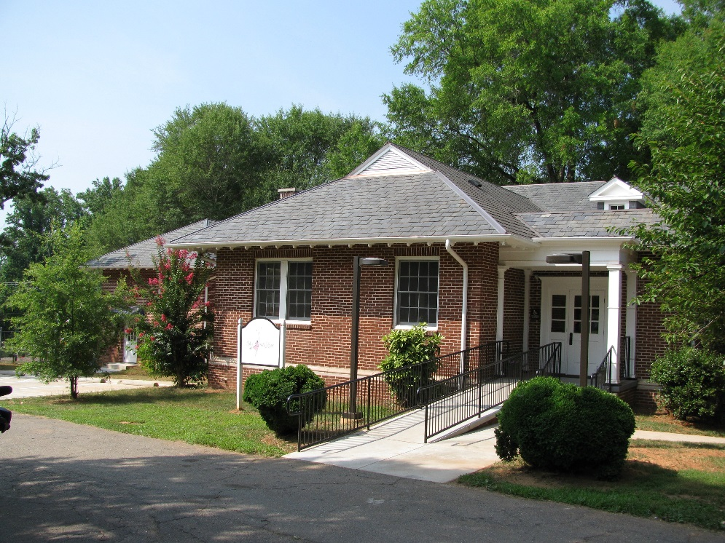
Type of Housing
Substance abuse treatment facilities
Emergency Shelter Rehabilitation
Permanent Housing
My Aunt’s House, Winston-Salem
8 bed licensed facility for children
with substance use disorder

Slide 6
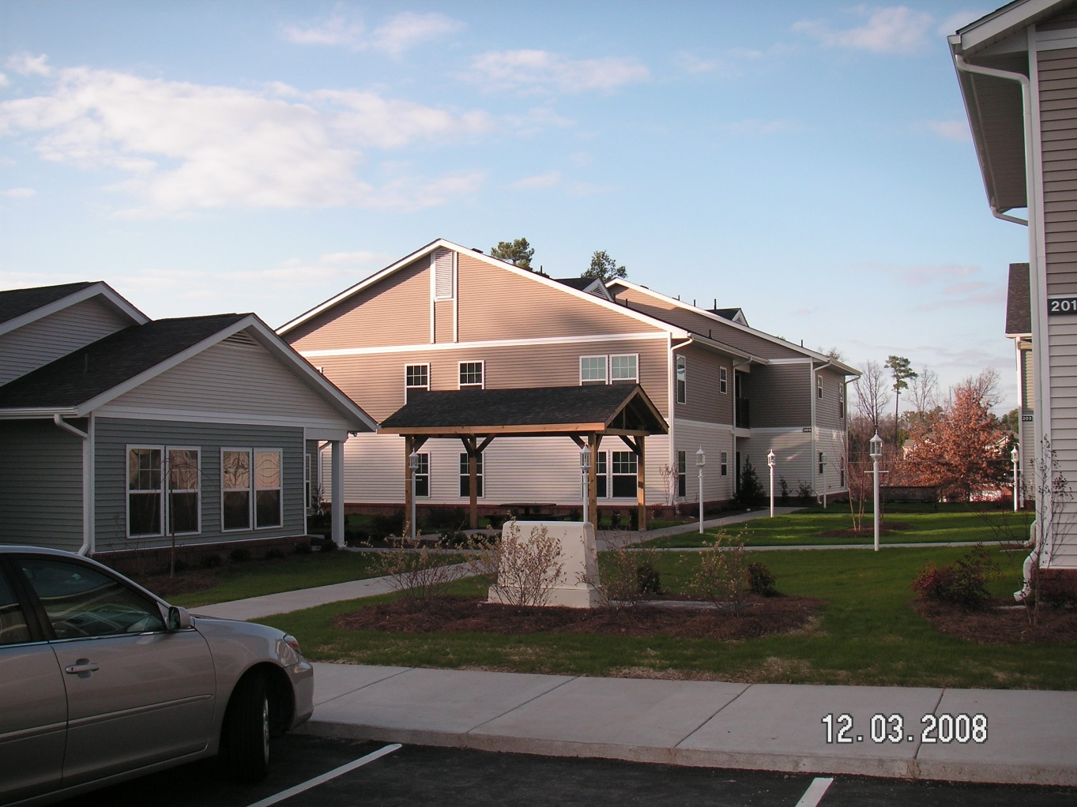
Eligible Populations
Homeless
Re-entry housing from corrections
Youth aging out of foster care
Maple Court Apartments, Durham
VA Transitional Housing Program
24 one-bedroom apartments for
homeless veterans with disabilities

Slide 7
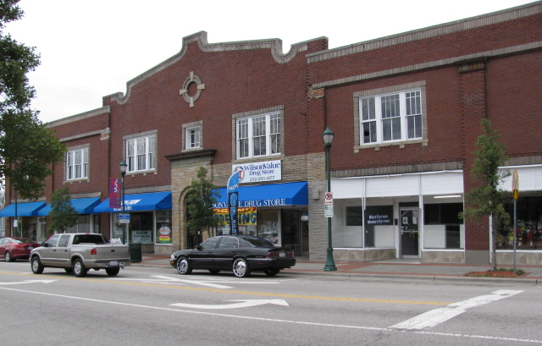
Eligible Populations, cont.
Non-Homeless with disabilities, including mental illness, development disabilities, physical disabilities, substance abuse, HIV/AIDS, etc.
Renaissance Apartments, Wilson
16 efficiency apartments for individuals with
special needs including homeless,
disabled, and frail elderly

Slide 8
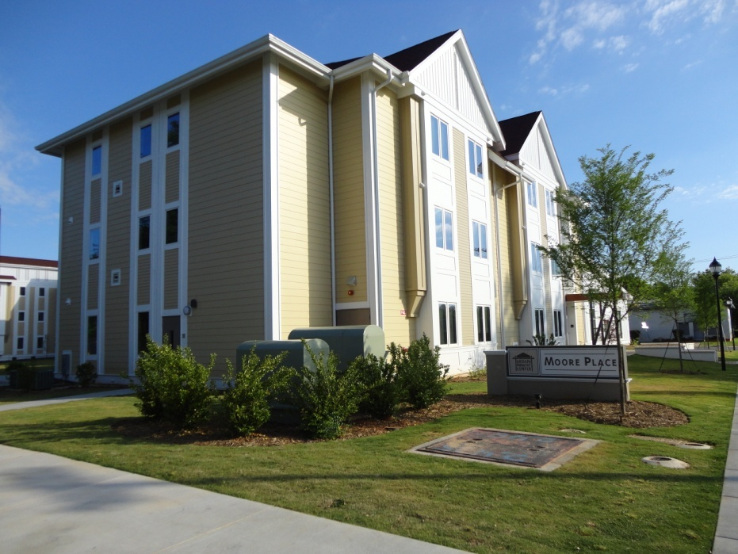
Type of Funding
Maximum funding capped at 50% of Total Development Cost in Large, 60% in Small and 70% in Non-entitlement Communities
Moore Place, Charlotte
115 efficiency apartments for chronically homeless men
and women

Slide 9
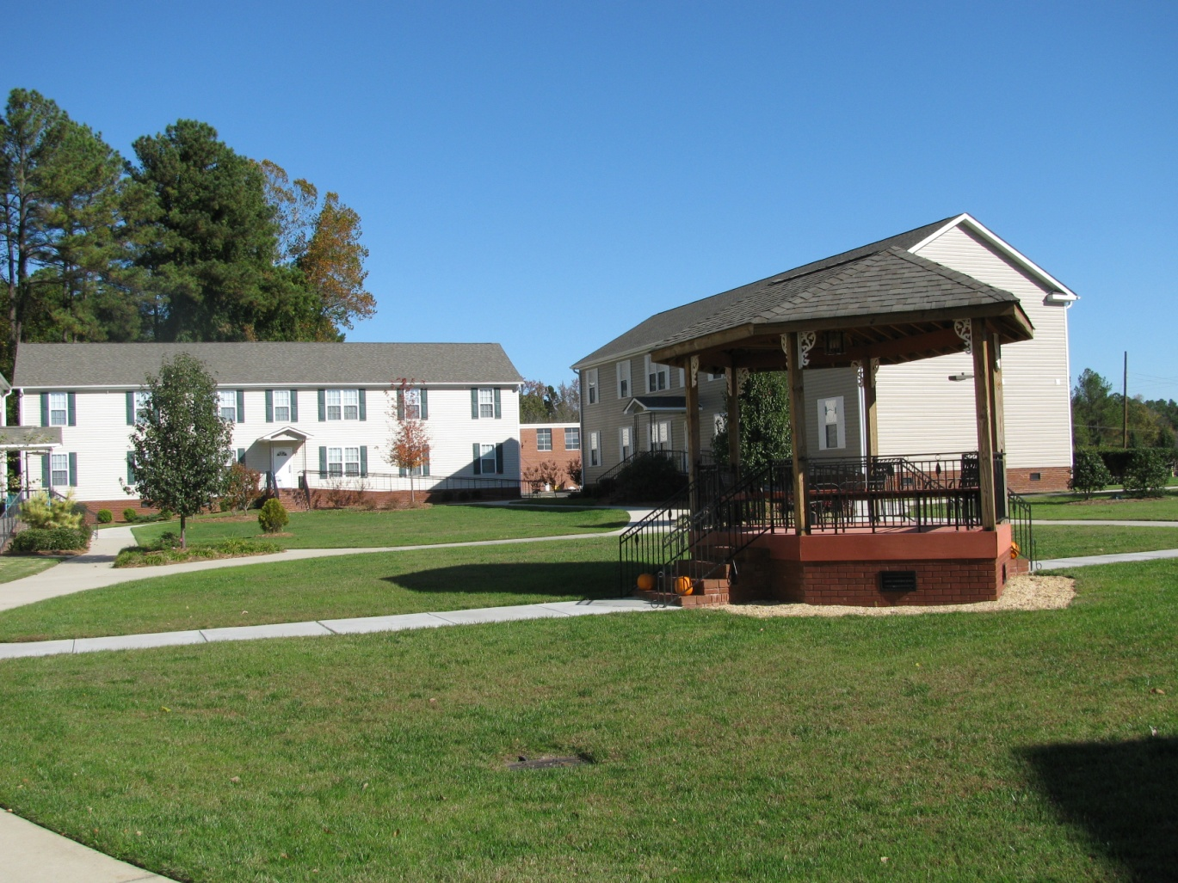
Type of Funding, cont.
20 year and 30 year 0% Loans up to $600,000 or $700,000 depending on location
One funding cycle a year, deadline in March
TROSA James Street Apartments, Durham
24 shared apartments for men and women in substance
abuse treatment program

Slide 10
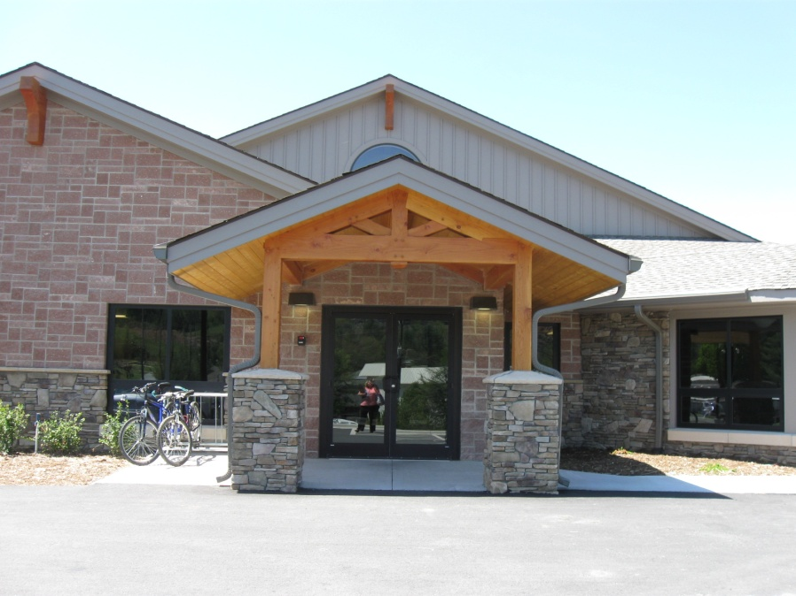
Application Process
Site visit required prior to application
Site Control required – option recommended
Preliminary Design required
Hospitality House, Boone
62 beds of emergency, transitional and permanent
housing for homeless men, women and children

Slide 11
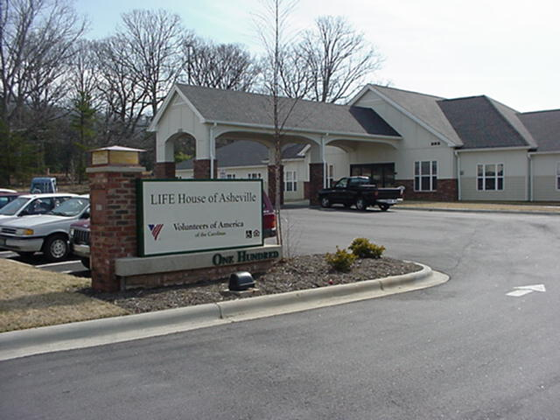
Application Process, cont.
Supportive Services Plan required
Application available at: https://www.nchfa.com/rental-housing-partners/supportive-housing-developers/fund-development
Life House of Asheville
22 apartments for persons with spinal cord
injuries

Slide 12
Accomplishments
4,841 Units Funded since 1994
Units Developed in 63 NC Counties
$104 million invested since 1994 in projects worth $311 million
261 Projects
Data as of 8/14/2019

Slide 13
NC Foundations

Slide 14
SHDP Staff
Gwen Belcredi, Senior Supportive Housing Development Officer
919-877-5648, sgbelcredi@nchfa.com
Margrit Bergholz, Senior Supportive Housing Development Officer
919-877-5633, mcbergholz@nchfa.com
Nancy Bloebaum, Senior Project Manager and Compliance Specialist
919-877-5619, nbbloebaum@nchfa.com
Jennifer Olson, Community Living Program Administrator and Strategic Coordinator
919-850-2928, jlolson@nchfa.com

