Slide 1
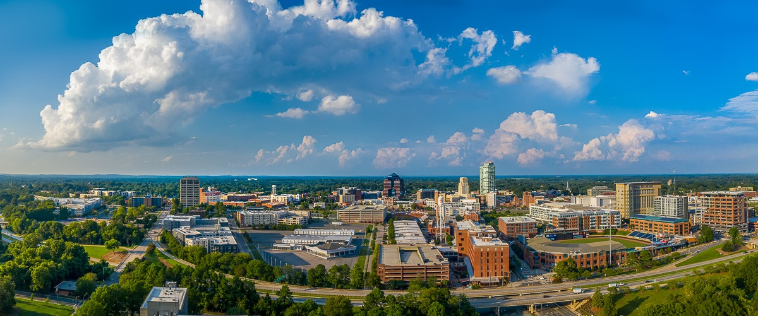
2019 Durham Affordable Housing Referendum

Slide 2
Affordable Housing Timeline
City Council approves “Penny for Housing” – 2012
Five Year Affordable Housing Goals adopted – June 2016
Community Development Department reorganization – 2016/17
Housing Plan implementation begins – FY2017-18
City Council votes to double local housing investment – June 2018
Mayor proposed $95 million Affordable Housing Bond during State of the City Address – February 2019
Municipal elections – November 5, 2019

Slide 3
PROPOSED INVESTMENT
$160 million investment in affordable housing over five years, $65 million from existing sources and $95 million from bond
Builds on current housing strategy and partnership with Durham Housing Authority

Slide 4
Anticipated Results
Nearly 1,600 new affordable rental units created
Over 800 affordable rental units preserved, including public housing, existing income restricted housing and naturally-occurring affordable housing (NOAH)
At least 400 homeownership opportunities created through a combination of construction of affordable homes and downpayment assistance for low income home buyers
At least 1,700 homeless households living in emergency shelter moved into permanent housing
Over 3,000 low income renters and homeowners stabilized (through eviction diversion, emergency rental assistance, property tax assistance and repair/rehab funding)
Final 9/6/19

Slide 5
Strengths Political leadership Community support (business, advocates, general) Strong partners Existing housing plan | Challenges Slow start to campaign Big ask for community (in wake of property tax reappraisal and failed transit plan) Questions about capacity – city/DHA Concerns about equity and accountability

Slide 6
Lessons Learned (so far!)
Allow enough lead time
Think about non-housing impacts of investment
Transparency and accountability are key

