Slide 1
Abi Bussone, MPH
Community Engagement Manager, Unite Us, a partner of NCCARE360

Slide 2
What is NCCARE360?
NCCARE360 is the first statewide coordinated network that includes a robust data repository of shared resources and connects healthcare and human services providers together to collectively provide the opportunity for health to North Carolinians.
NCCARE360 Partners:
Notes:
Navigating services can be difficult – transportation, employment, food assistance, housing
NCCARE360 is the first statewide coordinated network that brings all of theses different sectors together through an online platform to address these social determinants of health. The platform focuses on five pillars of housing, employment, food access, interpersonal violence, and transportation.
Formed through public private partnership between NCDHHS and FHLI
FHLI has done the fundraising to enable us to offer this platform to CBO’s at no cost so this program is going to be around for a while
5 year contract with two automatic three year renewals
Briefly describe other partners and go into detail later

Slide 3
Building a Healthier North Carolina Part of a Broader Statewide Framework
v
NCCARE360
v
v
The Problem:
Connecting people to community resources is inconsistent, not coordinated, not secure, and not trackable.
Work Force
(Community
Health Workers)
Standardized Screening
Multi-Faceted Approach
Promoting the Opportunity for Health
The Solution:
Uniform system for providers, insurers, and community organizations to coordinate care, collaborate, and track progress and outcomes.
v
v
Align enrollment w/ existing resources
Map SDOH Indicators
v
Medicaid
Managed
Care
1. Statewide Core Components
2. Regional Pilots
PROPRIETARY & CONFIDENTIAL
Notes:
The problem that we’re trying to solve is this:
We know that the majority of factors that directly influence health outcomes are often social and environmental. That is why NCCARE360 is taking a person centered approach that focuses on the Social Determinants of health.
Before NCCARE 360 there was no uniform IT system across the state that could connect providers from all sectors to address these 5 pillars of housing, food, IPV, Transportation, and …
Connecting people to resources they needed was also very fragmented, inconsistent, and not trackable
The system that is in place now you’re using phone calls, emails, faxes and you have no idea what happens to that patient once they leave your organization
NCCARE360 is part of a larger state wide transformation that is occurring across the state aimed to promote the opportunity for health for north Carolinians
The new tool provides three critical pieces to the larger framework
The first is a uniform system for providers, insurers, and CBOs to collaborate and coordinate care for their shared patients
It provides a seamless and easier process for organizations along the continuum to connect people with the multiple resources they need in the community
It enables all organizations that participate in the network to track data and outcomes together. Ensuring that everyone is on the same page.
Nccare360 is the infrastructure that will support the different initiatives and weave them together as part of this multi faceted approach to promoting the opportunity of health.

Slide 4
Vision:
Build a system of health that is focused on the person and helps them access the services and resources they need to be healthy.
Invest in both existing and new infrastructure to enable different types of organizations to connect people to health and social services in a way that makes the system more efficient.
Provide visibility and accountability to help bridge the gap between health care and social services.
Ours is a Vision, not just a product.
PROPRIETARY & CONFIDENTIAL
Notes:
When clients leave your four walls what happens? (3) which is not meant to be judgmental its meant to give yall more insight to your clients journey and be informative.

Slide 5
Three Functions
 | Functionality | Partner | Timeline
Resource Directory | Directory of statewide resources that will include a call center with dedicated navigators, a data team verifying resources, and text and chat capabilities. |  | Ongoing work
Data Repository | APIs integrate resource directories across the state to share resource data. |  | Phased Approach
Referral & Outcomes Platform | An intake and referral platform to connect people to community resources and allow for a feedback loop. |  | Rolled out by county January 2019 – December 2020
PROPRIETARY & CONFIDENTIAL
Notes:
There are three functions of our three tech partners……

Slide 6
What is a Coordinated Network?
A coordinated network connects providers (such as health care providers, insurers, or community organizations) through a shared technology platform to:
Communicate in real-time
Make electronic referrals
Securely share client information
Track outcomes together
PROPRIETARY & CONFIDENTIAL
Notes:
To boil it down, at it’s base, coordinated network is a shared technology platform for healthcare providers, government agencies, community-based organizations and other partners to send electronic referrals to one another.
Unite us has the pleasure of working with almost 50 communities across the country who are using our platform to support their Care Coordination networks.
The software isn’t just for making referrals- being part of a coordinated network also gives you insight into the other services your client is requesting and receiving within the network. In this way, the network model is patient-centered in efforts to address a client’s total health.
You all work in coordinated networks already
You work together through partnerships and collaboratives
Nccare360 is just a tool to do this work more efficiently and it is there to make your life easier

Slide 7
Coordination Platform at Work
Improving coordination efficiency and accuracy
Traditional Referral
Through NCCARE360
Client
Healthcare Provider
Housing Provider
Client
Healthcare Provider
Housing Provider
Service provider cannot always exchange PII or PHI via a secure method
Limited prescreening for eligibility, capacity, or geography
Onus is usually on the client to reach the organization to which he/she was referred
Service providers have limited insight or feedback loop
Client data is siloed & transactional data is not tracked
All information is stored and transferred on HIPAA compliant platform
Client is matched with the provider for which he/she qualifies
Client’s information is captured once and shared on his/her behalf
Service providers have insight into the entire client journey
Longitudinal data is tracked to allow for informed decision making by community care teams
PROPRIETARY & CONFIDENTIAL
Notes:
Bullet two there are filters in the system that you can utilize to make sure your client is getting the right service.
Follow ups may be time consuming if you traditionally wanted to track your clients …. But with nccare360 you have that insight in the platform
How long it took for a client to reach services and get connected …. But with nccare360 you have that data to allow for informed decision making

Slide 8
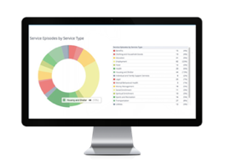
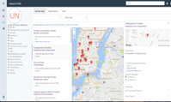
Network Model: No Wrong Door Approach
Understanding Referral Workflows
Housing Need Identified along with other needs
Additional Food Need Identified
Referral
Referral
Client
Care Coordinator
Housing
Provider
Food Bank
PROPRIETARY & CONFIDENTIAL
Healthcare
Partner
Notes:
So what does this really look like? We like to take this no wrong door approach to connect people to services in any way possible.
Weather its …. Or …. Or …..
They can also make a self referral through the nccare360 website
All you need is an internet connection and a log in to access this platform
Talk about the lock

Slide 9
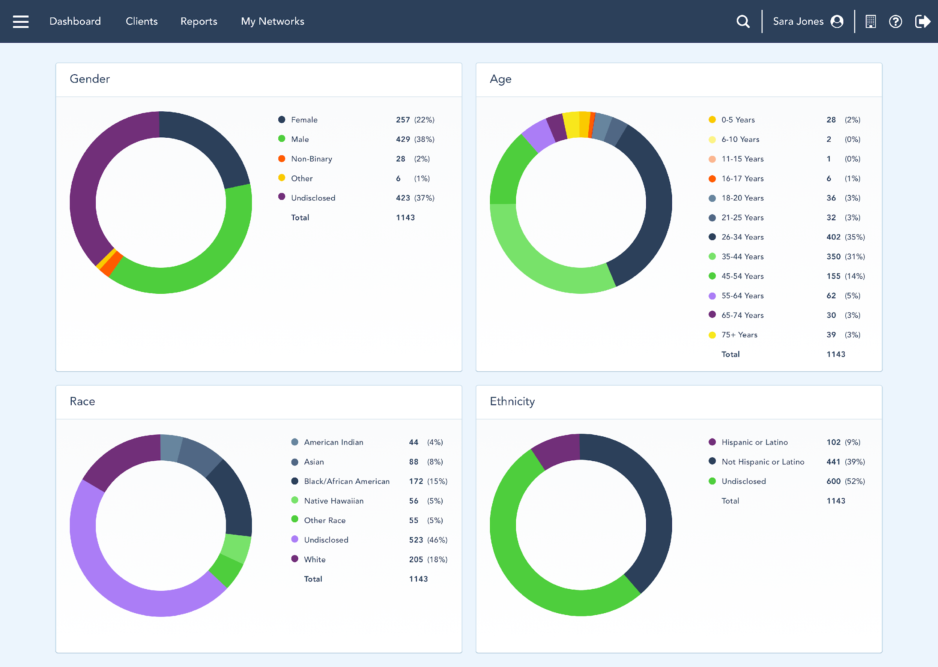
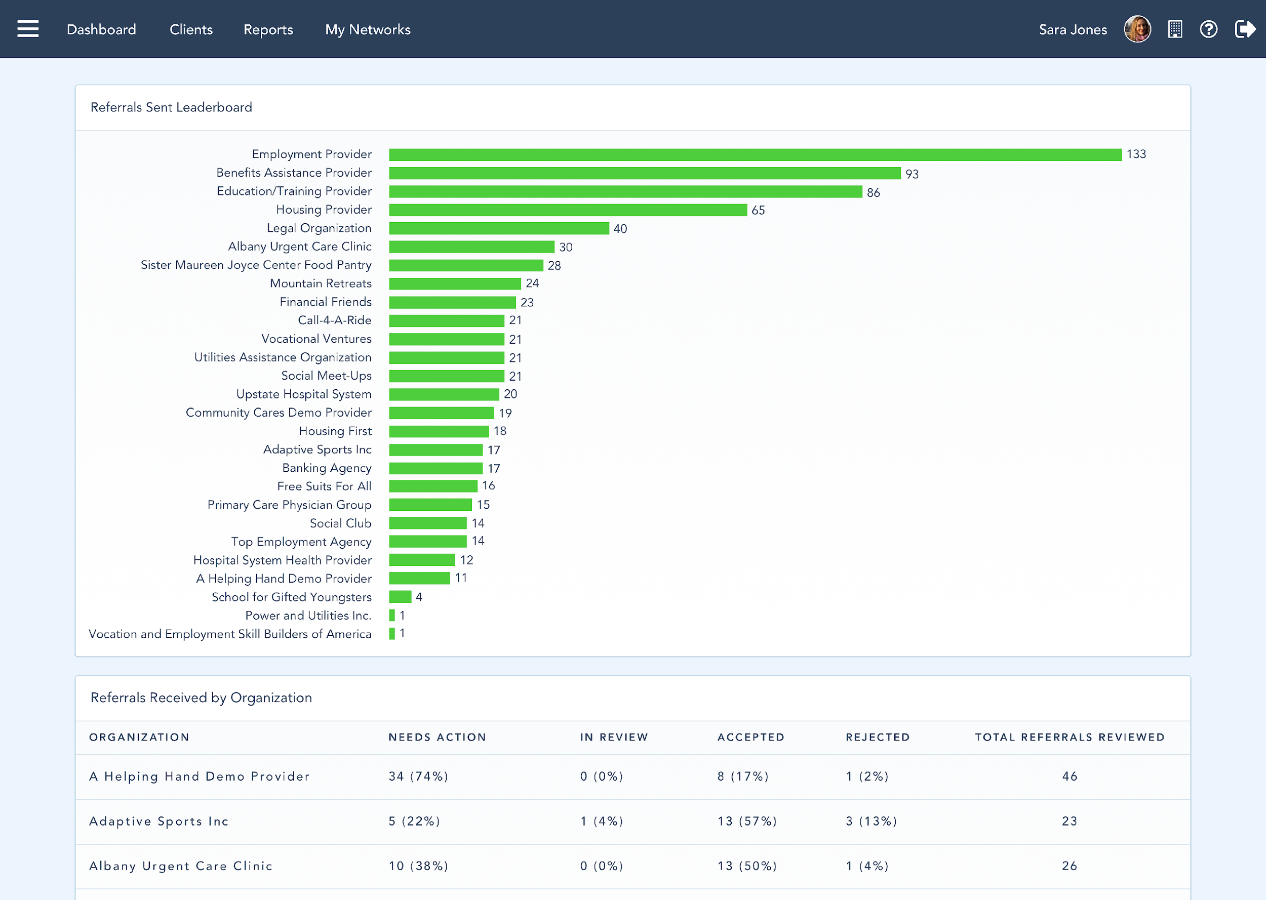
The Data You Need
Real-time reporting of outcomes, impact, performance & efficiency
Patient Level Coordination and Tracking
Network Level Transparency & Accountability
Service Episode history (longitudinal), Referrals Created, Received by, Structured Patient Outcomes for each specific need addressed
Patient Demographics, Patient Access Points, Service Delivery History, Outcome Breakdowns
Notes:
One of the benefits of joining nccare360 is gaining access to the data you need for your organization

Slide 10
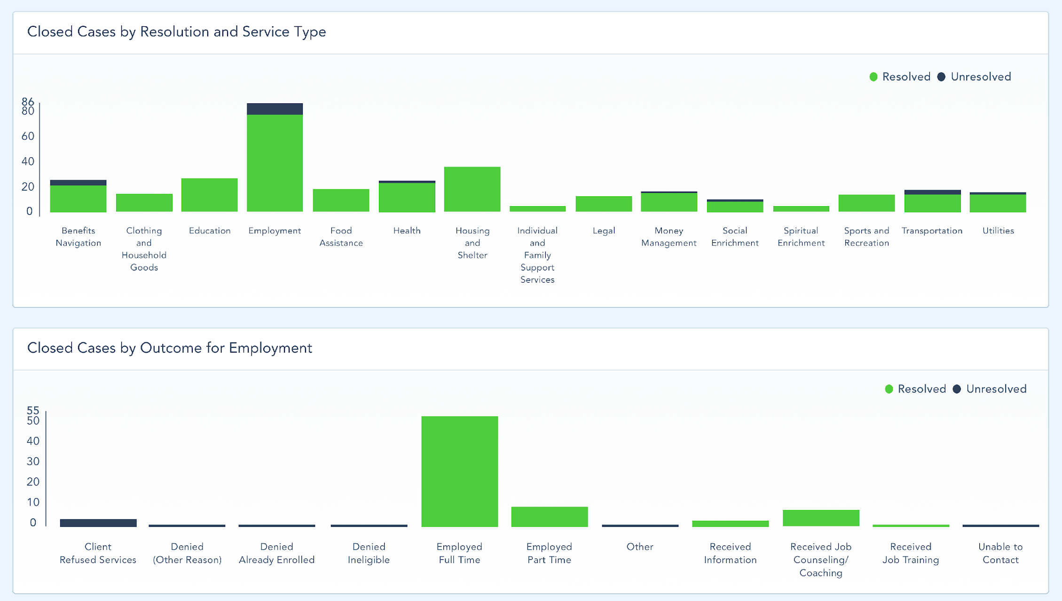
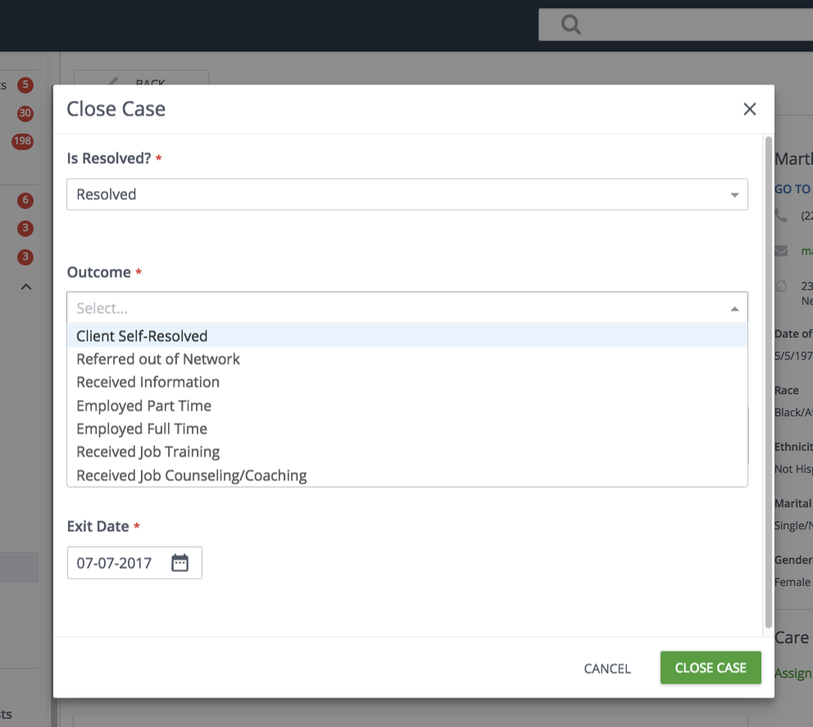
Configurable & Structured Reporting
Granular and detailed outcomes for every type of service
Employment Service Type Example
Notes:
You’ll also have access to this outcomes based data for your organization and utilization of services.

Slide 11
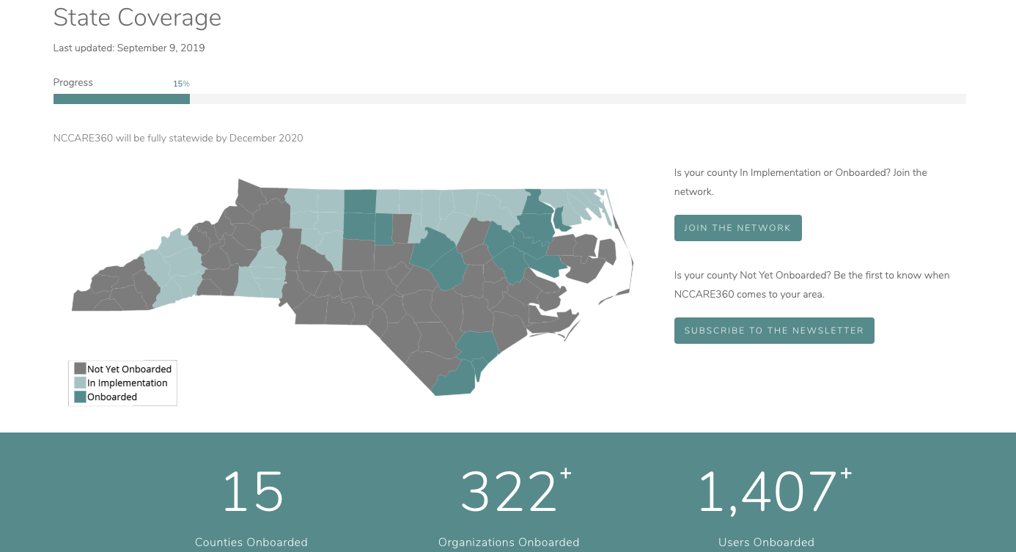

Slide 12
Questions?
Abi@uniteus.com

