Slide 1


LIHTC 101:
The Basics
for the 2022 North Carolina Affordable Housing Conference
Rebecca Darling
Chris Key
Partner, Novogradac
Partner, Novogradac
rebecca.darling@novoco.com
chris.key@novoco.com

Slide 2
Copyright Notice and Disclaimer:
Novogradac & Company LLP (“Novogradac”) is the copyright owner of this slide deck. Novogradac is making the printed version (but not the PowerPoint file) of this slide deck and any other handouts branded with the Novogradac logo (collectively the “Materials”) available to attendees of this session for informational and/or educational purposes only. The Materials and attendance are not a substitute for professional advice. By accessing the Materials and attending the session, you agree to the terms of this disclaimer. You agree not to make business, financial, and/or tax decisions based solely on the Materials and you agree that we are not responsible for any such business, financial and/or tax decisions made by you based on the information contained in the Materials. You agree not to make audio or video recordings of the session instruction. You may not copy, cite to, or distribute the Materials, in whole or in part, without the prior written consent of an authorized officer of Novogradac. All rights reserved 2022 by Novogradac & Company LLP. Novogradac & Company LLP is a registered trademark of Novogradac.

Slide 3
Let’s begin.

Slide 4
Outline
LIHTC Overview
Credit Calculation at the Building Level
Typical Ownership Structure
Development Timeline
Minimum Set-Aside, Income Limits, Rent Limits
How Credits Are Earned, Claimed, and Recaptured

Slide 5
Outline
LIHTC Overview
Credit Calculation at the Building Level
Typical Ownership Structure
Development Timeline
Minimum Set-Aside, Income Limits, Rent Limits
How Credits Are Earned, Claimed, and Recaptured

Slide 6

Affordable Housing Overview

Slide 7


Affordable Housing Overview
“Affordable Housing”
Sorry.
$700
$6.38M
DEBT
Developer/
Owner
Developer/
Owner
Total Project Costs
Can you lower your rent to $400/month?
$400

Slide 8





Intro to LIHTC and Section 42
Basic Zoom (out)
‘86
x 10 years
TAX CREDITS
IRS
Tax Liability
Investor
Section 42
IRC
“Low-Income Housing Tax Credit”
$
Partnership
LLC
DEBT
?
DEBT
Equity
TAX CREDITS
Tax Liability
Developer/
Owner
Developer/
Owner
Total Project Costs
Income limits
Rent limits
Suitability for Occupancy

Slide 9
Outline
LIHTC Overview
Credit Calculation at the Building Level
Typical Ownership Structure
Development Timeline
Minimum Set-Aside, Income Limits, Rent Limits
How Credits Are Earned, Claimed, and Recaptured

Slide 10
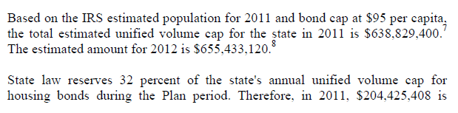

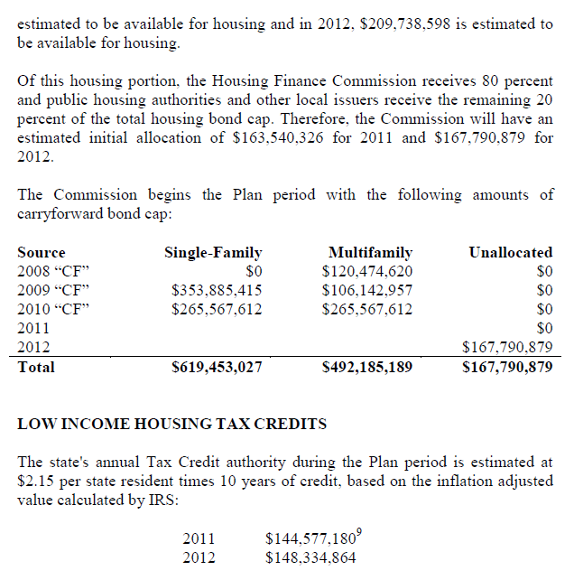







9% credits vs. bonds and 4% credits
Section 42
Section 42
IRC
IRC
$17.5mil
$17.5mil
LIHTCs
LIHTCs
State Allocating Agency
State Allocating Agency

Slide 11
9% credits vs. bonds and 4% credits
Section 42
IRC
$17.5mil
LIHTCs
State Allocating Agency

Slide 12
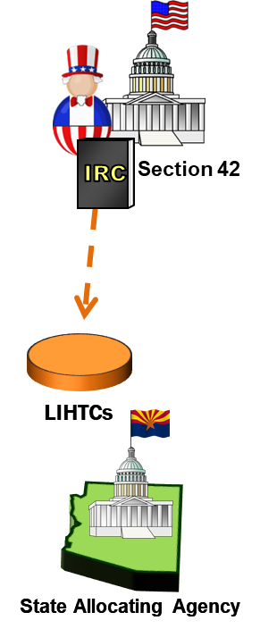
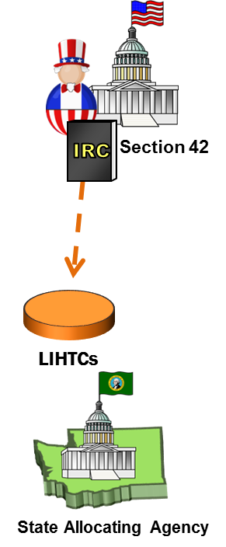
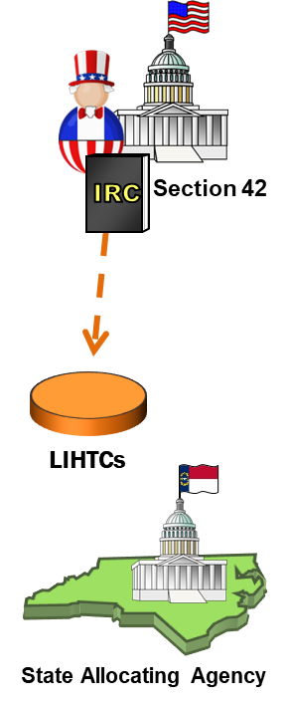






Eligible basis, DDA and QCT and basis boost
Total development costs
Less: ineligible costs
Eligible basis
1.8Mil
200k
1.6Mil
$
-
$
$10.8mil
Ineligible costs:
Land
Marketing
P’ship org. costs
Commercial property
Other
Eligible costs:
Building and paving
Construction loan interest
Developer fee
Site work
Off-site improvements
(under certain circumstances)
$800k
Section 42
Eligible Basis
IRC
= $10mil
A
Total Project Costs
B
30%
Eligible basis
6mil
$
4mil
$
State Allocating Agency
“QCT”
  Projects located in Qualified Census Tracts (QCTs), which are census tracts “in which 50 percent or more of the households have an income which is less than 60 percent of the area median income for such year or which has a poverty rate of at least 25 percent.” IRC §42(d)(5)(B)(ii)
  Projects located in Difficult Development Areas (DDAs), which are areas that have “high construction, land, and utility costs relative to area median gross income.” IRC §42(d)(5)(B)(iii)
1
2
3
$2.44B
“DDA”
See IRC § 42(d)(5)(B)
http://www.ohfa.org/housingdev/mfb.htm
$2.44B
Private Activity
Tax-Exempt Bonds

Slide 13
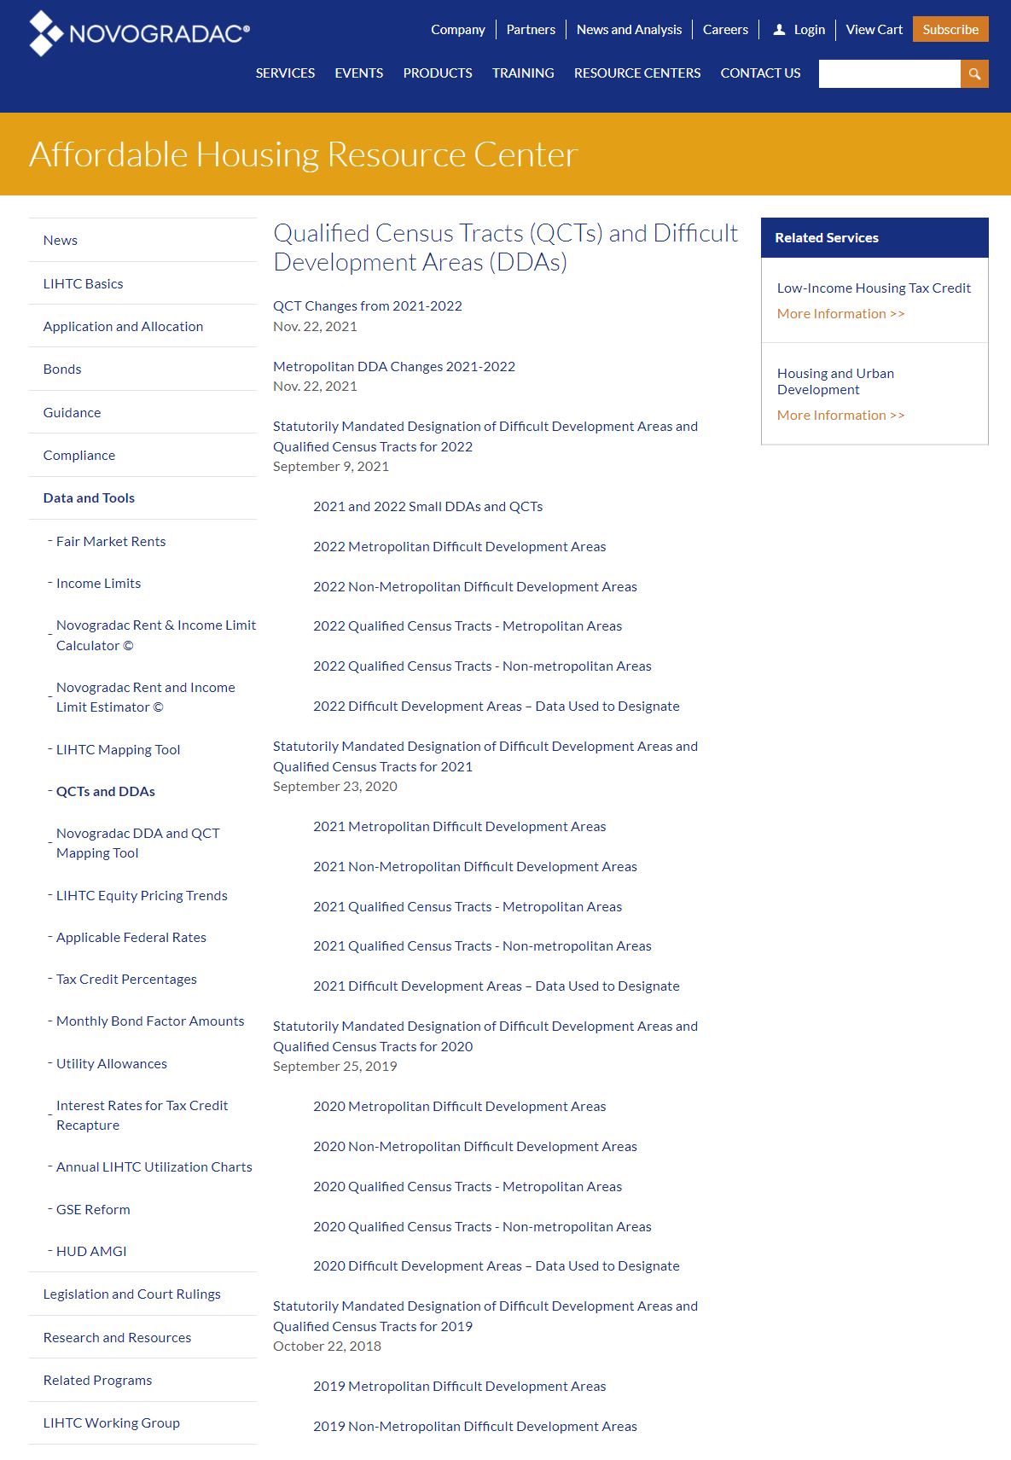
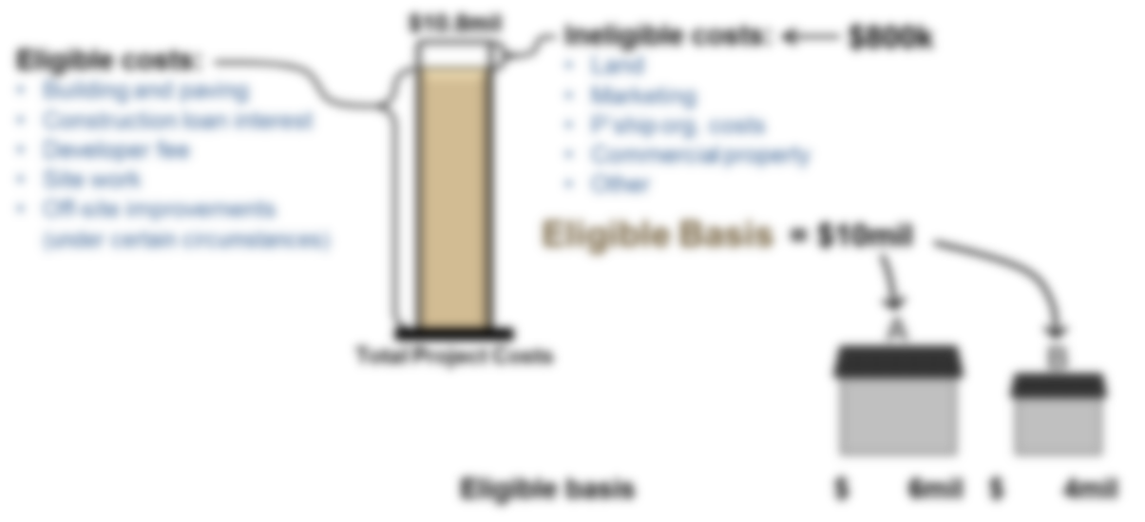


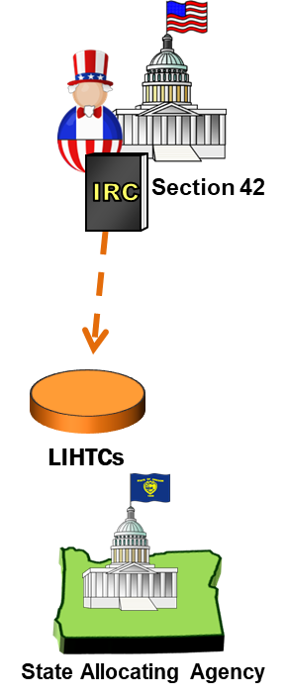
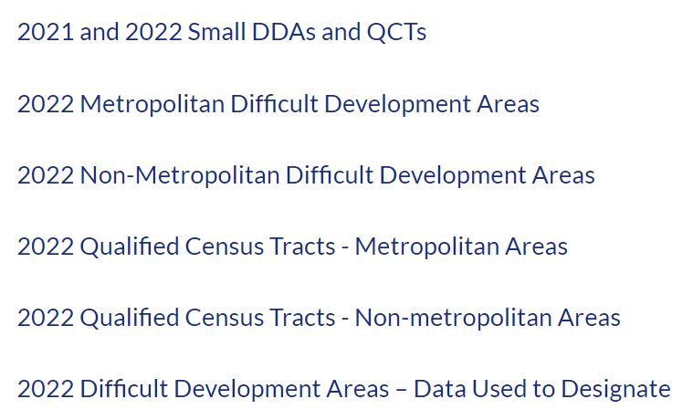
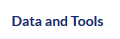



QCT and basis boost
1.8Mil
200k
1.6Mil
$
-
$
30%
“QCT”
1
2
3
“DDA”
www.novoco.com > affordable housing resource center
See IRC § 42(d)(5)(B)

Slide 14
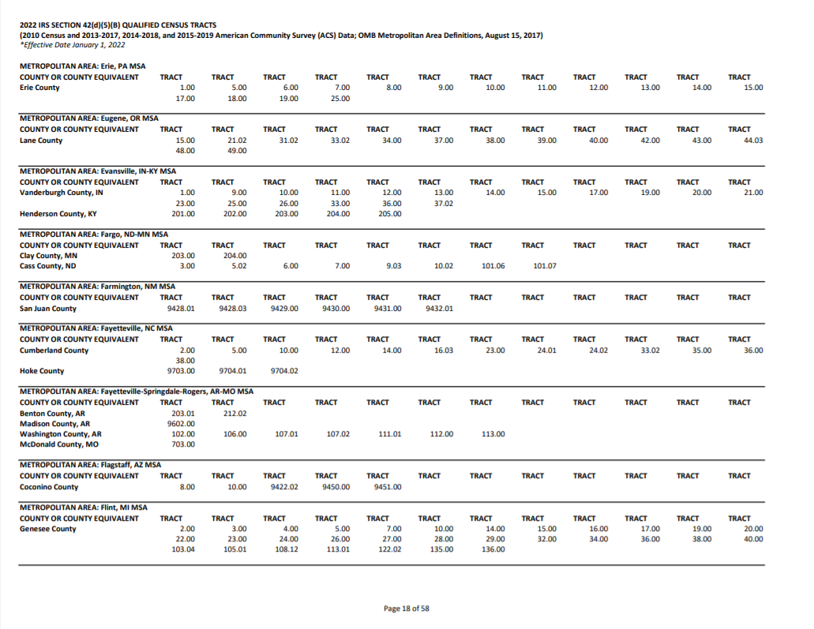

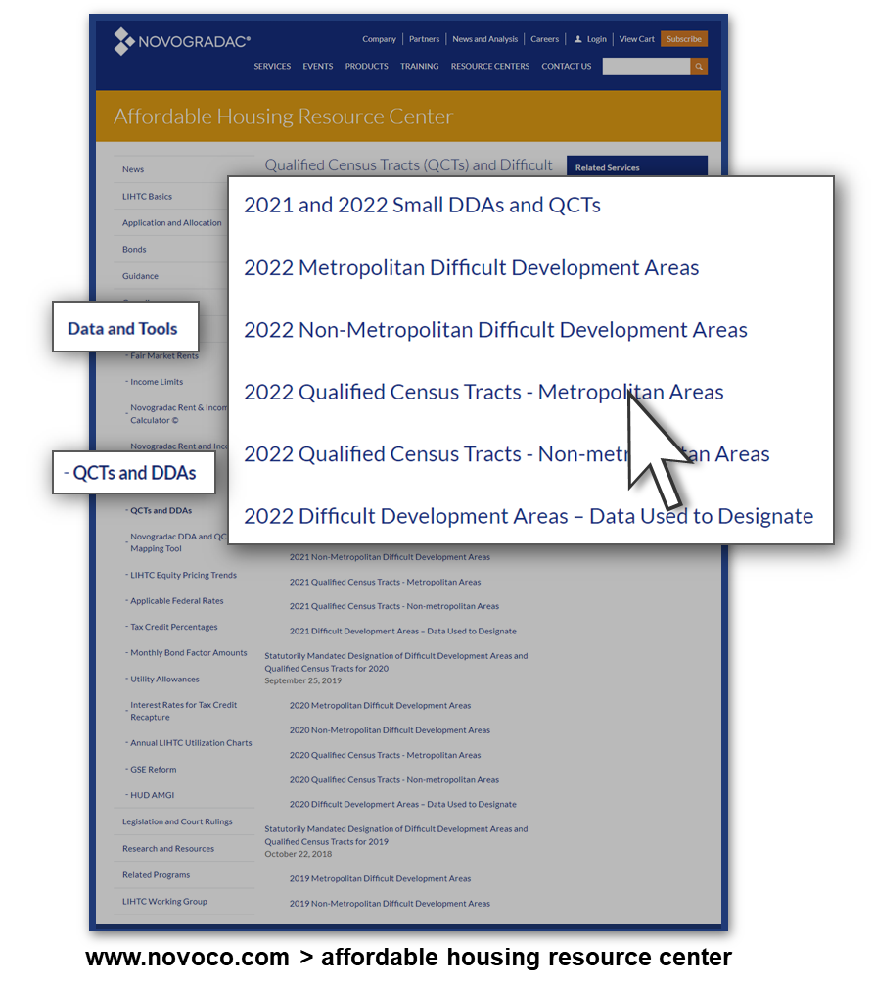
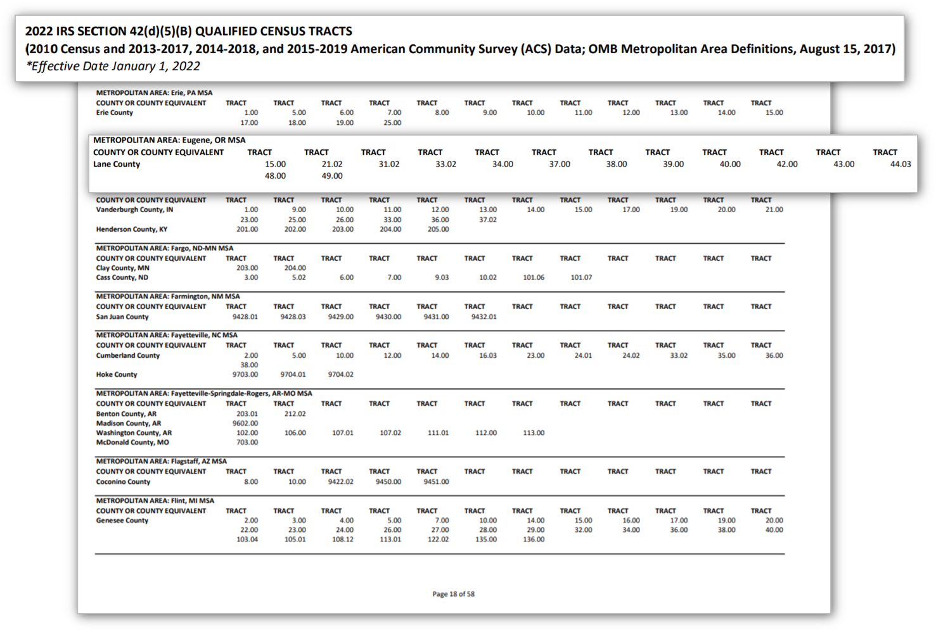

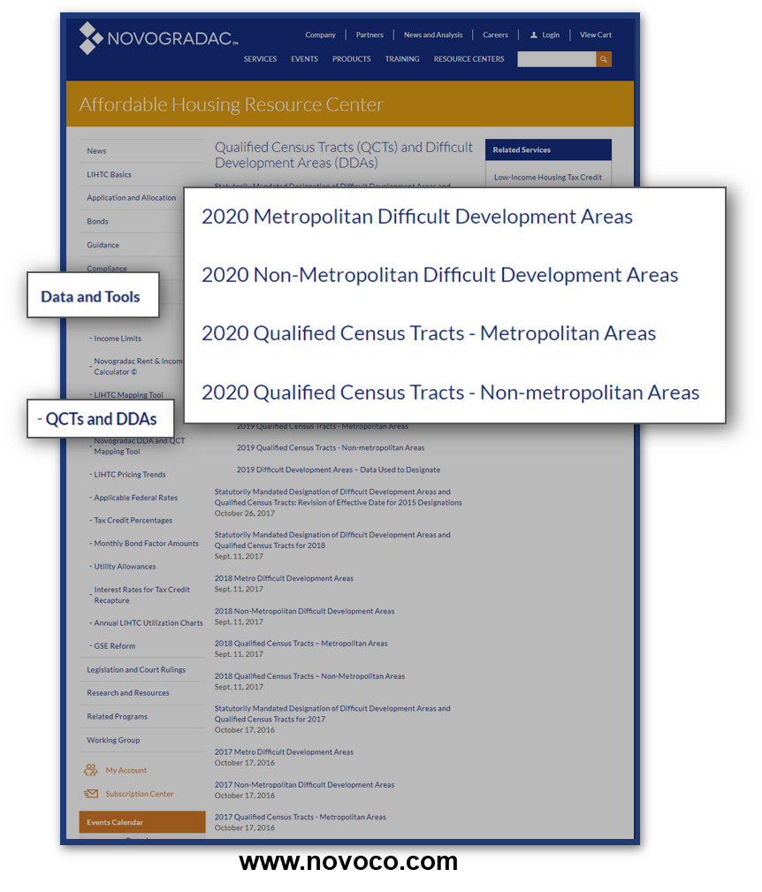
QCT and basis boost
1.8Mil
200k
1.6Mil
$
-
$
30%
“QCT”
1
2
3
“DDA”
See IRC § 42(d)(5)(B)

Slide 15



Eligible basis, DDA and QCT and basis boost
Total development costs
Less: ineligible costs
Eligible basis
1.8Mil
200k
1.6Mil
$
-
$
$10.8mil
Ineligible costs:
Land
Marketing
P’ship org. costs
Commercial property
Other
Eligible costs:
Building and paving
Construction loan interest
Developer fee
Site work
Off-site improvements
(under certain circumstances)
$800k
Section 42
Eligible Basis
IRC
= $10mil
A
Total Project Costs
B
30%
Eligible basis
DDA/QCT basis boost
Eligible basis (adjusted)
6mil
130%
7.8mil
$
x
$
4mil
130%
5.2mil
$
x
$
1
  9% projects not already in a QCT or DDA that the state allocating agency chooses to award up to a 30% basis boost so that the project may be “financially feasible.” Housing and Economic Recovery Act of 2008 (HERA), IRC §42(d)(5)(B)(v)
2
3
See IRC § 42(d)(5)(B)
http://www.ohfa.org/housingdev/mfb.htm
$2.44B
Private Activity
Tax-Exempt Bonds

Slide 16
Tax credit calculation, continued
Total development costs
Less: ineligible costs
Eligible basis
1.8Mil
200k
1.6Mil
$
-
$
$10.8mil
Section 42
Eligible Basis
IRC
= $10mil
A
Total Project Costs
B
Eligible basis
DDA/QCT basis boost
Eligible basis (adjusted)
Applicable fraction
6mil
130%
7.8mil
$
x
$
4mil
130%
5.2mil
$
x
$
1
2
3
$2.44B
See IRC § 42(c)(1)
http://www.ohfa.org/housingdev/mfb.htm
$2.44B
Private Activity
Tax-Exempt Bonds

Slide 17
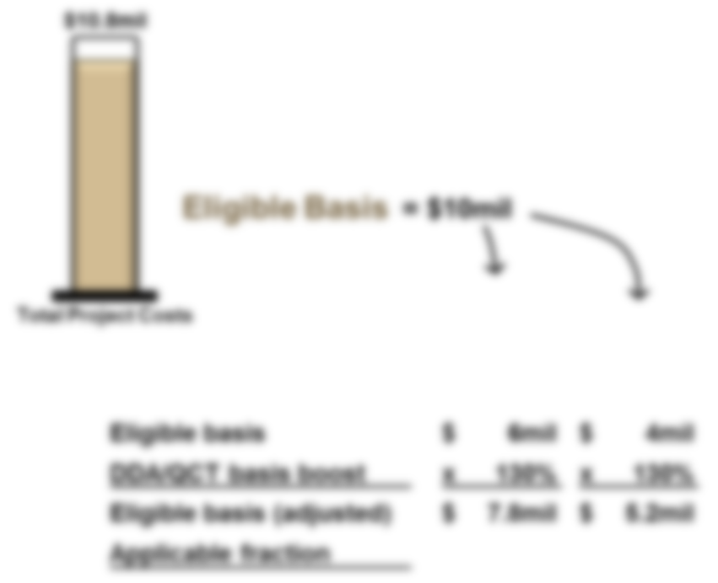

Applicable fraction
Building X
Scenario No. 1
Scenario No. 2
A
B
Applicable fraction
Unit Fraction:
50%
Unit Fraction:
50%
Floor-Space Fraction:
35%
Floor-Space Fraction:
65%
Lesser
Low-Income Units
Lesser
Market-Rate Units
See IRC § 42(c)(1)

Slide 18
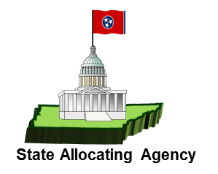
Qualified basis
Total development costs
Less: ineligible costs
Eligible basis
1.8Mil
200k
1.6Mil
$
-
$
$10.8mil
25% Market-Rate Units
Section 42
Eligible Basis
IRC
= $10mil
A
Total Project Costs
B
Eligible basis
DDA/QCT basis boost
Eligible basis (adjusted)
Applicable fraction
Qualified basis
6mil
130%
7.8mil
75%
5.85mil
$
x
$
x
$
4mil
130%
5.2mil
100%
5.2mil
$
x
$
x
$
1
2
3
$2.44B
See IRC § 42(c)(1)
http://www.ohfa.org/housingdev/mfb.htm
$2.44B
Private Activity
Tax-Exempt Bonds

Slide 19


Annual credits, total credits
$10.8mil
Eligible Basis
= $10mil
A
Total Project Costs
B
Eligible basis
DDA/QCT basis boost
Eligible basis (adjusted)
Applicable fraction
Qualified basis
Tax credit percentage
Annual tax credits
Ten years
Total tax credits
6mil
130%
7.8mil
75%
5.85mil
10
$
x
$
x
$
x
$
x
$
4mil
130%
5.2mil
100%
5.2mil
10
$
x
$
x
$
x
$
x
$
LIHTCs
Private Activity
Tax-Exempt Bonds
See IRC § 42(b)
2,439,100,000

Slide 20
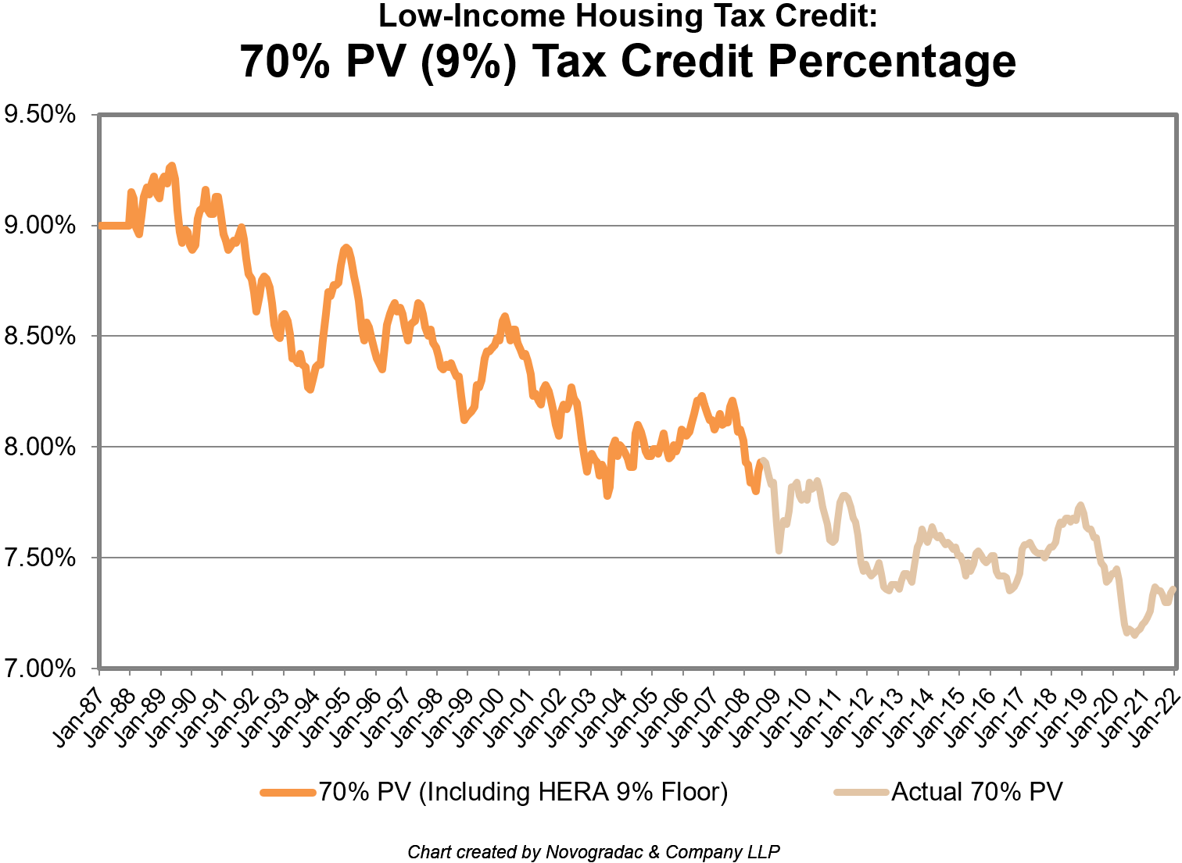
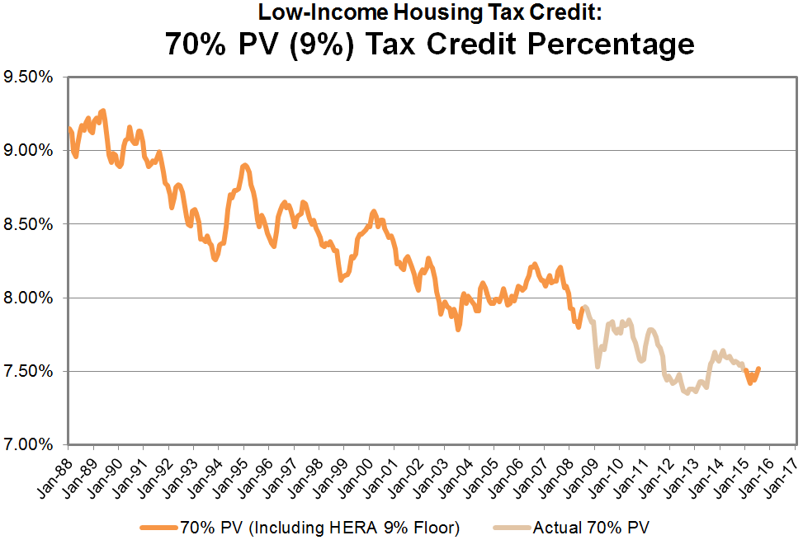
Tax Credit Calculation: 70% PV Rate
$10.8mil
9%
9% credits
Eligible Basis
= $10mil
70% present value credit
A
Total Project Costs
B
Eligible basis
DDA/QCT basis boost
Eligible basis (adjusted)
Applicable fraction
Qualified basis
Tax credit percentage
Annual tax credits
Ten years
Total tax credits
6mil
130%
7.8mil
75%
5.85mil
10
$
x
$
x
$
x
$
x
$
4mil
130%
5.2mil
100%
5.2mil
10
$
x
$
x
$
x
$
x
$
LIHTCs
Private Activity
Tax-Exempt Bonds
See IRC § 42(b)

Slide 21

Tax Credit Calculation: 70% PV Rate
$10.8mil
9%
9% credits
Eligible Basis
= $10mil
70% present value credit
A
Total Project Costs
A
B
NOV ‘20
7.18%
Eligible basis
DDA/QCT basis boost
Eligible basis (adjusted)
Applicable fraction
Qualified basis
Tax credit percentage
Annual tax credits
Ten years
Total tax credits
6mil
130%
7.8mil
75%
5.85mil
10
$
x
$
x
$
x
$
x
$
4mil
130%
5.2mil
100%
5.2mil
10
$
x
$
x
$
x
$
x
$
LIHTCs
Private Activity
Tax-Exempt Bonds
See IRC § 42(b)

Slide 22
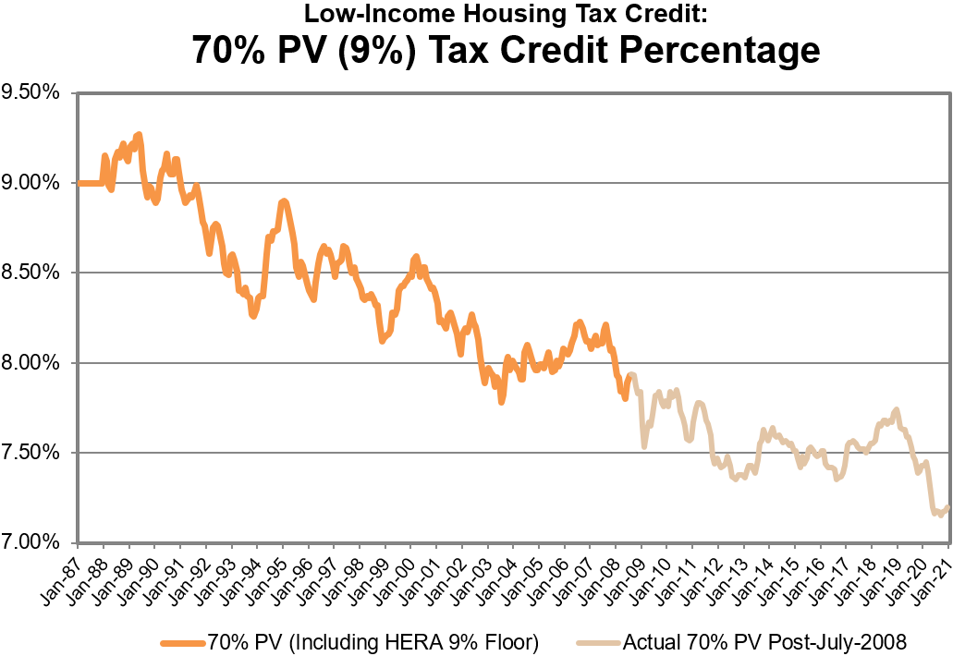
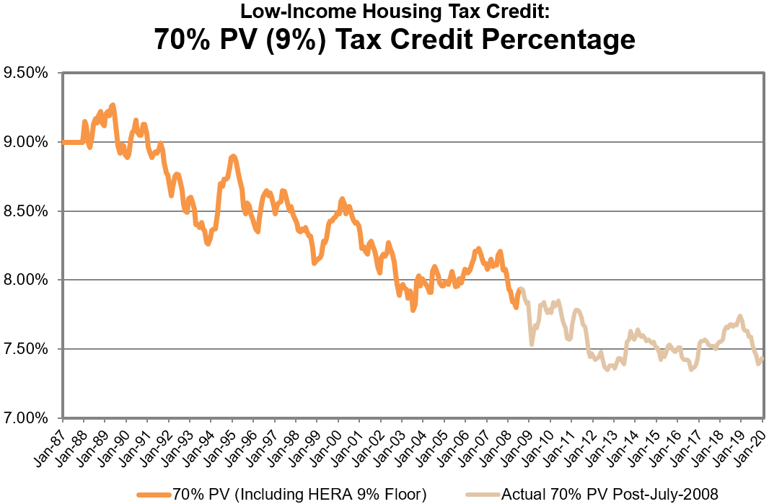
Tax Credit Calculation: 70% PV Rate
$10.8mil
9%
9% credits
Eligible Basis
= $10mil
70% present value credit
A
Total Project Costs
A
B
NOV ‘20
7.18%
Eligible basis
DDA/QCT basis boost
Eligible basis (adjusted)
Applicable fraction
Qualified basis
Tax credit percentage
Annual tax credits
Ten years
Total tax credits
6mil
130%
7.8mil
75%
5.85mil
7.18%
420k
10
4.20mil
$
x
$
x
$
x
$
x
$
4mil
130%
5.2mil
100%
5.2mil
10
$
x
$
x
$
x
$
x
$
*
LIHTCs
Private Activity
Tax-Exempt Bonds
See IRC § 42(b)
9%
MAR ‘20
7.40%

Slide 23
Tax Credit Calculation: 70% PV Rate
$10.8mil
9%
9% credits
Eligible Basis
= $10mil
70% present value credit
B
MAY ‘21
7.37%
A
Total Project Costs
A
B
NOV ‘20
7.18%
Eligible basis
DDA/QCT basis boost
Eligible basis (adjusted)
Applicable fraction
Qualified basis
Tax credit percentage
Annual tax credits
Ten years
Total tax credits
6mil
130%
7.8mil
75%
5.85mil
7.18%
420k
10
4.20mil
$
x
$
x
$
x
$
x
$
4mil
130%
5.2mil
100%
5.2mil
7.37%
383k
10
3.83mil
$
x
$
x
$
x
$
x
$
*
*
LIHTCs
$8.03 mil
Private Activity
Tax-Exempt Bonds
See IRC § 42(b)

Slide 24
Tax Credit Calculation: 9% Floor
$10.8mil
9%
9% credits
Eligible Basis
= $10mil
70% present value credit
B
MAY ‘21
7.37%
A
Total Project Costs
A
B
NOV ‘20
7.18%
Eligible basis
DDA/QCT basis boost
Eligible basis (adjusted)
Applicable fraction
Qualified basis
Tax credit percentage
Annual tax credits
Ten years
Total tax credits
6mil
130%
7.8mil
75%
5.85mil
9%
527k
10
5.27mil
$
x
$
x
$
x
$
x
$
4mil
130%
5.2mil
100%
5.2mil
9%
468k
10
4.68mil
$
x
$
x
$
x
$
x
$
The ability to use 9% as the credit rate (rather than 7.18% and 7.37%), produces approximately 24% more credits for our example Buildings A and B.
LIHTCs
24%
$9.95mil
Private Activity
Tax-Exempt Bonds
See IRC § 42(b)
2,439,100,000
Jul 2015
7.52%

Slide 25
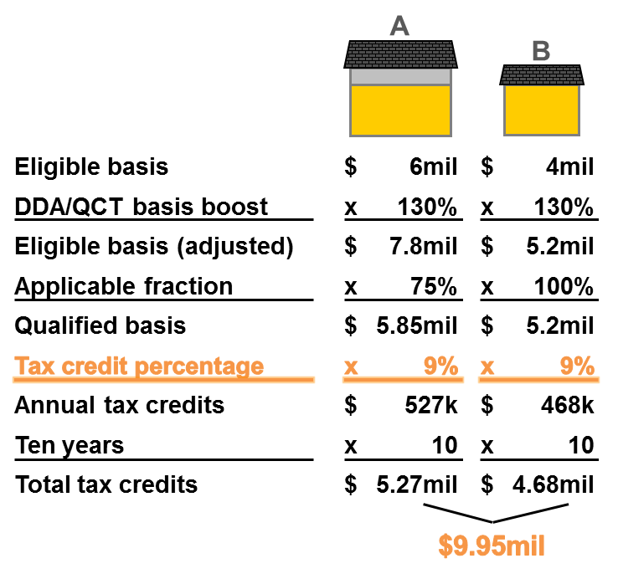
9% credits vs. bonds and 4% credits
Section 42
IRC
$17.5mil
LIHTCs
State Allocating Agency

Slide 26
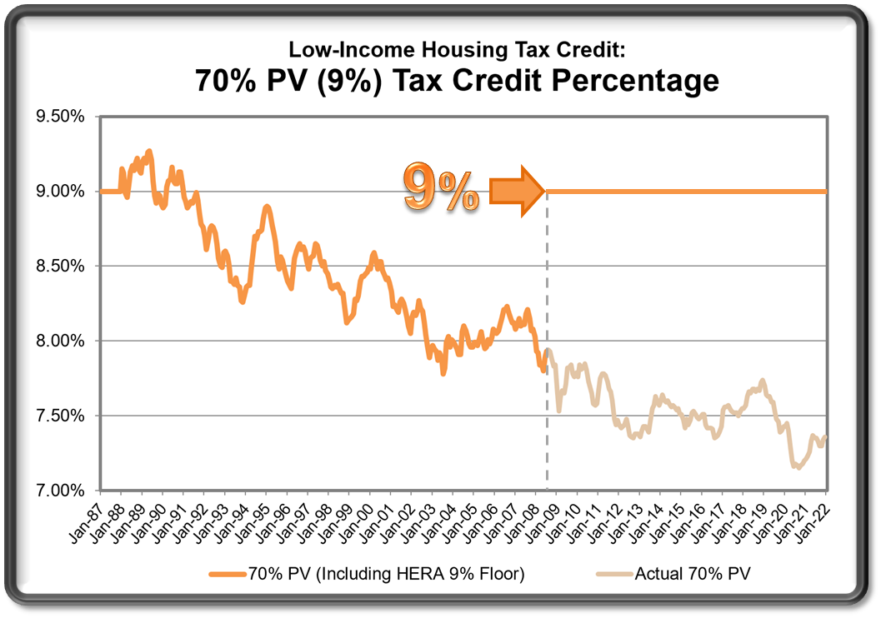


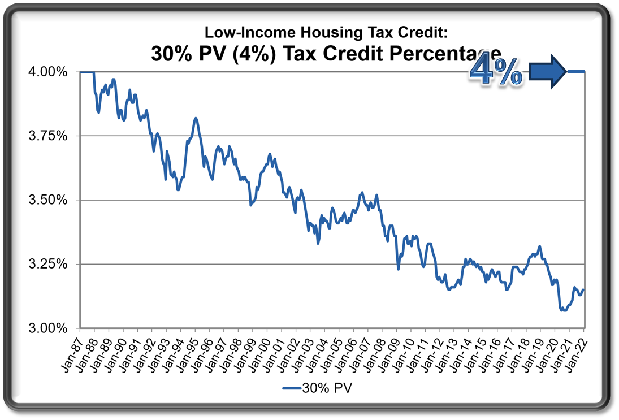




9% credits vs. bonds and 4% credits
9% = 4% x 2.25
“9% deals”
(“competitive/per-capita credits”)
Section 42
IRC
?
$17.5mil
LIHTCs
QB x 7.15% to 9.27%
QB x 3.07% to 4%
Developer/
Owner
Developer/
Owner
State Allocating Agency
“4% deals”
Private Activity
Tax-Exempt Bonds

Slide 27
Outline
LIHTC Overview
Credit Calculation at the Building Level
Typical Ownership Structure
Development Timeline
Minimum Set-Aside, Income Limits, Rent Limits
How Credits Are Earned, Claimed, and Recaptured

Slide 28

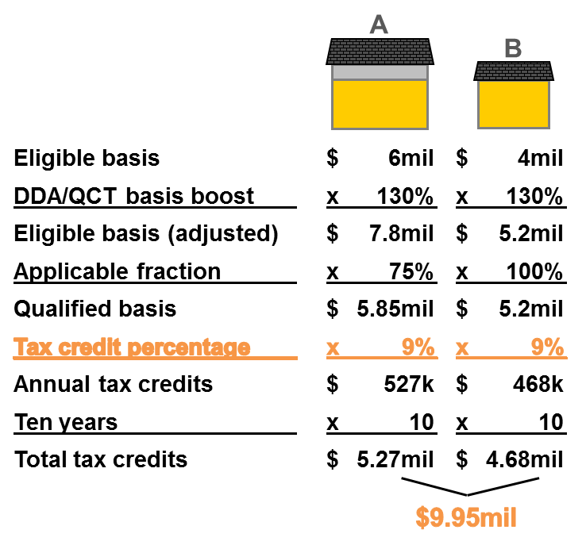
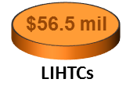
Typical ownership structure
LP
Tax Liability
Investor(s)
GP
$
Syndicator
Syndicator
$
Credits
$
9%
Developer Fee
Losses
Fund
“Upper Tier”
$
GP
$
LP
$
Credits
“Lower Tier”
Losses
Developer/
Owner
Developer/
Owner
$
LIHTCs
Private Activity
Tax-Exempt Bonds
2,439,100,000
$56.5 mil
LIHTCs

Slide 29
Outline
LIHTC Overview
Credit Calculation at the Building Level
Typical Ownership Structure
Development Timeline
Minimum Set-Aside, Income Limits, Rent Limits
How Credits Are Earned, Claimed, and Recaptured

Slide 30


Ten Percent Test
Placed-in-service due date
Placed-in-service due date
Placed-in-service due date
Placed-in-service due date
Reservation
12 mo.
12/31/21
12/31/21
12/31/22
1/1/20
12/31/20
12/31/22
Section 42
IRC
Carryover
Reservation
?
$5.3M
$450k
!
LIHTCs
10% Test
Carryover
Request
Document
10%
= $530k
Developer/
Owner
“Reasonably Expected Basis”
(Fixed assets at construction completion)
State Allocating Agency
See IRC § 42(h)(1)(E)

Slide 31




Finish construction, inspection, COO
Syndicator
Tax Liability
Investor
Section 42
IRC
Certificate
of
Occupancy
$
Certificate
of
Occupancy
$
Reservation
$450k
LIHTCs
Developer/
Owner
Developer/
Owner
Property Manager
State Allocating Agency

Slide 32
Placed-in-service package, 8609s, etc.
Tax Liability
Investor
Section 42
Loan documents
Architectural agreements
Permits
Final Cost Certification
IRC
Certificate
of
Occupancy
Certificate
of
Occupancy
$450k
$6.92mil
Final Cost
Certification
LIHTCs
Placed-In-
Service
Package
Form
8609
Regulatory
Agreement
Form
8609
Developer/
Owner
Property Manager
State Allocating Agency
“Low-Income” Households

Slide 33
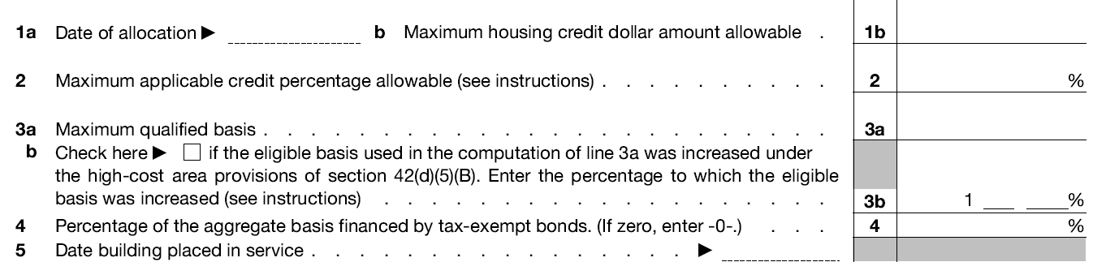
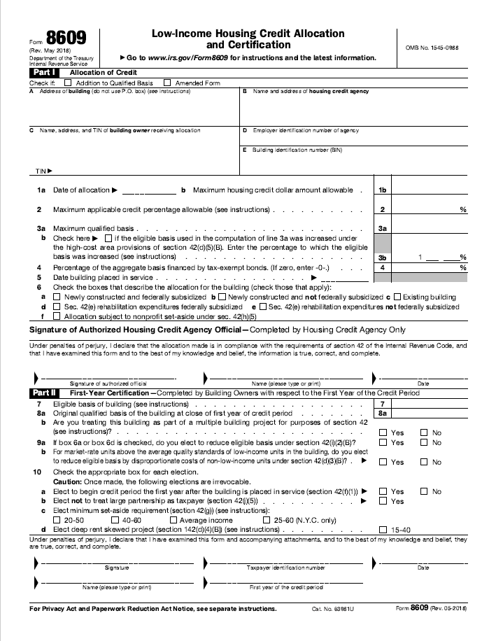
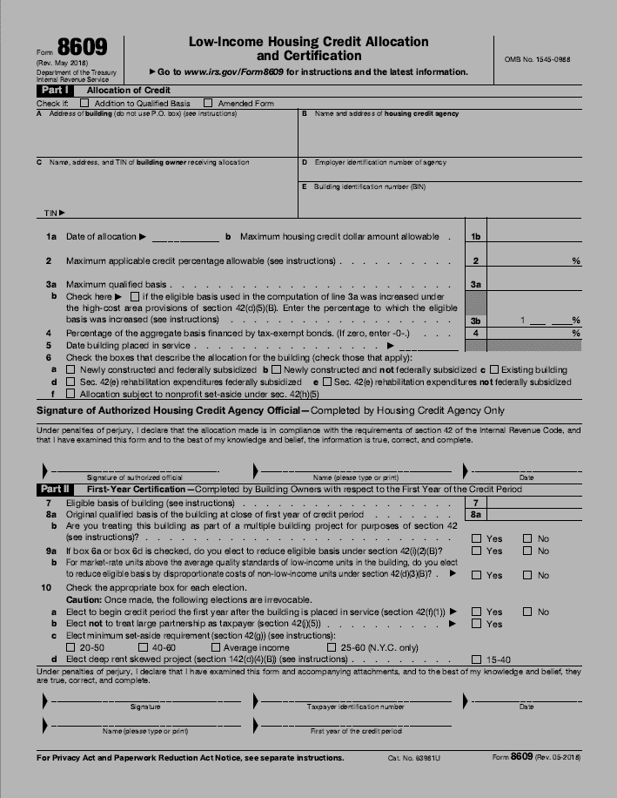

Placed-in-service package, 8609s, etc.
IRS
Tax
Return
Tax
Return
$450k
x 10 =
$4.5 M
$450k
$450k
Tax Liability
Investor
Section 42
IRC
$450k
XX / XX / 2020
240,000.00
Fund
$450k
$450k
9.00
LIHTCs
2,666,666.67
Form
8609
Form
8609
0 0
Developer/
Owner
Developer/
Owner
Property Manager
0
XX / XX / 2022
State Allocating Agency
Form 8609

Slide 34
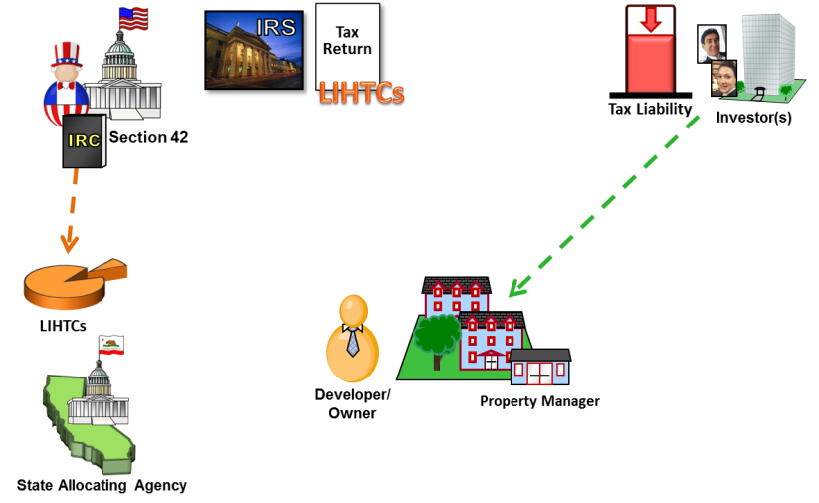

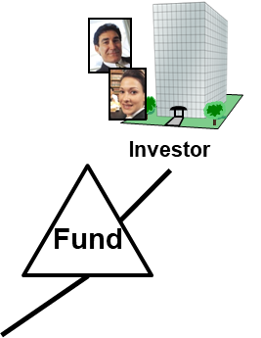






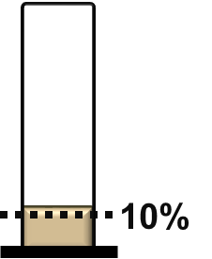








Important things
Investor
Fund
10%
Investor(s)
Timeline of a Typical 9% Deal
Keys:
Investor(s)/Fund Enters
1.
2.
Placing buildings/units in service
Initial lease up of units to qualified households
Lenders
$
Form Partnership
Contractors
Architect
Property Management Company
Reservation
Line Up Team
10% Test
Forecast
Market
Study
PIS
Construction Period
Lease Up
Operating Period
Regulatory
Agreement
State Allocating Agency

Slide 35
Outline
LIHTC Overview
Credit Calculation at the Building Level
Typical Ownership Structure
Development Timeline
Minimum Set-Aside, Income Limits, Rent Limits
How Credits Are Earned, Claimed, and Recaptured

Slide 36
Minimum Set-Aside
Tax Liability
Investor
Section 42
IRC
Reservation
%
$450k
2
$6.92mil
B
A
LIHTCs
Property Manager
State Allocating Agency
1
“Low-Income” Households

Slide 37
Minimum Set-Aside
!
Minimum Set-Aside:
Set aside at least 20% of units in a project to be rent restricted for households with incomes at or below 50% of area median income
Tax Liability
Investor
Section 42
IRC
OR
Reservation
%
$450k
Set aside at least 40% of units in a project to be rent restricted for households with incomes at or below 60% of area median income
2
$6.92mil
LIHTCs
OR (as of 3/23/18)
Property Manager
Set aside at least 40% of units in a project to be rent restricted and have household income limits (designated in 10% increments from 20% to 80%) that on average are at or below
60% of area median income
State Allocating Agency
1
See IRC § 42(g)(1)
“Low-Income” Households

Slide 38

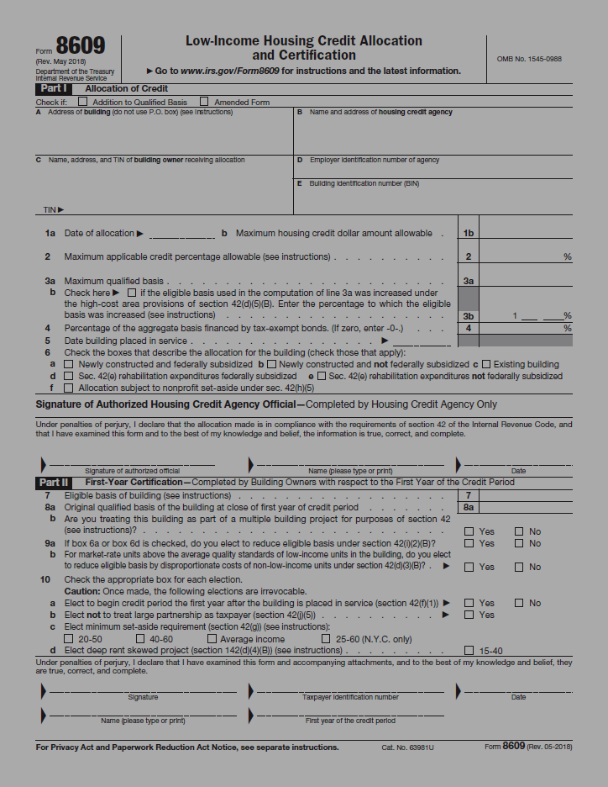

Minimum Set-Aside
Set aside at least 40% of units in a project to be rent restricted and have household income limits (designated in 10% increments from 20% to 80%) that on average are at or below
60% of area median income
Tax Liability
Investor
Section 42
IRC
MAX
$450k
$6.92mil
Form 8609
Project
Project
1/2
LIHTCs
$50k
Median
20%
20%
40%
40%
80%
20 50
$30k
60%
40 60
State Allocating Agency
at
$25k
1/2
% UNITS
Avg.
50%
INCOME
(% of AMI)
40%
MIN
Area Incomes

Slide 39
Minimum Set-Aside
Tax Liability
Investor
Section 42
IRC
MAX
$450k
$6.92mil
Form 8609
Project
1/2
Project
Project
Project
Project
LIHTCs
$50k
Median
70%
50%
10%
40%
40%
30%
40 60
$30k
60%
State Allocating Agency
at
1/2
% UNITS
INCOME
(% of AMI)
MIN
Area Incomes

Slide 40

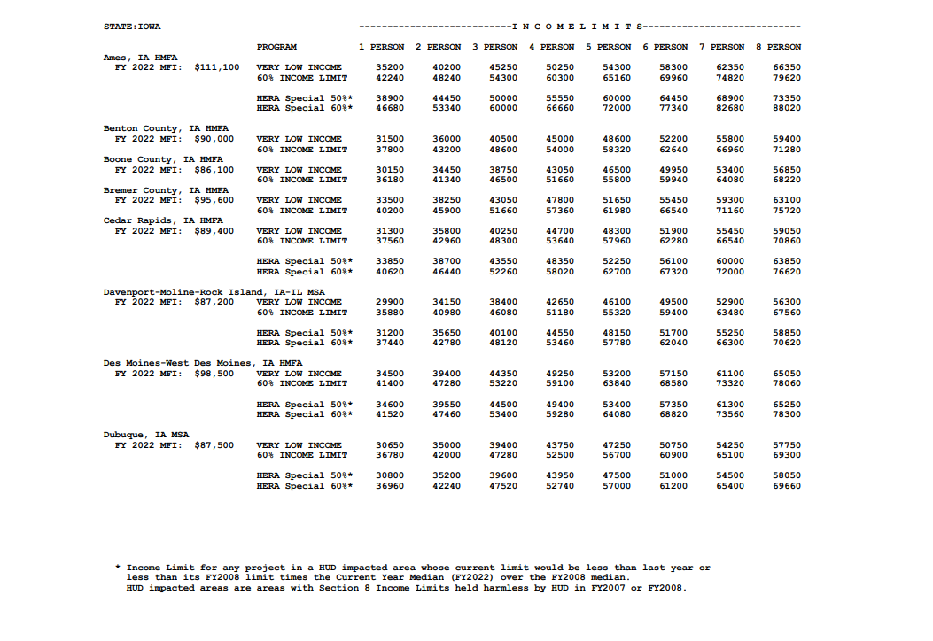





Rent Limits
Tax Liability
Investor
Section 42
IRC
2022 MTSP Income Limits
$450k
2022 Rent Limits:
Income limits for actual households:
$6.92mil
HUD
2 Bedroom Unit – Bremer County, Iowa
3-person
household
LIHTCs
40-at-60 minimum set-aside
$51,660
30%
30%
State Allocating Agency
$1,291/mo
($15,498/yr)
Imputed Household Size = 1.5 x No. of BDR
Income Limit
Rent
Limit
(30% of income limit for imputed household size)

Slide 41
Outline
LIHTC Overview
Credit Calculation at the Building Level
Typical Ownership Structure
Development Timeline
Minimum Set-Aside, Income Limits, Rent Limits
How Credits Are Earned, Claimed, and Recaptured

Slide 42
Noncompliance
Tax Liability
Investor
Section 42
IRC
$450k
$6.92mil
LIHTCs
Noncompliance
Property Manager
1.
2.
3.
Minimum Set-Aside
Income Limits
Rent Limits
State Allocating Agency
“Low-Income” Households

Slide 43
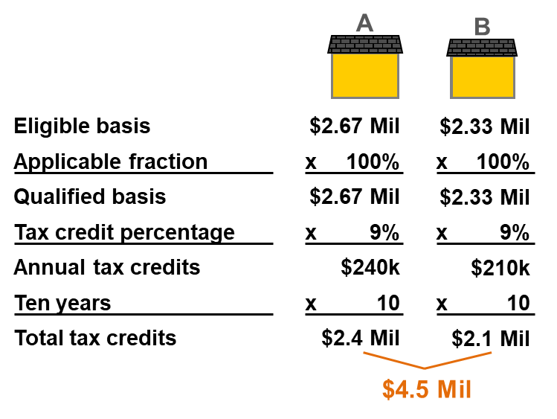
Earning and claiming tax credits
IRS
Tax
Return
$450k
x 10 =
$4.5 M
Tax Liability
Investor
Section 42
IRC
$450k
Tax Credit Period
LIHTCs
Building A
Compliance Period
⅓
80k
80k
80k
80k
80k
80k
80k
80k
80k
80k
Developer/
Owner
Property Manager
⅔
$2.4 M
160k
160k
160k
160k
160k
160k
160k
160k
160k
160k
160k
160k
160k
160k
160k
State Allocating Agency
1
2
3
4
5
6
7
8
9
10
11
12
13
14
15
Year
See IRC § 42(f)(1) – Tax credit period equals ten taxable years

Slide 44
Earning and claiming tax credits
IRS
Tax
Return
$450k
x 10 =
$4.5 M
Tax Liability
Investor
Section 42
IRC
$450k
$6.92mil
Tax Credit Period
LIHTCs
Building A
⅓
80k
Accelerated Credits
80k
80k
80k
80k
80k
80k
80k
80k
80k
Developer/
Owner
Property Manager
⅔
160k
160k
160k
160k
160k
160k
160k
160k
160k
160k
State Allocating Agency
1
2
3
4
5
6
7
8
9
10
11
12
13
14
15
Year
See IRC § 42(f)(2)(B) - Disallowed 1st year credit allowed in 11th year

Slide 45

Non-compliance, Form 8823
Recapture and/or Disallowance!
IRS
Tax
Return
$450k
x 10 =
$4.5 M
Tax Liability
Investor
Section 42
!
Incomes vs. Income Limits
Rents vs. Rent Limits
Suitability for Occupancy
IRC
Noncompliance!
Form
8823
$
$450k
Tax Credit Period
LIHTCs
Credits Eligible to be Recaptured
Building A
Recapture potential:
Unearned credits, proportionate to reduction in qualified basis
80k
Accelerated Credits
80k
80k
80k
80k
80k
80k
80k
!
80k
Developer/
Owner
Property Manager
Earned Credits are not in danger of being recaptured
160k
160k
160k
160k
160k
160k
160k
160k
160k
State Allocating Agency
1
2
3
4
5
6
7
8
9
10
11
12
13
14
15
Year

Slide 46
Tax Credit Recapture Calculations
IRS
Tax
Return
$450k
x 10 =
$4.5 M
Tax Liability
Investor
Section 42
IRC
$450k
Recapture
$6.92mil
LIHTCs
Building A
$220K
80k
80k
!
Claimed credits
Earned credits
Accelerated credits
$ 660,000
- 440,000
220,000
Developer/
Owner
Property Manager
60k
160k
120k
160k
State Allocating Agency
1
2
3
4
5
6
7
8
9
10
11
12
13
14
15
Year

Slide 47
Tax Credit Recapture Calculations
IRS
Tax
Return
$450k
x 10 =
$4.5 M
Tax Liability
Investor
Section 42
IRC
Disallowance of current-year credits
$450k
Recapture
LIHTCs
Building A
$220K
80k
80k
80k
!
Developer/
Owner
Property Manager
60k
In danger of disallowance because they haven’t been earned yet
160k
160k
120k
160k
Claimed credits
Earned credits
Accelerated credits
Units out of compliance
Recapture amount
10%
$2,500,000
- 2,167,500
332,500
6.25%
State Allocating Agency
$2,000,000
- 1,734,000
266,000
1
2
3
4
5
6
7
8
9
10
11
12
13
14
15
Year
33,250
16,625
$49,875
+ Interest

Slide 48
Tax Credit Recapture Calculations
IRS
Tax
Return
$450k
x 10 =
$4.5 M
Tax Liability
Investor
Section 42
IRC
Disallowance of current-year credits
$450k
Recapture
$6.92mil
LIHTCs
Building A
$700K
80k
80k
80k
80k
80k
80k
80k
80k
80k
!
Developer/
Owner
Property Manager
60k
160k
160k
160k
160k
160k
160k
160k
120k
160k
160k
Claimed credits
Earned credits
Accelerated credits
Units out of compliance
Recapture amount
10%
$2,500,000
- 2,167,500
332,500
6.25%
State Allocating Agency
$2,000,000
- 1,734,000
266,000
1
2
3
4
5
6
7
8
9
10
11
12
13
14
15
Year
33,250
16,625
$49,875
+ Interest

Slide 49
Tax Credit Recapture Calculations
IRS
Tax
Return
$450k
x 10 =
$4.5 M
Tax Liability
Investor
Section 42
IRC
$450k
$4.5M
x
$2.4 Million
.133
LIHTCs
Building A
$320K
$598.5k
80k
80k
80k
80k
80k
80k
80k
80k
80k
Developer/
Owner
60k
!
Property Manager
160k
160k
160k
160k
160k
160k
160k
120k
160k
160k
State Allocating Agency
1
2
3
4
5
6
7
8
9
10
11
12
13
14
15
Year

Slide 50
Tax Credit Recapture Calculations
IRS
Tax
Return
$450k
x 10 =
$4.5 M
Tax Liability
Investor
Section 42
IRC
$450k
$6.92mil
LIHTCs
Building A
$220K
80k
800k
80k
!
Developer/
Owner
Property Manager
60k
160k
160k
120k
160k
State Allocating Agency
1
2
3
4
5
6
7
8
9
10
11
12
13
14
15
Year
Claimed credits
Earned credits
Accelerated credits
Units out of compliance
Recapture amount
10%
$2,500,000
- 2,167,500
332,500
6.25%
$2,000,000
- 1,734,000
266,000
33,250
16,625
$49,875
+ Interest

Slide 51
Tax Credit Recapture Calculations
IRS
Tax
Return
$450k
x 10 =
$4.5 M
Tax Liability
Investor
Section 42
IRC
$450k
$6.92mil
LIHTCs
Building A
$320K
Developer/
Owner
!
Property Manager
160k
160k
160k
160k
160k
160k
160k
120k
160k
160k
State Allocating Agency
1
2
3
4
5
6
7
8
9
10
11
12
13
14
15
Year
Claimed credits
Earned credits
Accelerated credits
Units out of compliance
Recapture amount
10%
$2,500,000
- 2,167,500
332,500
6.25%
$2,000,000
- 1,734,000
266,000
33,250
16,625
$49,875
+ Interest

Slide 52
Tax Credit Recapture Calculations
IRS
Tax
Return
$450k
x 10 =
$4.5 M
Tax Liability
Investor
Section 42
IRC
$450k
$6.92mil
LIHTCs
Building A
$700K
80k
80k
80k
80k
80k
80k
80k
80k
80k
!
Developer/
Owner
Property Manager
60k
160k
160k
160k
160k
160k
160k
160k
120k
160k
300k
State Allocating Agency
1
2
3
4
5
6
7
8
9
10
11
12
13
14
15
Year
Claimed credits
Earned credits
Accelerated credits
Units out of compliance
Recapture amount
10%
$2,500,000
- 2,167,500
332,500
6.25%
$2,000,000
- 1,734,000
266,000
33,250
16,625
$49,875
+ Interest

Slide 53
Outline
LIHTC Overview
Credit Calculation at the Building Level
Typical Ownership Structure
Development Timeline
Minimum Set-Aside, Income Limits, Rent Limits
How Credits Are Earned, Claimed, and Recaptured

Slide 54
Rebecca Darling, CPA
Partner, Novogradac
rebecca.darling@novoco.com
Rebecca Darling is a partner in the metro Atlanta office of Novogradac. Darling has experience in all areas of real estate accounting, with an emphasis in the new markets tax credit (NMTC), historic rehabilitation tax credit (HTC) and affordable housing sectors. She specializes in the audit and taxation of NMTC, HTC and low-income housing tax credit partnerships, including those subject to the auditing requirements of the U.S. Department of Housing and Urban Development. Darling has provided accounting, financial statement audits, tax preparation, and cost certification audits for numerous organizations in the affordable housing industry. She has extensive experience in assisting in the facilitation, review and preparation of NMTC allocation applications. Darling works closely with the Novogradac NMTC Working Group, a membership organization that is highly regarded for its effort in addressing technical programmatic issues surrounding the NMTC industry. She is a contributor to the Novogradac New Markets Tax Credit Handbook and Novogradac Introduction to New Markets Tax Credit booklet. Additionally, she is a frequent speaker at industry events. Darling earned a bachelor’s degree in business administration with a concentration in accounting from Kennesaw State University. She is licensed in Georgia as a certified public accountant.

Slide 55
Chris Key, CPA
Partner, Novogradac
chris.key@novoco.com
Chris Key is a partner in the metro Atlanta office of Novogradac. Key has extensive experience in developer consulting with an emphasis in real estate partnership audit, taxation, final cost certification audits, development period special purpose attest engagements and consulting. He is experienced in affordable housing transactions, specializes in the low-income housing tax credit (LIHTC) and has extensive experience in performing LIHTC property compliance testing. Key has worked extensively with equity sponsors specializing in equity fund audit and tax consulting, as well as auditing requirements of the U.S. Department of Housing and Urban Development. He is a frequent speaker at industry conferences and seminars on affordable housing industry topics. Key received his bachelor’s degree in accounting from Anderson University in South Carolina and is a member of the Georgia Society of CPAs. He is licensed in Georgia as a certified public accountant.

Slide 56
LIHTC 101:
The Basics
for the 2022 North Carolina Affordable Housing Conference
Rebecca Darling
Chris Key
Partner, Novogradac
Partner, Novogradac
rebecca.darling@novoco.com
chris.key@novoco.com

