Slide 1
Housing Works 2022 Industry Update
Emily Cadik | CEO | Affordable Housing Tax Credit Coalition
September 8, 2022

Slide 2
2022 Key Dates for Tax Policy
Campaign Season
House recess: Oct. 3 – Nov. 11
Senate recess: Oct 3 – 10, Oct. 24 – Nov. 8
Government Funding Expires &
Income Averaging Regulations Expected
Sept. 30
Lame Duck Session
Tax Extenders?
Inflation Reduction Act Signed
Aug. 16
Dec
Sept
Oct
Nov
Aug
Midterm Elections
Nov. 8

Slide 3
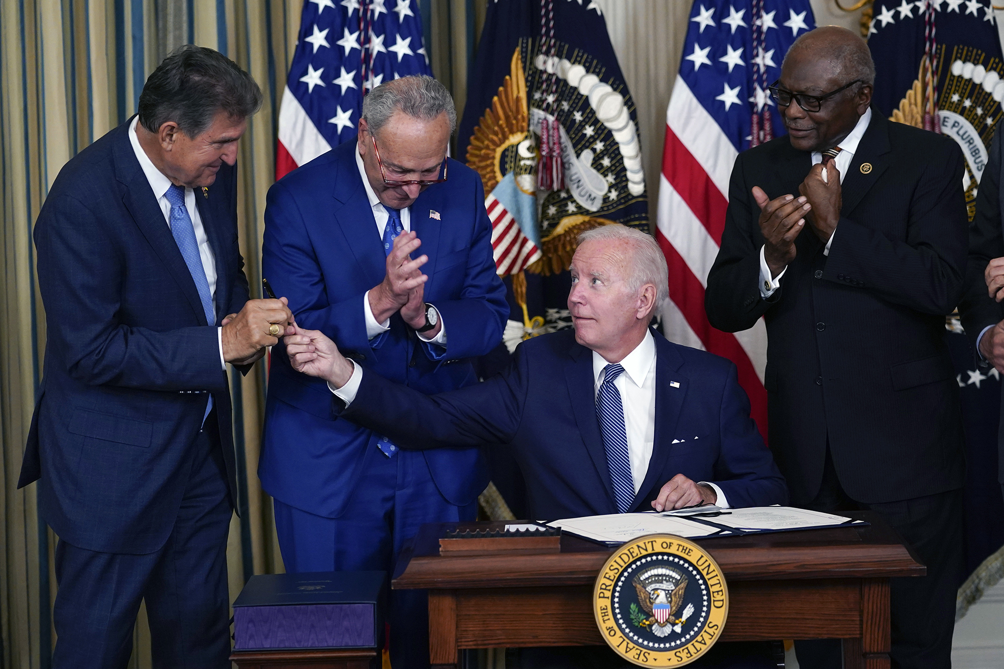
Inflation Reduction Act: Affordable Housing Impacts
No major housing investments, but several provisions impact affordable housing:
15% corporate minimum tax
Housing Credit can be taken against minimum tax
Affordable housing now compatible with energy credits
Energy and solar investment tax credits (ITC) no longer reduce Housing Credit basis
20 percent bonus investment tax credit for facilities on covered federal affordable housing programs
1 billion in HUD funding to improve energy and water efficiency in affordable housing

Slide 4
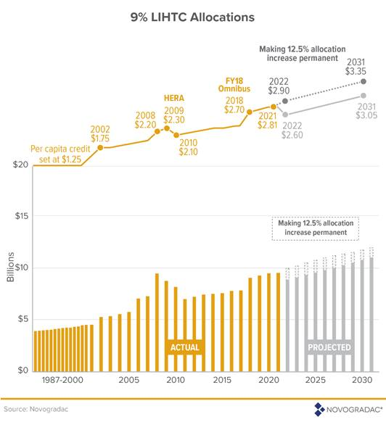
Housing Credit Legislative Priorities: Allocation Increase
Increase affordable housing production by:
Restoring the temporary 12.5 percent Housing Credit allocation that expired at the end of 2021, and
Further increasing the Housing Credit allocation

Slide 5
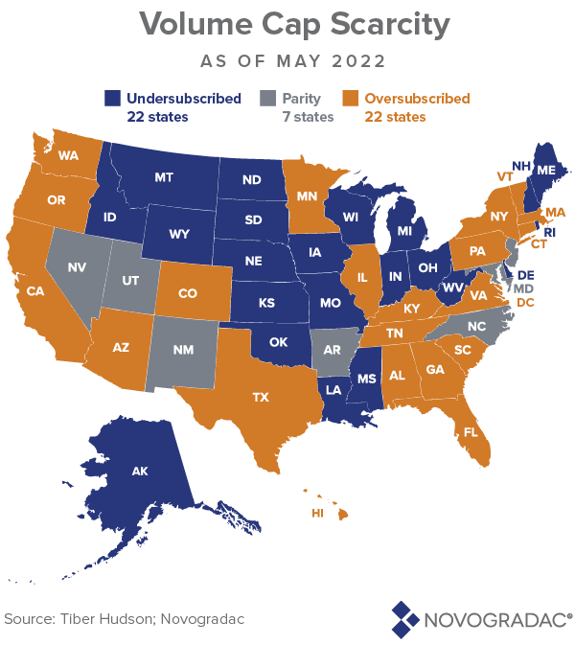
Housing Credit Legislative Priorities:
Lowering 50% test to 25%
Lowering the 50% Test to 25% for 5 years would produce 735,500
additional affordable homes
Source: Novogradac

Slide 6
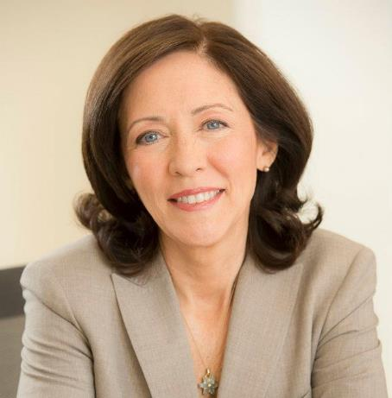
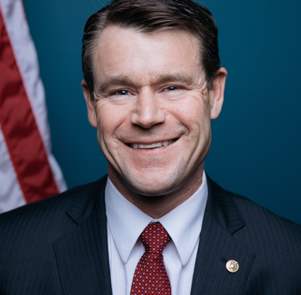
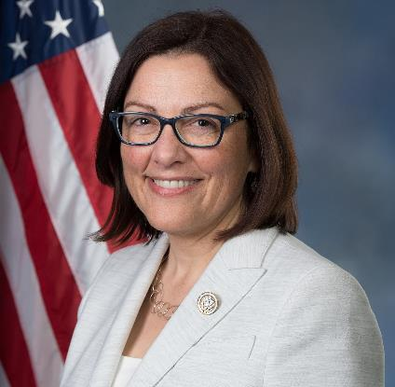
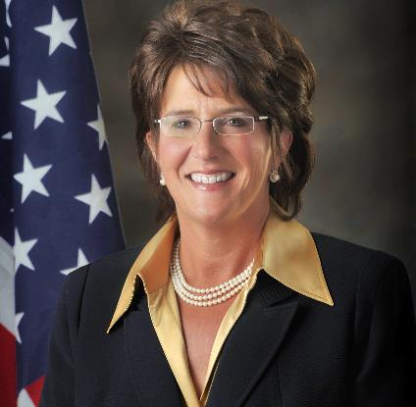
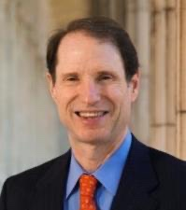
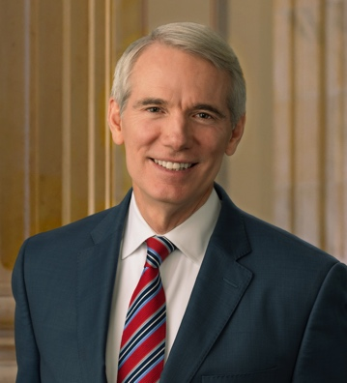
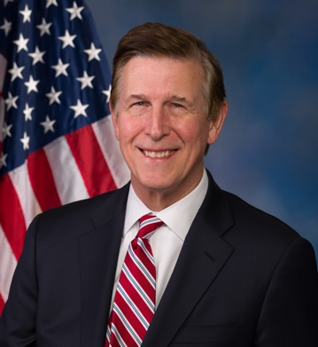
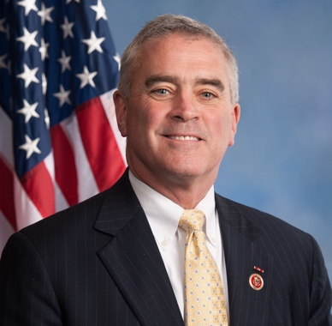
Affordable Housing Credit Improvement Act Legislation to Expand and Strengthen the Housing Credit
Sen. Maria Cantwell (D-WA)
Sen. Todd Young (R-IN)
Rep. Suzan DelBene (D-WA)
Rep. Jackie Walorski (R-IN)
Sen. Ron Wyden (D-OR)
Sen. Rob Portman (R-OH)
Rep. Don Beyer (D-VA)
Rep. Brad Wenstrup (R-OH)
S. 1136: 24 Democrats
10 Republicans
H.R. 2573: 109 Democrats + over 20 Dems in queue
61 Republicans + 3 Reps in queue

Slide 7
Affordable Housing Credit Improvement Act Support in North Carolina
Current Supporters | Past Supporters
Rep. Greg Murphy (R-NC-3) *Ways and Means | Rep. Patrick McHenry (R-NC-10) *Financial Services
Rep. Ted Budd (R-NC-13) *Financial Services | Rep. David Price (D-NC-4)
Rep. Richard Hudson (R-NC-8) | Rep. G.K. Butterfield (D-NC-1)
Rep. David Rouzer (R-NC-7) | Rep. Alma Adams (D-NC-12)
Rep. Kathy Manning (D-NC-6)

Slide 8
Affordable Housing Regulatory Issues: Treasury and the IRS
State and Local Fiscal Recovery Funds
July 27 guidance increased flexibility to use SLFRF to fully finance long-term affordable housing loans and expanded presumptively eligible affordable housing uses to maximize the availability of SLFRF funds for affordable housing
LIFELINE Act, sponsored by Reps. Alma Adams (D-NC-12) and David Rouzer (R-NC-07) in the House, no longer needed
Average Income Test Regulations
Final rule expected by 9/30 according to White House Housing Action Supply Plan
Housing Credit deadline extensions
Further extensions of placed in service and other key deadlines have been requested

Slide 9
Affordable Housing Regulatory Issues: CRA
85% of $22 billion Housing Credit market is CRA-motivated
Proposed CRA modernization rule threatens investment in affordable housing
Eliminates investment test, and combines investments and loans into one test
Prioritizes retail activities
Reduces incentive for banks to aim for outstanding rating
Comments were due August 5, regulators aiming for final rule by the end of the year
In a survey of large bank investors, 42% of respondents thought they might somewhat reduce their Housing Credit investments because of the elimination of the investment test

Slide 10
Affordable Housing Regulatory Issues: Global Minimum Tax
Secretary Yellen negotiating with nearly 140 countries to implement a 15% minimum tax on large multinational corporations
Businesses in violation would pay a “top-up tax” to other nations
Minimally 48% of Housing Credit investment at risk if Housing Credit factors into 15% global minimum tax calculation
“Equity method exclusion” could provide a solution if formalized in OECD guidance and adopted by participating nations

Slide 11
Questions?
Emily.Cadik@taxcreditcoalition.org
www.taxcreditcoalition.org
@EmilyCadik
@AHTCCoalition

