Slide 1
2023 North Carolina Housing Conference
Community Development Opportunities: Supporting Partnerships, Fostering Innovation
Raymond Irizarry, Community Affairs Officer
October 23, 2023

Slide 2
DISCLAIMER
The views expressed here are those of the presenter and do not necessarily reflect the views of the Office of the Comptroller of the Currency.​

Slide 3
Office of the Comptroller of the Currency
The Office of the Comptroller of the Currency (OCC) is an independent bureau of the U.S. Department of the Treasury. The OCC charters, regulates, and supervises all national banks, federal savings associations (FSA), and federal branches and agencies of foreign banks.
We ensure that the banks we supervise operate in a safe and sound manner, provide fair access to financial services, treat customers fairly, and comply with applicable laws and regulations.
The OCC examines financial institutions for safety and soundness, cybersecurity, anti-money laundering (AML), consumer protection, and the Community Reinvestment Act (CRA).

Slide 4
OCC OFFICE LOCATIONS
West
Midwest
South
Southeast
East
Northeast

Slide 5
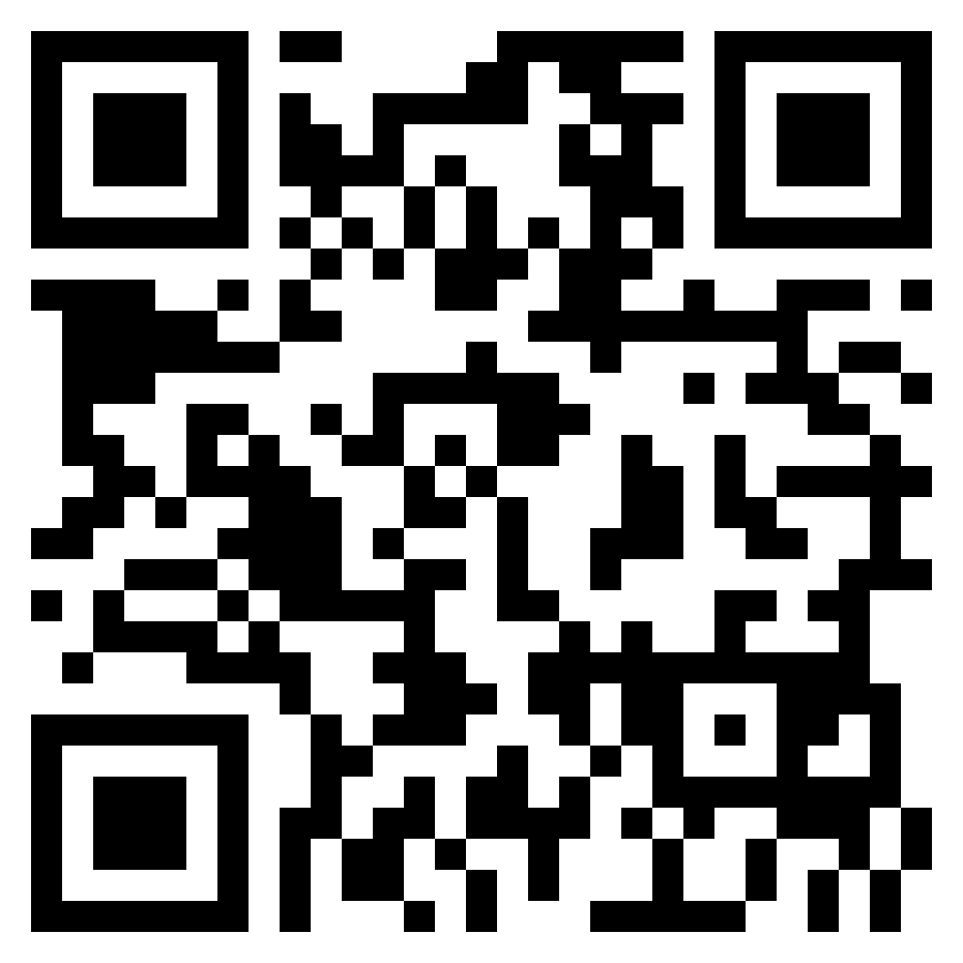
Community Affairs
Scan the QR code to access the OCC’s Community Affairs website:
Provide CRA Training and Technical Assistance
Bankers, Communities, Examiners
Conduct CRA-related Outreach
Support CRA Examinations of National Banks & FSAs
Issue Community Development Publications
Share Resource Directories

Slide 6
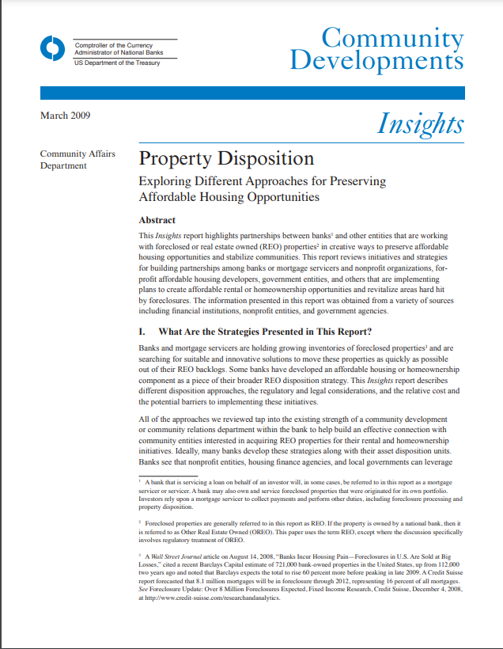
OCC Publications
Partners in Recovery: Community Reinvestment and Resilience
Property Disposition: Exploring Different Approaches for Preserving Affordable Housing Opportunities

Slide 7
OCC Publications
www.occ.gov/publications

Slide 8
OCC Project REACh
Removing Barriers to Financial Inclusion
Notes:
REACh stands for Roundtable for Economic Access and Change
Project REACh to identify and reduce barriers to full, fair participation in the nation’s banking system and the economy to help expand access to credit and capital.

Slide 9
Project REACh
Alternative Credit Assessment Utility
Affordable
Homeownership
Small Business
Opportunity
Revitalizing MDIs
These barriers include:
Nearly 50 million people in the United States have no usable credit scores, making credit less accessible and more expensive for them.
Affordable housing remains an intractable problem, but homeownership helps families build wealth.
Minority-owned banks play critical roles in their communities but face challenges accessing capital, growing technology, modernizing infrastructure, and retaining talent.
Small businesses serve as engines for the economy, but resources to support their expansion are limited.

Slide 10
Project REACh
Alternative Credit Assessment Utility
Affordable
Homeownership
Small Business
Opportunity
Revitalizing MDIs
What We Do
The Affordable Housing Workstream is seeking to:
Address challenges with closing costs, down payment, appraisals, and underwriting.
Develop a coordinated housing counseling and financial education program.
Identify ways to expand affordable single-family inventory

Slide 11
Project REACh
What We’ve Done
Launching a program to provide potentially forgivable, interest-free down payment loans to LMI home buyers with no required monthly payments.
Launching a grant program to provide LMI buyers with closing cost assistance.
Establishing an interest‑free down payment and low-closing-cost assistance pilot program to help LMI homebuyers in certain cities the Midwest.
Launching a grant program for down payments and closing costs to purchase a home in majority-Black neighborhoods. Borrowers may receive additional dollars if they complete a home buyer education course with an approved counseling agency.
Establishing a program to help borrowers with the upfront cash needed to refinance their homes to take advantage of lower interest rates.

Slide 12
Project REACh
Where We’re Going
Identifying ways to eliminate appraisal disparities.
Identifying ways to more efficiently connect borrowers who have been denied a mortgage with housing counseling agencies that could help them get on the path to future homeownership.
Evaluating how alternative data that show repayment history for rent and other recurring payments can more effectively be used in the mortgage underwriting process.
Expanding use of special purpose credit programs.
Identifying ways to expand the affordable single-family inventory including accessory dwelling units, single-family acquisition and rehabilitation financing, and repurposing of commercial properties for residential use.

Slide 13
Local REACh
Local approaches focus on developing regional solutions to reduce barriers to economic access for minority communities.
Local REACh cities:
Detroit (est.2022)
Dallas (est.2022)
Los Angeles (est.2020)
Milwaukee (est.2022)
Washington, D.C. (est.2021)

Slide 14
Contact Information
Email: raymond.irizarry@occ.treas.gov
Cell: (202) 431-8990
Web: wwwˌoccˌgov/communityaffairs
Raymond Irizarry
Community Affairs Officer
Notes:
My contact information if you have questions.

