Slide 1
Fair Housing Update: Access to Housing Opportunities & Affirmatively Furthering Fair Housing
Lauren Brasil
Co-Director / Managing Attorney
Fair Housing Project
Legal Aid of Nort Carolina
www.fairhousingnc.org
Bill Rowe
Senior Counsel
North Carolina Justice Center
www.ncjustice.org

Slide 2
The work that provided the basis for this publication was supported in part by funding under a grant with the U.S. Department of Housing and Urban Development. The substance and finding of the work are dedicated to the public. The author and publisher are solely responsible for the accuracy of the statements and interpretations contained in this publication. Such interpretations do not necessarily reflect the views of the Federal Government.
The material in this presentation is for information and educational purposes only and does not constitute legal advice.

Slide 3
Who is the audience?

Slide 4
Brief History of Fair Housing

Slide 5
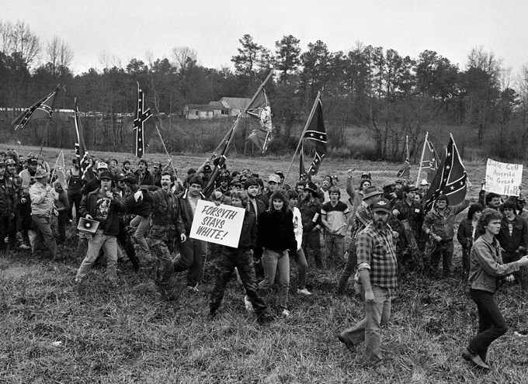
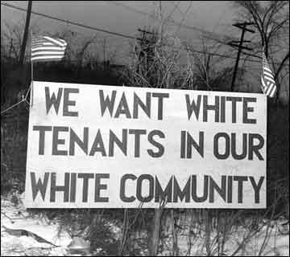
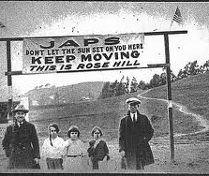
History of Discrimination: Community Intimidation & Violence

Slide 6
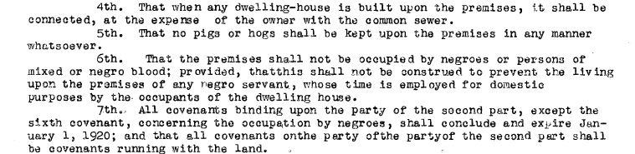
History of Discrimination: Restrictive Covenants
…That the premises shall not be occupied by negros or persons of mixed or negro blood; provided, that this shall not be construed to prevent the living upon the premises of any negro servant, whose time is employed for domestic purposes by the occupants of the dwelling house…
- Deed from Greater Raleigh Land Company, 1909

Slide 7
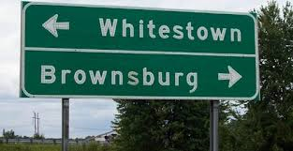
History of Discrimination: Racial Steering
Until 1950, National Association of Real Estate Boards’ Code of Ethics required members to promote segregation.

Slide 8
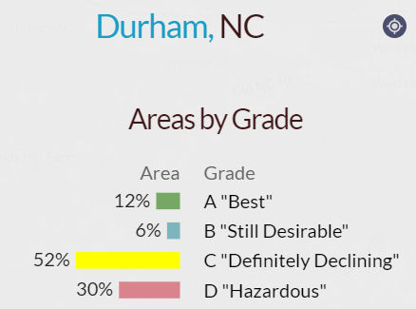
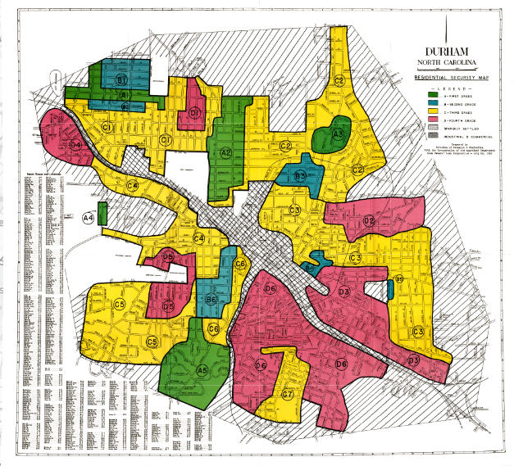
History of Discrimination: Redlining
https://dsl.richmond.edu/panorama/redlining/#loc=13/36/-78.943&city=durham-nc

Slide 9
“It is the policy of the United States to provide, within constitutional limitations, for fair housing throughout the United States.”
42 U.S.C. § 3601 (the Fair Housing Act)

Slide 10
Basics of Fair Housing Law

Slide 11
Types of Property Covered
The FHA broadly applies to “dwellings,” which includes almost every residential unit available for sale or rental
Single and multi-family housing
houses, apartments & condos
Group homes
Shelters
Migrant housing
Assisted living housing
Long-term transient lodging
Vacant land

Slide 12
Markets Covered
Rental
Sales
Lending
Insurance
Municipal Services
Zoning
All Areas Connected With Residential Housing
Subsidized AND Private Housing

Slide 13
What conduct is Prohibited?
Refusing to sell, rent, or negotiate for housing
Discriminating in the terms, conditions, or privileges of sale or rental of a dwelling, or in the provision of services or facilities
Misrepresenting availability
Statements indicating preference or limitation
Coerce, intimidate, threaten, or interfere with a person’s right to fair housing
Harassment
“Otherwise make unavailable or deny” housing

Slide 14
Protected Classes
The FHA prohibits discrimination based on:
Race
Color
National origin
Religion
Sex (includes sexual orientation & gender identity)
Familial status (families with kids)
Handicap (disability)
Affordable housing (NC)

Slide 15
Affordable Housing as a Protected Class

Slide 16
Affordable Housing as a Protected Class for Land-Use Decisions (NCFHA)
NCGS§ 41A-4(g): ʺIt is an unlawful discriminatory housing practice to discriminate in land-use decisions or in the permitting of development based on…the fact that a development or proposed development contains affordable housing units for families or individuals with incomes below eighty percent (80%) of area median income.”

Slide 17
Affordable Housing as a Protected Class (NCFHA): What It Means
“It is not a violation of this Chapter if land-use decisions or permitting of development is based on considerations of limiting high concentrations of affordable housing.”
Allows land-use planners to limit “high concentrations” of affordable housing.
No definition of “high concentrations.”
HUD data for Fair Housing Assessments in 2015 AFFH Rule included numbers on racially concentrated areas of poverty

Slide 18
Affordable Housing as a Protected Class (NCFHA): In Practice
Pinehurst (2014) and Clemmons (2019) cases

Slide 19
Discriminatory Effects Standard
In 2023, HUD issued a Final Rule Restoring HUD’s 2013 Discriminatory Effects Standard

Slide 20
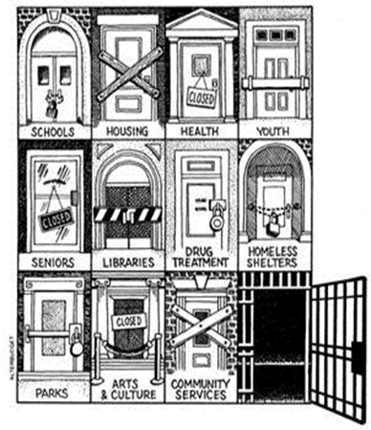
HUD Guidance on Criminal Background Screening (June 2022) (April 2022) (April 2016)
HUD Office of General Counsel, Guidance on Application of Fair Housing Act Standards to the Use of Criminal Records by Providers of Housing and Real Estate-Related Transactions (April 4, 2016)
HUD Memo, Implementation of the Office of General Counsel’s Guidance on Application of Fair Housing Act Standards to the Use of Criminal Records by Providers of Housing and Real Estate-Related Transaction (June 10, 2022) HUD Memo, Eliminating Barriers That May Unnecessarily Prevent Individuals with Criminal Histories from Participating in HUD Programs (April 12, 2022)

Slide 21
HUD Guidance: Exclusion Based on Conviction
Blanket prohibition based on conviction not permissible
Tailored policy that excludes people with certain types of convictions may be permissible if it considers:
Nature of offense
Severity of offense
Amount of time that has passed since conduct

Slide 22
NCHFA Model Policy Low Income Housing Tax Credit Properties
Automatic Exclusion v. Individualized Assessment v. No Exclusion
Based on type of conviction
Period begins at date of conviction
Violent misdemeanor & violent felony convictions have automatic exclusion periods of 2 and 5 years; violent convictions may be considered indefinitely w/ an individualized assessment.
An arrest (w/o conviction) & expunged conviction will not be considered. Pending charge may be the basis of denial upon completion of an individualized assessment.
Type of Conviction | Automatic Exclusion Period | Individualized Assessment Period | No Exclusion
Nonviolent Misdemeanor (Classes 1-3) | NOT APPLICABLE | 0 - 5 years | > 5 years
Nonviolent Felony (Classes H-I) | NOT APPLICABLE | 0 - 7 years | > 7 years
Violent Misdemeanor (Class A1 & sex offenses) | 0 - 2 years | > 2 years | NOT APPLICABLE
Violent Felony (Classes A-G & sex offenses) | 0 - 5 years | > 5 years | NOT APPLICABLE
Felony Involving Sale or Manufacture of a Controlled Substance | 0 - 5 years | 5 – 10 years | > 10 years

Slide 23
Individualized Assessment
Screening based on an individualized assessment is a less discriminatory alternative to overly broad exclusion policies
Private landlords should allow for an individualized assessment.
Required for Low Income Housing Tax Credit housing properties, as well as subsidized housing
The apartment could consider the individual circumstances, such as:
the length of time since the offense
age at the time of the offense
the seriousness of the criminal offense
whether the offense affects the safety and security of residents, staff or property
evidence of rehabilitation, such as having a job or participating in a job training program, education, participation in a drug or alcohol treatment program

Slide 24
Reasonable Accommodations
Protections for People with Disabilities

Slide 25
Reasonable Accommodations
Definition
A change in rules, policies or procedures
Necessary because of the person’s disability
Provides full/equal use and enjoyment of housing
Can request at any time
Before tenancy/when applying
During tenancy
When facing eviction, if RA could remove basis for eviction
Can be requested by
Tenant, family member,
MD, social worker, therapist, or
Others
Notes:
25

Slide 26
Interactive Process

Slide 27
What Can housing Provider Request When Evaluating RA/RM Request?
Proof of disability
But only if disability is not obvious or otherwise known
Not entitled to medical history or even diagnosis
Information of how RA/RM will help w/ this disability (the “nexus”)
But only if not readily apparent or known

Slide 28
When Can an RA Request be Denied?
The request is not reasonable because:
the request would require a “fundamental alteration” in the nature of the services, program or activity, or
the request creates an undue financial and administrative burden

Slide 29
Reasonable Accommodation Requests in Rental Applications
Credit History
Rental History
Criminal Background

Slide 30
Reasonable Accommodations Requests in Evictions
Individualized Inquiry

Slide 31
Exceptions
Direct Threat. FHA does not require a tenancy that would be a “direct threat” to the health or safety of others or result in substantial damage to the property of others unless a Reasonable Accommodation could eliminate the threat
Determination must be based on an individualized assessment
Unlawful to exclude people b/c of fear, speculation or stereotypes
Drug use. Current use of illegal drugs is excluded from the definition of disability.

Slide 32
Affirmatively Furthering Fair Housing

Slide 33
AFFH: HUD’s Obligations
Administer programs “in a manner affirmatively to further the policies” of the FHA.
42 U.S.C. §3608(e)(5)
Do “more than simply refrain from discriminating;” must also “assist in ending discrimination & segregation”
NAACP v. Sec. of HUD, 817 F.2d 149 (1st Cir. 1987)
AFFH includes “a mandate to take actions that undo historic patterns of segregation and other types of discrimination and that afford access to long-denied opportunities.”
President’s 1/26/21 Memorandum.
Notes:
33

Slide 34
Affirmatively Furthering Fair Housing: Grantee Obligations
CDBG grants “shall be made only if the grantee certifies” that
“the grant will be conducted and administered in conformity with” the FHA
“the grantee will affirmatively further fair housing.”
42 U.S.C. §5304(b)(2)
Applies to PHAs
Applies to local gov’t as subgrantees/subrecipients
Also applies to HOME, ESG, HOPWA, NSP funds
Notes:
34

Slide 35
AFFH Interim Final Rule 2021
On June 10, 2021, HUD published an interim final rule (AFFH IFR) “Restoring Affirmatively Furthering Fair Housing Definitions and Certifications,” as part of HUD’s AFFH requirement.
AFFH IFR restores certain definitions and certifications from the 2015 AFFH Rule.
HUD grantees are therefore again regularly certifying compliance to a standard that requires them to take meaningful action to combat residential segregation and eliminate unequal access to housing-related opportunities.
Notes:
35

Slide 36
AFFH: 2023 Proposed Final AFFH Rule in the works…
On February 9, 2023, HUD published a Notice of Proposed Rulemaking entitled “Affirmatively Furthering Fair Housing.”
The proposed 2023 AFFH Final rule builds on the 2015 AFFH Rule and refines it by simplifying analyses, incorporating more robust public input, implementing evaluation and accountability measures, and linking fair housing planning to other planning processes.
Notes:
36

Slide 37
2023 Proposed Final AFFH Rule
Affirmatively furthering fair housing means taking meaningful actions, in addition to combating discrimination, that overcome patterns of segregation, eliminate inequities in housing and related community assets, and foster inclusive communities free from barriers that restrict access to opportunity based on protected characteristics.

Slide 38
AFFH & Looking at Opportunities

Slide 39
Questions?
Website: fairhousingnc.org
Refer clients: 1-855-797-FAIR (3247)

