Slide 1
Accessory Dwelling Units
City of Wilmington, NC
2023 Neighborhood Works Conference
October 23 & 24
Suzanne E. Rogers, Community Development & Housing Planner

Slide 2
Changes to Land Development Code
The City of Wilmington updated the Land Development Code (LDC) in December 2021 and as part of that re-write, the city expanded our Accessory Dwelling Units (ADU) code section to be more equitable:
Allowing internal and attached ADUs on properties that do not meet the minimum lot size.
Allowing detached ADUs on lots that meet the minimum lot size.
  This is a change from the previous code where detached ADUs were required to exceed the minimum by at least 50% or 5,000 sq. Ft. (whichever is less)

Slide 3
Changes to Land Development Code
The city removed the requirement for property owners to provide two additional off-street parking spaces for ADUs.
  This created an unnecessary burden on property owners, specifically those who own property downtown and do not have a driveway or any off-street parking.
Allowing internal units to not exceed 50% of the gross floor area of the principal dwelling unit and allowed attached.
  This again was to try and address the inequities of the previous code which only allowed attached ADUs.

Slide 4
Changes to Land Development Code
Allowing detached units to be 50% of the gross floor area of the principal structure or 1,200 sq. Ft., whichever is less.
  Previously, detached ADUs over garages to be 35% of the gross floor area or 800 sq. Ft., whichever is less.

Slide 5
City of Wilmington LDC Section 18-200
Minimum Setbacks for detached ADUs
Front | Shall not be in front of principal building
Side Street | Shall not be closer to a side street than the principal building
Side Interior | 5 feet
Rear | 5 feet

Slide 6
City of Wilmington LDC Section 18-200
Permitted
ADUs shall only be allowed when constructed as an accessory to a principal single dwelling.
Only one ADU shall be permitted on any lot. For detached ADUs, the lot must meet the minimum required lot area for the zoning district.
B. Creation
  ADUs may be created through new construction, the conversion of an existing building or structure, or as an addition to an existing building or structure.

Slide 7
City of Wilmington LDC Section 18-200
C. Types of ADUs
1. Internal units are created when a portion of a detached single dwelling is partitioned off to become a separate dwelling unit. It is fully within and under the same roof as the principal dwelling unit, though it has an external entrance into the unit.
dwelling unit types
2. Detached units stand alone from the principal dwelling unit and include detached garage apartments, backyard cottages, and outbuildings.
3. Attached units are connected to the principal dwelling unit, either by both a roof and at least one wall or by a breezeway or other similar architectural feature (see Figure 18-200: Accessory dwelling unit types).

Slide 8
City of Wilmington LDC Section 18-200
D. Development standards
1. Maximum dwelling unit size (gross floor area) shall be:
  a. Internal: 50 percent of the gross floor area of the principal dwelling unit; and
  b. Attached or detached: 50 percent of the gross floor area of the principal structure or 1,200 square feet, whichever is less.
2. Internal ADUs shall meet the following standards:
  a. The ADU may have an exterior entrance but shall otherwise be fully internal to the principal dwelling unit and shall meet all building height and setback regulations for the principal dwelling unit.
  b. The ADU shall meet all applicable codes for the level of occupancy.
3. ADUs that are fully attached to the primary building by both a roof and at least one wall shall comply with specific setback standards for principal buildings within that zoning district.
4. ADUs shall comply with the setbacks outlined in Table 18-199.

Slide 9
Land Development Code Zoning Districts
ADU’s permitted w/conditions in:
Zoning District | Description
R-20 | Legacy district min 20,000 sq ft single-dwelling home
R-15 | Minimum 15,000 sq ft. single-dwelling home
R-10 | Minimum 10,000 sq ft. single-dwelling home
R-7 | Minimum 7,000 sq. ft. single-dwelling home
R-5 | Minimum 5,000 sq. ft. single-dwelling home
R-3 | Minimum 0 sq. ft. Must meet other requirements/setbacks
MD-10* | Multiple Dwelling Residential 10 units/acre
MD-17* | Multiple Dwelling Residential 17 units/acre
* ADUs not allowed if Multiple Dwelling Residential present.

Slide 10
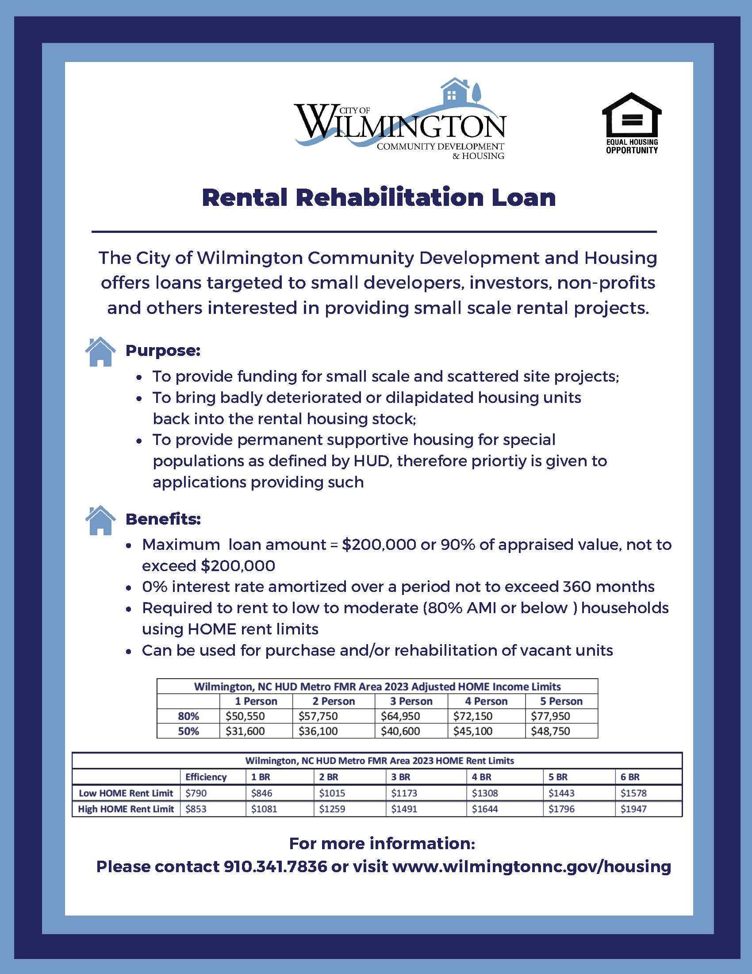
Financing ADUs
Using an existing loan program RRIL for ADUs
Maximum loan $200,000 @ 0%
For Rental Properties, can be used for new construction
Finance homeowner for ADU as a second mortgage on primary residence
Must rent to LMI at High HOME Rents for 20-year affordability period.
Annual Monitoring to ensure compliance

Slide 11
Financing ADUs
UNDERWRITING:
Property Requirements – not in 100-year flood zone; ERR
Loan Terms – 20 years; amortize up to 360 months; LTV 90%
Loan Agreement – 10% per annum penalty if transfer property during affordability period; Annual inspections, reporting including lease agreement and tenant eligibility; HOME High Rents
Developer Capacity & Fiscal Soundness – prior experience or consultant; references; adequate net worth & credit score minimum 680.
Tenant Selection: Tenant Selection Plan approved by City; Lease approved by City
Development Budget: Reasonable and Comparable to similar projects
Operating Proforma: Replacement Reserve @ $500/annually, Realistic Operating Cost included; Debt Service Coverage Ratio 115%.
Plan Specifications: energy efficiency, accessibility, utilities, zoning, design, quality materials, etc.

Slide 12
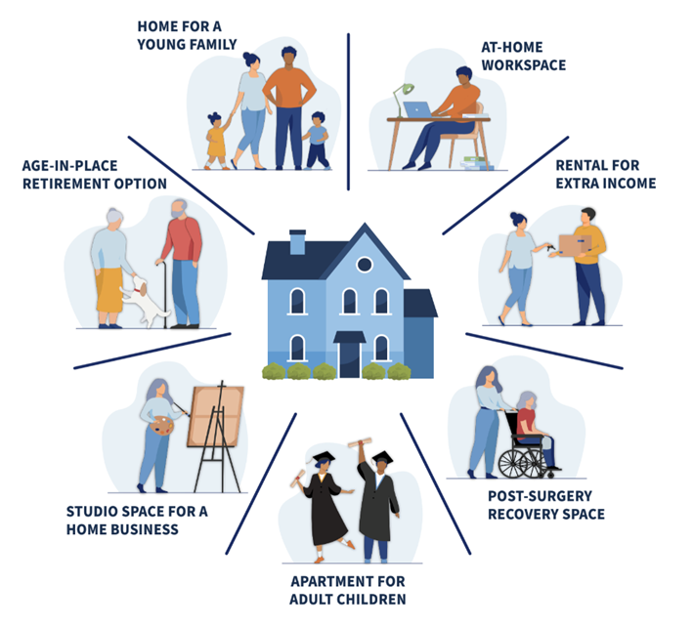
Partners
Provide Technical Assistance to Homeowners:
Determine if ADU possible on site
Assist w/Design process
Submit Project to City Planning Dept
Assist w/Permits
Assist w/Loan Applications Finance Project
Assist w/Contractor Selection
Monitor Construction Process to CO

Slide 13
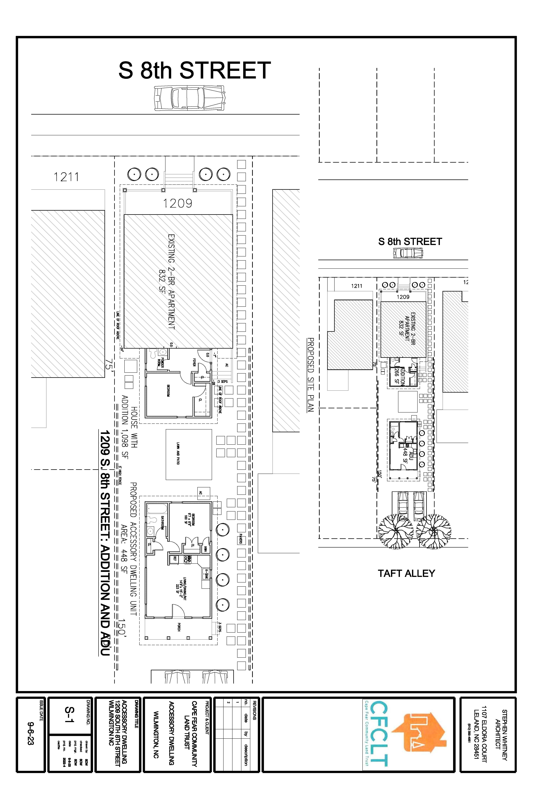
Partners
Cape Fear Community Land Trust

