Slide 1
CRA: Its History and Modernization

Slide 2
The views and opinions expressed herein are those of the authors. They do not represent an official position of the Federal Reserve Bank of Richmond or the Federal Reserve System.

Slide 3
The following slides are based on an article featured on Fed Communities written by Ben Horowitz.

Slide 4
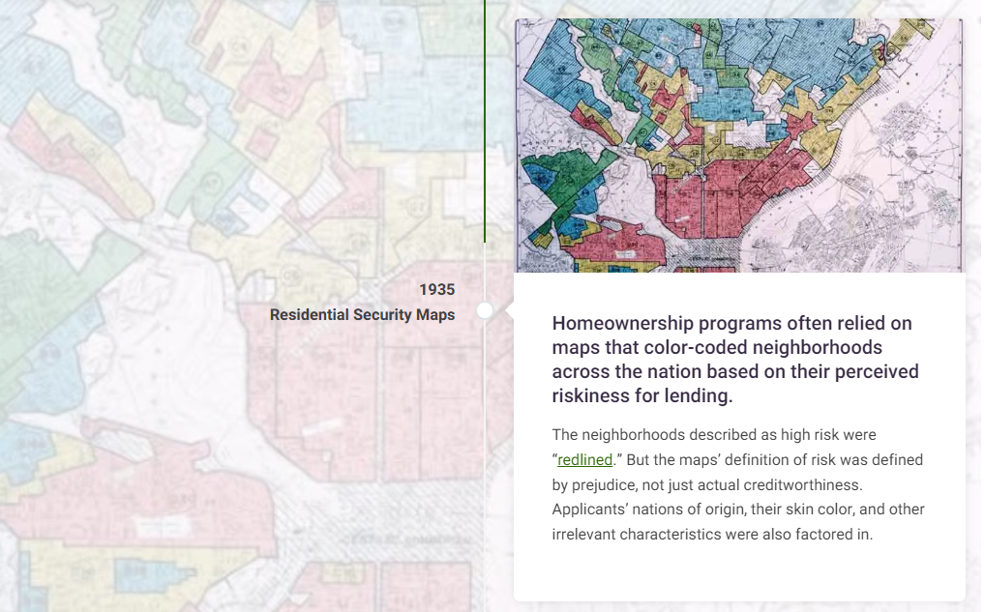
Notes:
A government-sponsored corporation and federal housing agencies are formed to support homeownership…for white people.
For most of the 20th century, federal initiatives subsidizing homeownership excluded Native American households and households of color. From 1934 to 1962, for example, 98 percent of federally backed home loans from one program went to white homeowners.
Redlining caused more enduring harm than limiting people’s opportunities to buy a house or finance a business.
Federal Reserve researchers have credibly linked redlining to long-term impacts. Redlined neighborhoods are more likely to negatively influence their residents on labor market outcomes, incarceration, and credit scores. People living in these neighborhoods are also less likely to own a home and more likely to experience racial segregation. Redlining’s legacy is even correlated with higher COVID-19 infection rates.

Slide 9
Notes:
…and the CRA is redefined.
Changes in the 1980s also introduced the rating scale used in today’s CRA exams. Further, banks were now required to make available to the public the results of their CRA evaluations.
In the 1990’s, the CRA is updated to reflect trends in the public and financial sectors.
New legislation passed in the 1990s aimed to incorporate public and industry feedback about the CRA evaluations’ consistency and relevancy.
Notably, these reforms raised the stakes for CRA exams, tying a bank’s ability to expand its holdings, primarily through acquiring other financial institutions, to its previous CRA performance.
Regulators update guidelines.
The Fed, OCC, and FDIC devised new guidelines that responded to consumers’ concerns and changes in the banking industry since the CRA’s passage into law in 1977. For example, revamped examination processes would better differentiate between banks of different sizes. The new processes also clarified the expectations for banks’ community development work and addressed concerns about the cost of compliance.

Slide 12
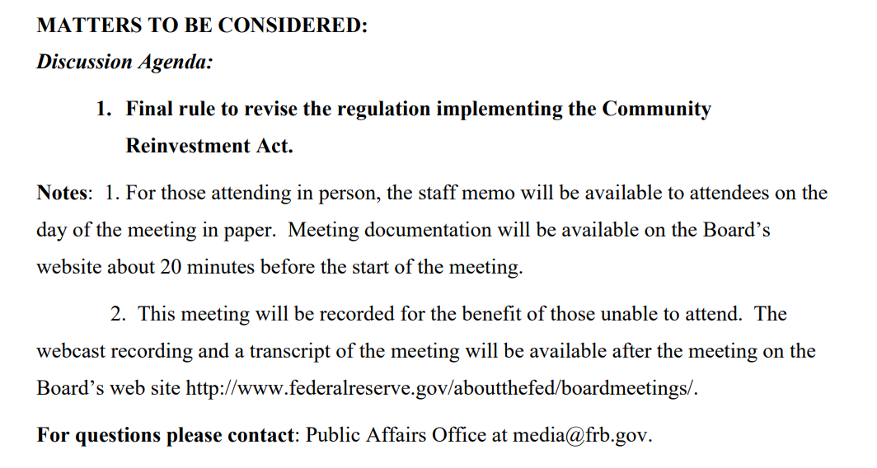
Tuesday, October 24

Slide 13
Housing: A Snapshot

Slide 14
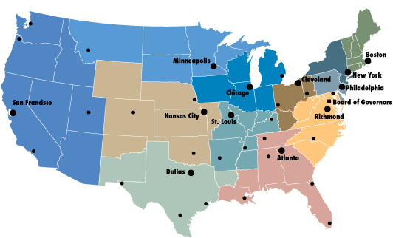
District Map
Map: FRBRSL

Slide 15
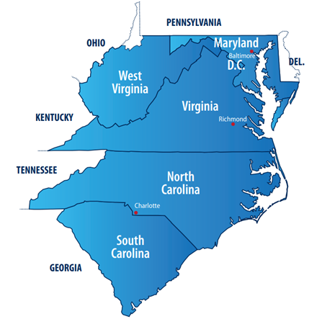
Who are we?
The Fifth District
Includes
Maryland
North Carolina
South Carolina
Virginia
Washington D.C.
(most of) West Virginia

Slide 16
Rural Housing at the Richmond Fed
Understanding rural housing conditions, challenges, and opportunities is a focal part of our Small Town and Rural Initiative. We build our knowledge through community engagement and original research.
Through our work we:
Analyze market conditions and resident outcomes related to housing
Create space for conversation and collaboration among community leaders and professionals working to address rural housing needs
Showcase innovative housing policy solutions
Explore how housing fits into the larger network of infrastructure and community resources

Slide 17
Housing the Workforce in the Rural Fifth District
Typically, the terms "affordable housing" and "workforce housing" are used to refer to housing that is affordable to low- and middle-income households, respectively. This article and presentation uses the term "low- to middle-income housing" to refer to both — that is, all housing affordable to low- to middle-income households earning up to 120 percent of the area median income (AMI).
Article and Research by Sierra Latham

Slide 18
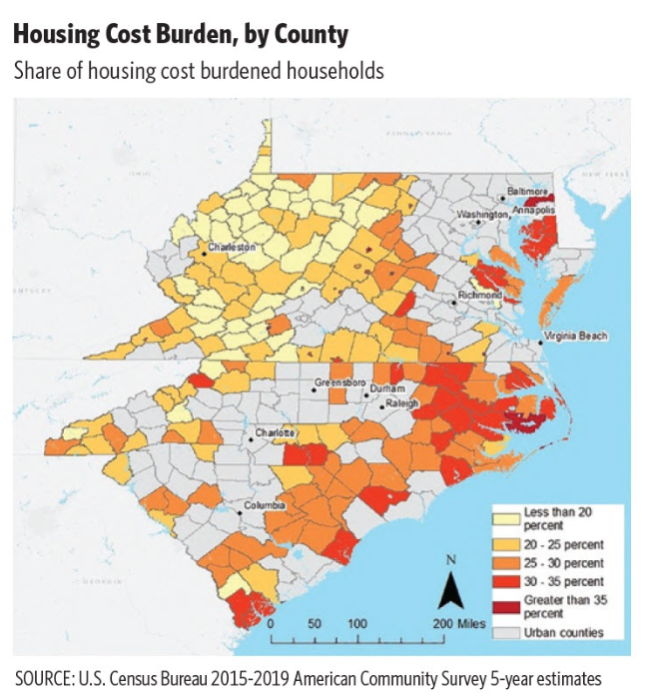
When housing practitioners think about the affordability of housing expense, they consider households to be "cost burdened" if rent or ownership costs account for more than 30 percent of gross income.
In the Fifth District, 25 percent of rural households at all income levels are housing cost burdened, versus 28 percent of urban households.
Housing cost burden is often thought of in urban contexts where property values and rent costs are relatively high. In rural areas, lower incomes are often the driving forces behind housing cost burden levels.
https://www.richmondfed.org/publications/research/econ_focus/2022/q1_district_digest
Notes:
Focusing on low- to middle-income households, about 38 percent of Fifth District rural households earning 120 percent AMI or less are housing cost burdened. For rural households earning less than 60 percent AMI, the share that are housing cost burdened jumps to more than half.
Nationally, in rural areas, the share of renters who are housing cost burdened has consistently been greater than the share of owners who are. This trend holds true for the Fifth District, where 45 percent of rural renters are cost burdened versus 25 percent of homeowners with a mortgage.

Slide 19
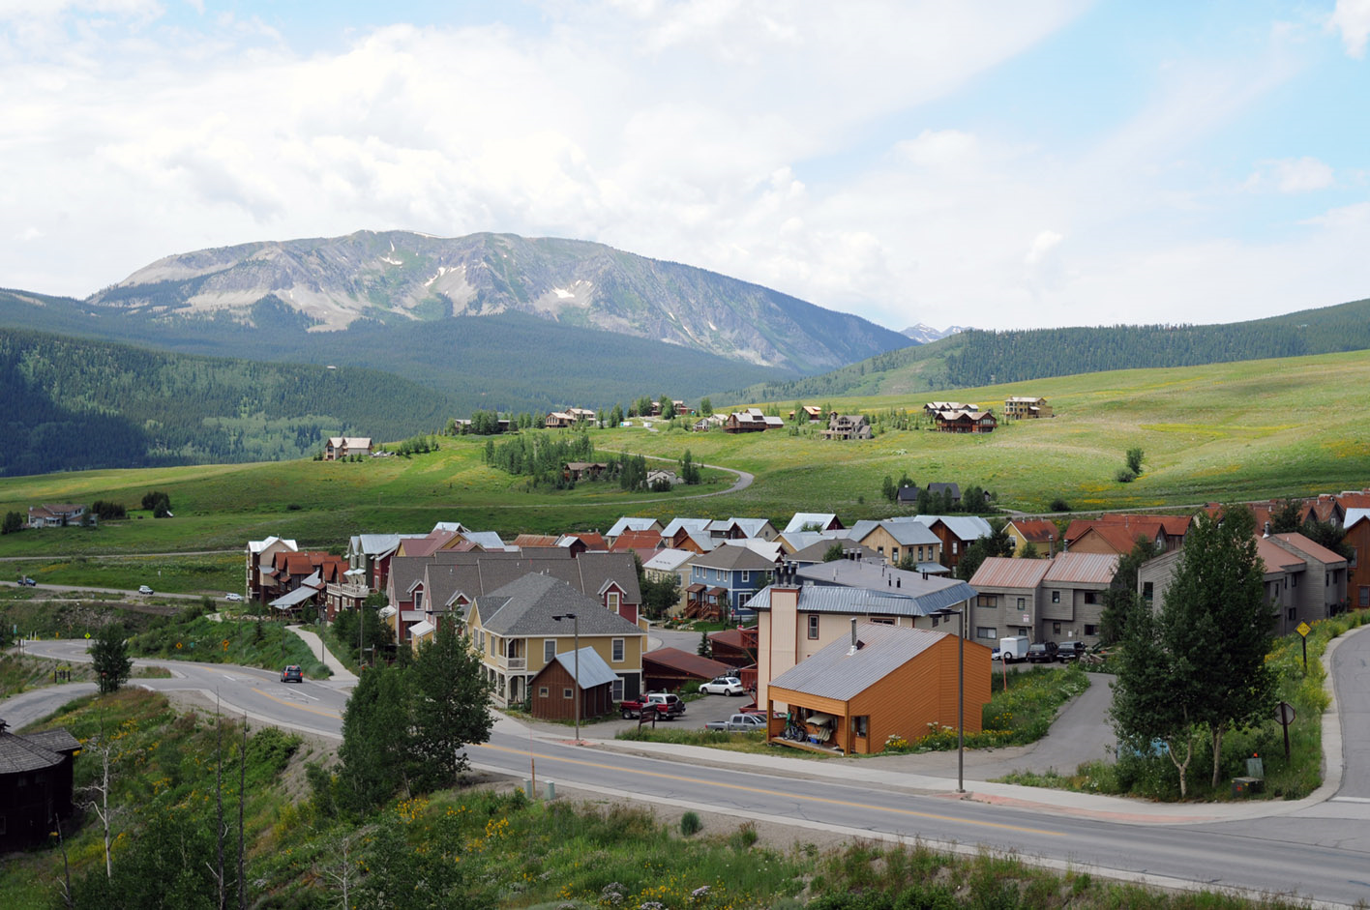
In the Fifth District, 48 percent of units in rural areas were constructed prior to 1980 versus 44 percent in urban areas. In particular, Virginia and West Virginia have a larger share of housing units constructed prior to 1950 in rural areas compared to urban areas.
In rural parts of the Fifth District, single-family and manufactured homes account for most of the housing stock (71 and 17 percent, respectively).
Apartments account for only 12 percent of rural housing stock (versus 25 percent in urban areas), in part because it is more difficult to finance and construct multifamily properties in less dense communities.
Notes:
The housing stock in rural areas tends to be older than in urban areas. In the Fifth District, 48 percent of units in rural areas were constructed prior to 1980 versus 44 percent in urban areas. In particular, Virginia and West Virginia have a larger share of housing units constructed prior to 1950 in rural areas compared to urban areas.
Single-family and manufactured homes make up a larger share of the rural housing stock nationwide, while apartment buildings represent a greater share of units in urban areas. In rural parts of the Fifth District, single-family and manufactured homes account for most of the housing stock (71 and 17 percent, respectively).
Apartments account for only 12 percent of rural housing stock (versus 25 percent in urban areas), in part because it is more difficult to finance and construct multifamily properties in less dense communities. Because apartment units make up such a small share of rural housing, rural renters are more likely to rent a single-family or mobile home than renters in urban areas.

Slide 21
​ richmondfed.org/email_subscriptions​
Subscribe to the
Richmond Fed

Slide 22
Twitter: @RichmondFed
Instagram: @RichmondFed
LinkedIn: /company/federal-reserve-bank-of-richmond
Facebook: @FederalReserveBankOfRichmond

Slide 23
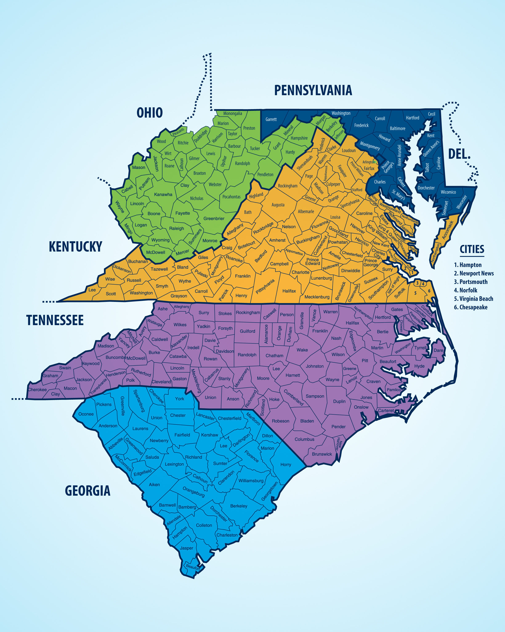
We Want to Hear From You!
Sign up to be a Survey Panelist!
Your participation will:
Inform monetary policy-making
Give you the opportunity to be heard
Require about 7 minutes each month
Enable you access to economic information and our Fed economists/policymakers
Data are confidential and personal information and responses will never be shared
To sign-up, you can:
Email our Survey Director, Jason Kosakow at Jason.kosakow@rich.frb.org
Sign up on your own: bit.ly/SurvBizForm

Slide 24
Sources
Federal Register: https://public-inspection.federalregister.gov/2023-22992.pdf
Horowitz, Ben: https://fedcommunities.org/four-decades-how-why-cra-keeps-evolving/
Latham, Sierra: https://www.richmondfed.org/publications/research/econ_focus/2022/q1_district_digest

Slide 25
Erika Bell, Federal Reserve Bank of Richmond erika.bell@rich.frb.org

