Slide 1
CITY of CHARLOTTE
&
DREAMKEY PARTNERS
LEVERAGING AGENCY HOME BUYER PRODUCTS WITH MUNICIPALITIES
HOUSE CHARLOTE DOWN PAYMENT ASSISTANCE PROGRAM OVERVIEW
October 2023
Notes:
COVER OPTION 2

Slide 2
DreamKey Partners, formerly Charlotte Mecklenburg Housing Partnership, administers the House Charlotte Program for the City of Charlotte and has been doing so since January 2011. The City of Charlotte sets the guidelines for the program and provides the funding, and we complete the processing and underwriting for the program.
Notes:
COVER OPTION 2

Slide 3
The official House Charlotte website address is…
www.dreamkeypartners.org/house-charlotte-program/
Website contains a wealth of information pertaining to program eligibility, loan approval guidelines, property eligibility look up, required documentation, approved Lenders, Post-closing services, and so much more!
Notes:
COVER OPTION 2

Slide 4
HOUSE CHARLOTTE PROGRAM
The House Charlotte program provides deferred and forgivable loans to qualified applicants who purchase in the City of Charlotte.
Loans may be used for:
Down payment
Points/Interest rate buy down
Closing costs
Notes:
COVER OPTION 2

Slide 5
WHAT ARE THE TERMS OF THE HOUSE CHARLOTTE LOAN?
The House Charlotte loan is a 15 or 30-year deferred loan with a 0% interest rate.
The loan must be paid back if any of the following occurs: death of the borrower, default, change in occupancy status, refinance for cash out, or sale of the home.
To check property eligibility, you must use the mapping application on our website.
Notes:
COVER OPTION 2

Slide 6
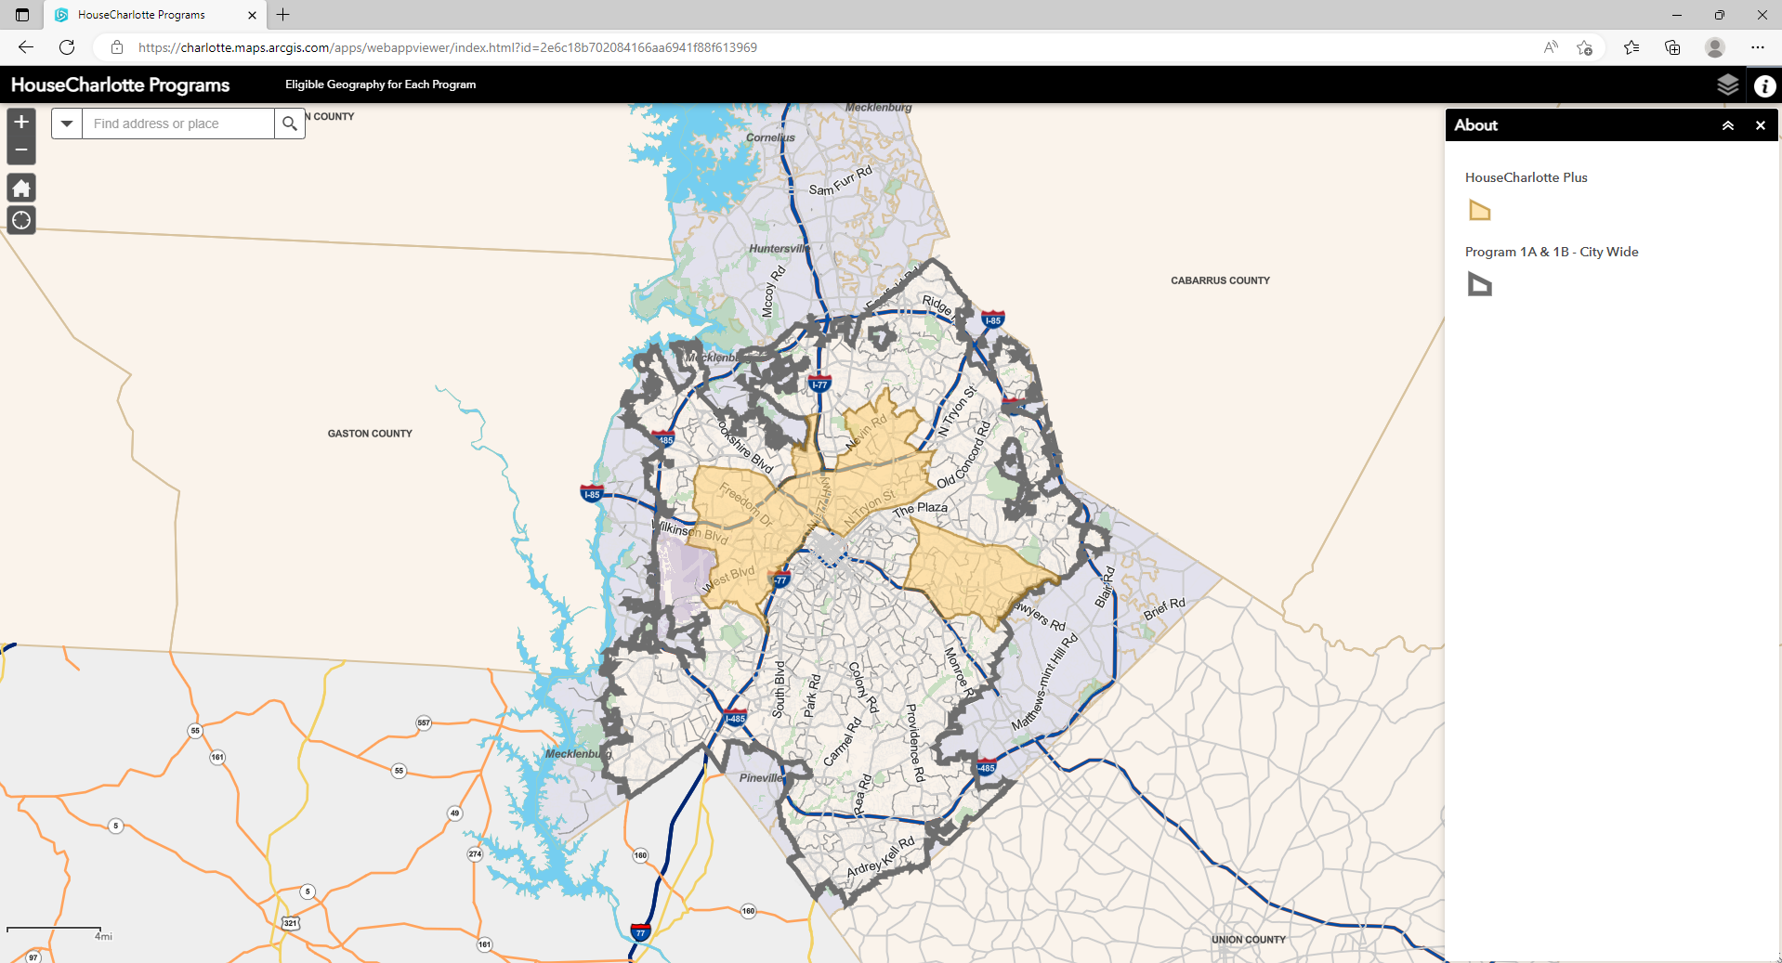
HOUSE CHARLOTTE MAPPING APPLICATION

Slide 7
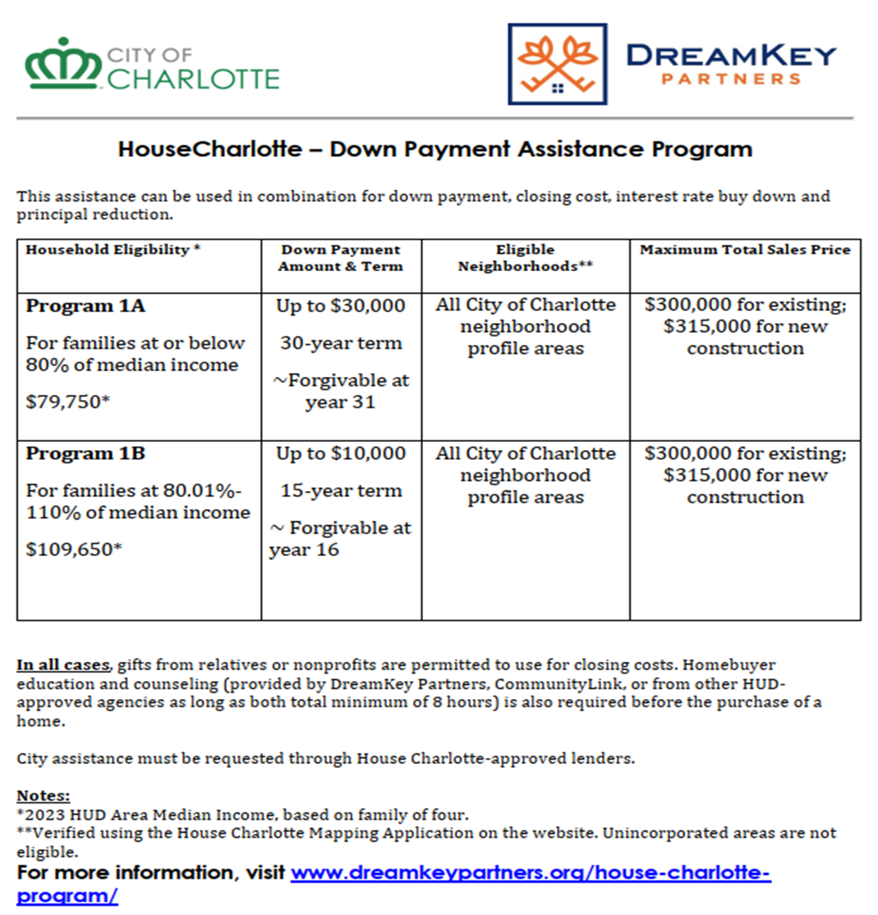
*Please note the income figures listed here are based on a household size of 4 (four) as an example. You must refer to the income chart to determine your customer’s program eligibility.

Slide 8
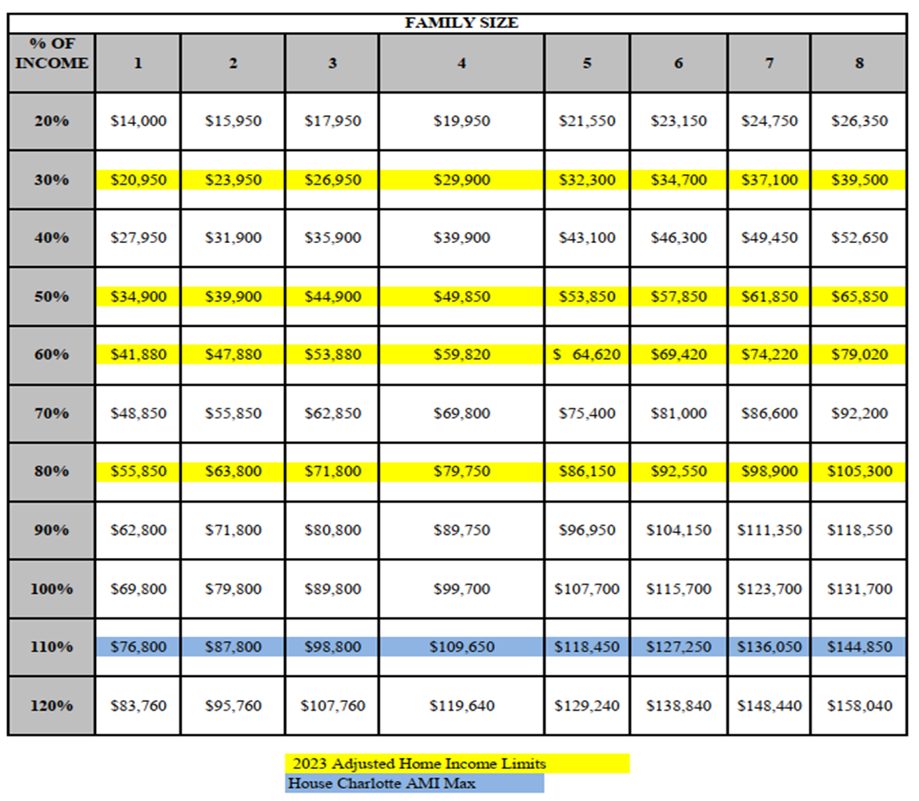
Housing & Neighborhood Services
2023 Area Median Family Income Charlotte, NC
HouseCharlotte Program
AMI Matrix – Effective June 15, 2022
Maximum household income

Slide 9
House Charlotte Program Guidelines
The House Charlotte Program is based on total household gross income and family size.
Customers don’t have to be FTHB but cannot have ownership interest in any other real estate or land (this includes timeshares).
Qualifying ratios are 33/45 (max 40%/49.9% with good compensating factors).
No minimum credit score requirement.
Max CLTV 105%.
Must be purchasing within City of Charlotte limits.
Max Sales price; $300K for existing, $315K New Construction.
Allowable first mortgage products include 15-30yr fixed rate FHA, Conv., VA & USDA
No ARMs & No 203K Rehab (or any other type of rehab loan).
Existing properties must pass a House Charlotte Code Inspection (2 options)
As-Is properties are not allowed.
Everyone on the loan must attend a minimum of 8hrs of combined HBEC and 1-on-1 Counseling.
Online HBEC accepted from Framework or EHome America only.
Must use an approved House Charlotte lender as lender applies on customer’s behalf.
Mandatory House Charlotte Lender Training for MLOs.
Notes:
COVER OPTION 2

Slide 10
PAIRING HOUSE CHARLOTTE WITH NCHFA PRODUCTS
Scenario #1: House Charlotte $30K & CPLP $50K
Scenario #2: NCHFA $15K & House Charlotte $10K
Please note: MCC will be considered as a 4th compensating factor in cases where House Charlotte DTI ratios are exceeded.
Notes:
COVER OPTION 2

Slide 11
PLEASE CONTACT US IF YOU NEED ASSISTANCE
House Charlotte Hotline (704)705-3999
HC Team Email: HouseCharlotte@dkp.org
Website: www.dreamkeypartners.org/house-charlotte-program/
DreamKey Partners
Attn: House Charlotte
4601 Charlotte Park Drive, Suite 350
Charlotte, NC 28217
Post Closing Services:
Ronald Mason , House Charlotte Program Manager, City of Charlotte Housing & Neighborhood Services.
Ronald.Mason@charlottenc.gov or (704) 336-2754
Notes:
COVER OPTION 2

Slide 12
THANK YOU.

