Slide 1




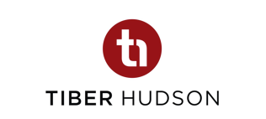



Creative Financing Approaches for Affordable Multifamily Housing
David Bennett
Centrant Community Capital
david@centrant.org
Allison King, Esq.
Tiber Hudson
allison@tiberhudson.com
Rasheca Barrow
Fifth Third Bank
rasheca.barrow@53.com
David Kautter
Wells Fargo
david.w.kautter@wellsfargo.com
Moderator
Notes:
1

Slide 2

Creative Financing for Affordable Multifamily Housing
What is scary about today’s market?
                Delays
                Cost Overruns
                Financing Gaps
                Rising Interest Rates
                Equity Pricing
                Volume Cap Scarcity
Copyright © 2023 Tiber Hudson LLC

Slide 3
Important Market Indicators

Slide 4
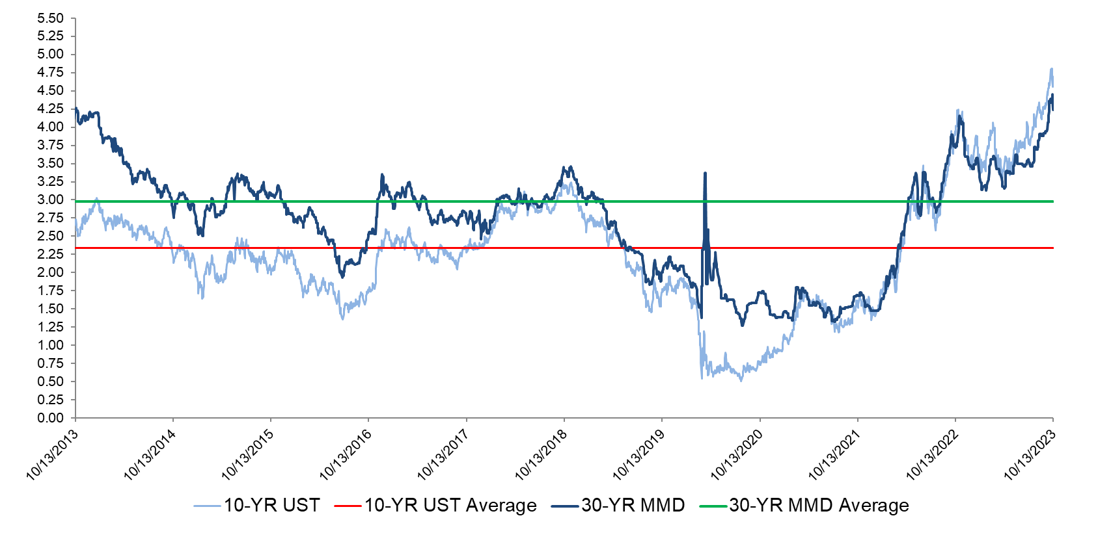
Long-Term Rates – Past 10 Years
Historical Average = 2.98%
10/13/2023 = 4.24%
Historical Average = 2.34%
10/13/2023 = 4.64%
Source: Bloomberg. Thomson Reuters
Reflects market conditions as of October 13, 2023
Thomson Reuters Municipal Market Data (MMD) AAA curve is a proprietary yield curve that provides the offer-side of AAA rated state general obligation bonds
4

Slide 5
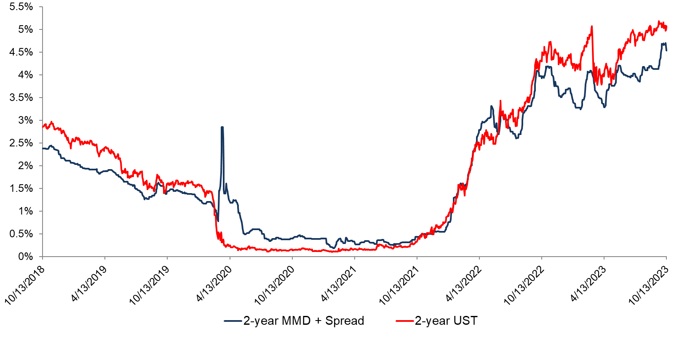
2-Year Short-Term Yield Curves (as of 10/13/2023)
Source: Bloomberg. Thomson Reuters
Reflects market conditions as of October 13, 2023
Thomson Reuters Municipal Market Data (MMD) AAA curve is a proprietary yield curve that provides the offer-side of AAA rated state general obligation bonds
5

Slide 6
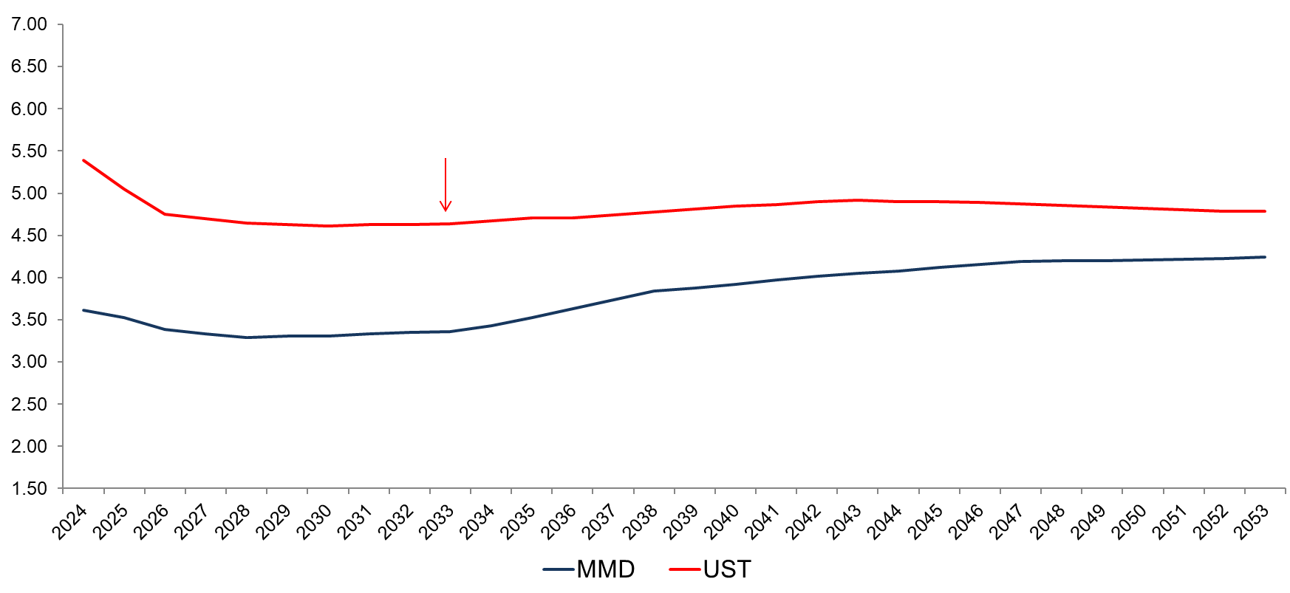
Yield Curve: Taxable UST vs. Tax-Exempt MMD (as of 10/13/2023)
30-year UST = 4.79%
1-year UST = 5.39%
10-year UST = 4.64%
30-year MMD = 4.24%
1-year MMD = 3.61%
10-year MMD = 3.36%
Source: Bloomberg. Thomson Reuters
Reflects market conditions as of October 13, 2023
Thomson Reuters Municipal Market Data (MMD) AAA curve is a proprietary yield curve that provides the offer-side of AAA rated state general obligation bonds
6

Slide 7
4% vs 9% Deals Comparison
9% Deals
4% Deals
5%: Soft Funds/DDF
5%: Soft Funds/DDF
30%: Debt
9% LIHTC Deals:
Competitive
Tax-Exempt Bonds are not permitted
60%: Debt
4% LIHTC Deals:
Noncompetitive
Tax-Exempt Bonds are required
65%: Tax Credit Equity
35%: Tax Credit Equity
Copyright © 2023 Tiber Hudson LLC

Slide 8
50% Test
To qualify for 4% Tax Credits, the Project must utilize
Private Activity Bonds greater than 50% of Aggregate Basis
(which equals Eligible Basis plus Land)
Land
Sitework
Aggregate Basis
Financing
3rd Party Reports
COI
=
Eligible Basis
Tax-Exempt Municipal Bonds
(>50%)
Construction Contract
Ex: If a Project has $20mm in Aggregate Basis, the Borrower should request greater than $10mm in Tax-Exempt Municipal Bonds
Copyright © 2023 Tiber Hudson LLC

Slide 9
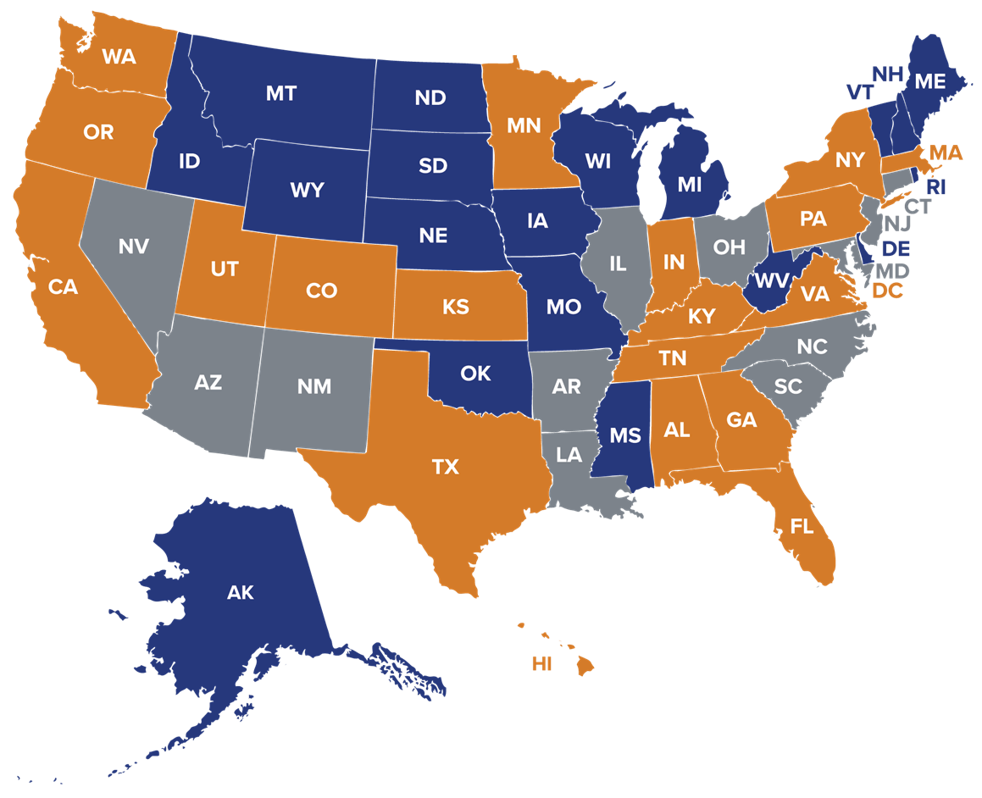
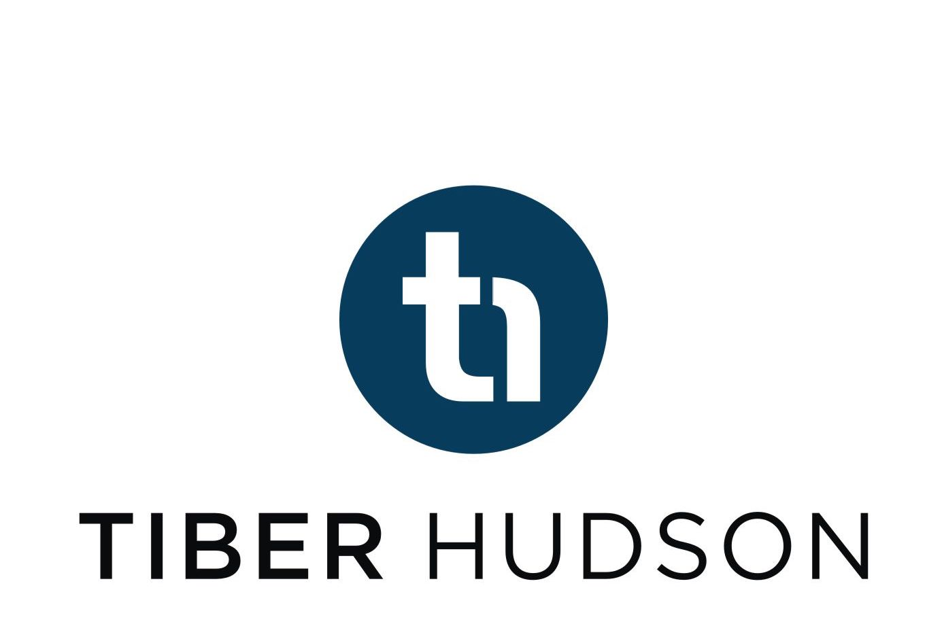
Multifamily Volume Cap Scarcity
Undersubscribed (19 states)
Parity (12 states)
Oversubscribed (19 states &
Washington, D.C.)
Information as of October 2023
Source: Tiber Hudson; Novogradac
Copyright © 2023 Tiber Hudson LLC
9

Slide 10

Creative Financing for Affordable Multifamily Housing
Cash-Backed Forward

Slide 11
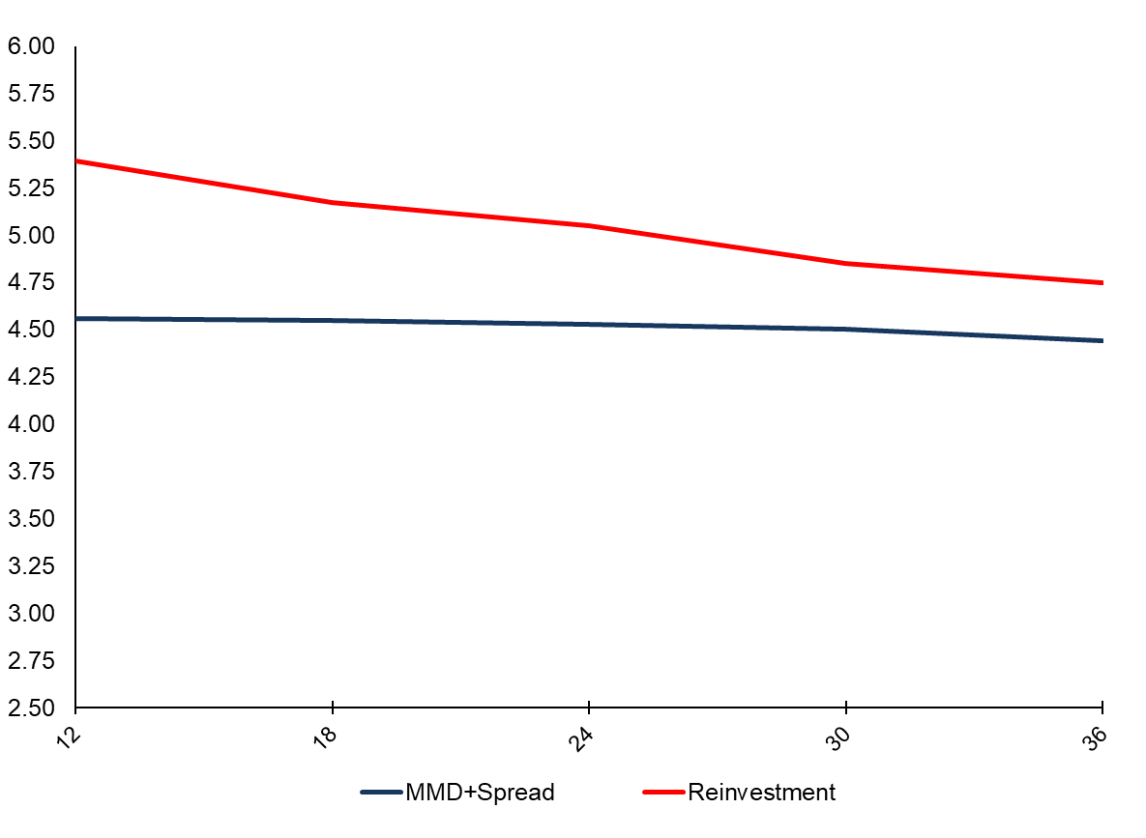
Short-Term Rates vs. Reinvestment Rates – 12 to 36 Months
POSITIVE ARBITRAGE
Source: Bloomberg. Thomson Reuters
Reflects market conditions as of October 13, 2023
Thomson Reuters Municipal Market Data (MMD) AAA curve is a proprietary yield curve that provides the offer-side of AAA rated state general obligation bonds
11

Slide 12
Cash-Backed Forward
Works with any Tax-Exempt financing that involves a forward commitment from a Permanent Lender to purchase the debt at conversion
Takes advantage of inverted yield curve and provides other significant benefits
Provides positive earnings during Cash-Backed mode, as well as additional equity to the project
Allows Equity Investor to also serve as Construction Lender without certain tax implications
In Texas, significantly reduces interest costs on construction loan due to draw down structure
Copyright © 2023 Tiber Hudson LLC

Slide 13




Cash-Backed Forward
Upon Conversion
Borrower
Bond
Proceeds
Trustee
Bond
Debt Service
Payments
Tax Exempt Bonds
Lender
Funds
Permanent Lender
Bond
Proceeds
Cash
Collateral
Initial Cash-Backed Bond Holder
Construction Lender
Equity Investor

Slide 14
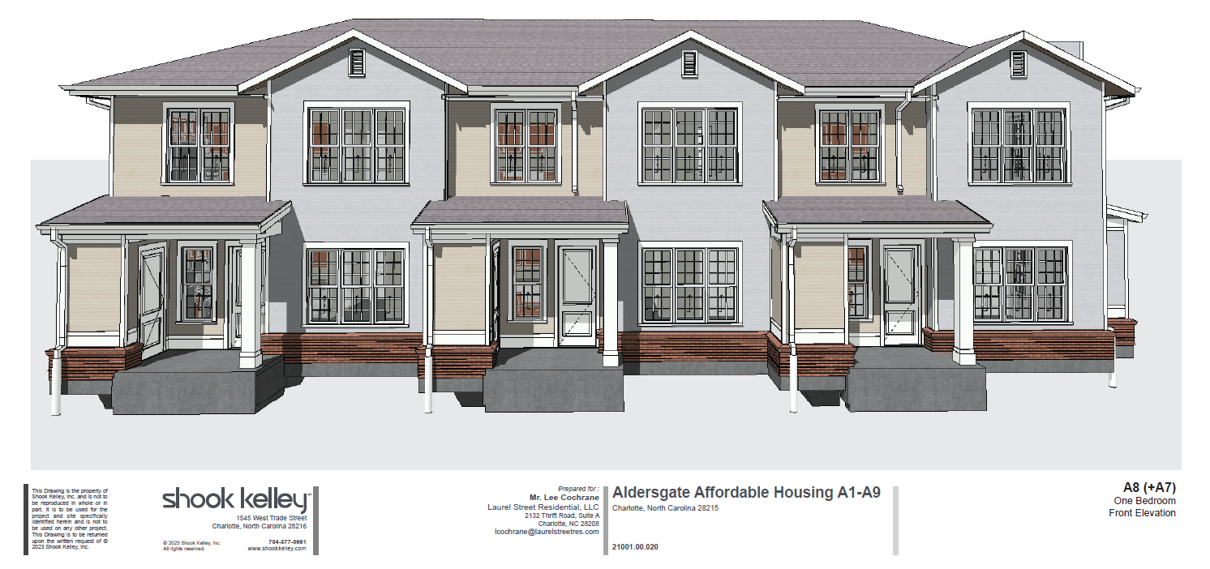
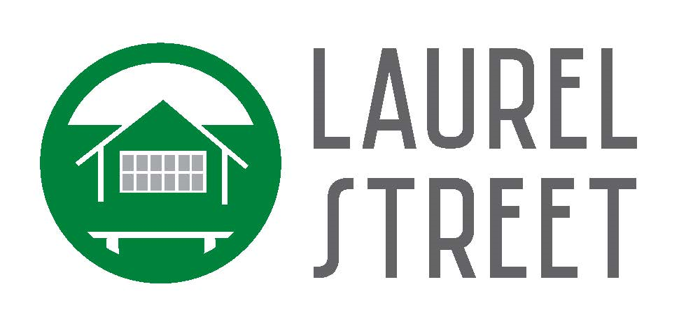
Aldersgate Apartments: Case Study
Project Overview
Project Type | New Construction
Mortgage Lender | National Bank
Perm Bond Purchaser: | National Bank
Issuer | INLIVIAN
Location | Charlotte, North Carolina
Tax-Exempt Allocation | $16,500,000
Earliest Conversion: | 30 Months
Initial Mandatory Tender: | 36 Months
Maturity Date | 17 Years
Units | 136

Slide 15
Aldersgate Apartments: Summary of Benefits
Summary of Bond Pricing Results
Yield To Earliest Call | Yield To IMTD | Investment Yield | Bond Price | Bond Par | Bond Premium
4.52% | 4.59% | 4.86% | 101.108% | $16,319,000 | $180,814.52
Summary of Overall Structure
 | Standard Draw-Down Bond Structure | Cash-Backed Forward | Savings*
Est. Positive Earnings | $0 | $137,000 | $137,000
Est. Additional Equity (Bond Interest)* | $0 | $650,000 | $650,000
Est. Add’l Construction Loan Interest | $0 | $0 | $0
Est. Additional Costs of Issuance | $0 | ($180,000) | ($180,000)
Est. Savings: $607,000
*Assumes equity generated at 35% of projected bond interest through completion
Copyright © 2023 Tiber Hudson LLC

Slide 16
Aldersgate Apartments: Highlights
Over $600,000 in projected savings; even larger for transactions with higher bond allocation
Approximately 30 days from decision to pursue structure to closing
Estimated $550,000 in investment earnings generated on bond proceeds can count towards 50% test
Copyright © 2023 Tiber Hudson LLC

Slide 17
Cash-Backed Forward Benefits
17

Slide 18
Cash-Backed Forward Yield Blending
Permanent Loan Rate = 6.00%
Positive Earnings During Cash-Backed Mode (subject to bond counsel approval to blend yields)
“Yield Blending” refers to the ability to blend the short-term bond yield with the long-term bond/note yield over the first 5 years for arbitrage rebate purposes.
The resulting blended bond yield often results in the ability to retain certain earnings at or below such rate (subject to bond counsel approval).
Investment Yield = 4.85%
Short Term Bond Rate = 4.25%
Blended Bond Yield
IMTD:
Blended Bond Yield = 4.25%
Retainable Earnings: $0
Owed to IRS: $540,000
5-Year Mark:
Blended Bond Yield = 4.95%
Retainable Earnings: $540,000
Owed to IRS: $0
Positive Earnings
Retainable Earnings
Copyright © 2023 Tiber Hudson LLC

Slide 19
Cash-Backed Forward Benefits
Additional equity generated when counting bond interest through completion in eligible basis*
Bond Interest:
$2.55mm
Construction Loan Interest:
$2.175mm
Additional Equity:
$900,000
Equity:
$750,000
Equity:
$750,000
Est. Savings: $900,000
****** Inclusion of bond and construction loan interest subject to approval from Developer’s accounting firm.
******Assumes $30mm par amount and 3-year initial term to Conversion, 24-month construction period, with level draw schedule.
******Equity generated assumed to be 35% of interest cost through completion. Confirm impact of investment income with equity investor
******Additional equity generated from taxable construction loan interest in situations where equity investor and construction lender are not related parties
Copyright © 2023 Tiber Hudson LLC

Slide 20
Cash-Backed Forward Other Benefits
Allows Equity Investor to also serve as Construction Lender without triggering program investment test
Copyright © 2023 Tiber Hudson LLC

Slide 21
Possible Added Costs Of Cash-Backed Forward*
Additional Costs of Issuance for Publicly Offered Bonds:
Expense | Est. Cost
Underwriter’s Fee | $180,000
Underwriter’s Counsel | $60,000
Rating Agency | $5,500
Verification Agent | $2,500
Other Costs | $2,000
Est. Expense: $250,000
* Possible added cost from taxable construction loan interest in situations where equity investor and construction lender are not related parties
Copyright © 2023 Tiber Hudson LLC

Slide 22
Cash-Backed Forward Comparison
Summary of Overall Structure
 | Standard Draw-Down Bond Structure | Cash-Backed Forward | Savings*
Est. Positive Earnings | $0 | $540,000 | $540,000
Est. Additional Equity | $750,000 | $1,650,000 | $900,000
Est. Additional Costs of Issuance | $0 | ($250,000) | ($250,000)
Est. Savings: $1,190,000
* Lower savings in situations where equity investor and construction lender are not related parties
Copyright © 2023 Tiber Hudson LLC

Slide 23

Creative Financing for Affordable Multifamily Housing
Tax-Exempt Seller Note

Slide 24
Tax-Exempt Seller Note*
  If deal contemplates a long-term seller note or other subordinate loan as part of the capital stack, ability to potentially convert all or some to tax-exempt financing to meet 50% test by running through issuer
  Can allow blending of yields between short- and long-term bonds as fixed yield issuance
  This increases the tax-exempt bond yield above the investment yield for the term, creating excess earnings that can often be retained instead of being rebated to the IRS
  *Subject to bond counsel approval

Slide 25
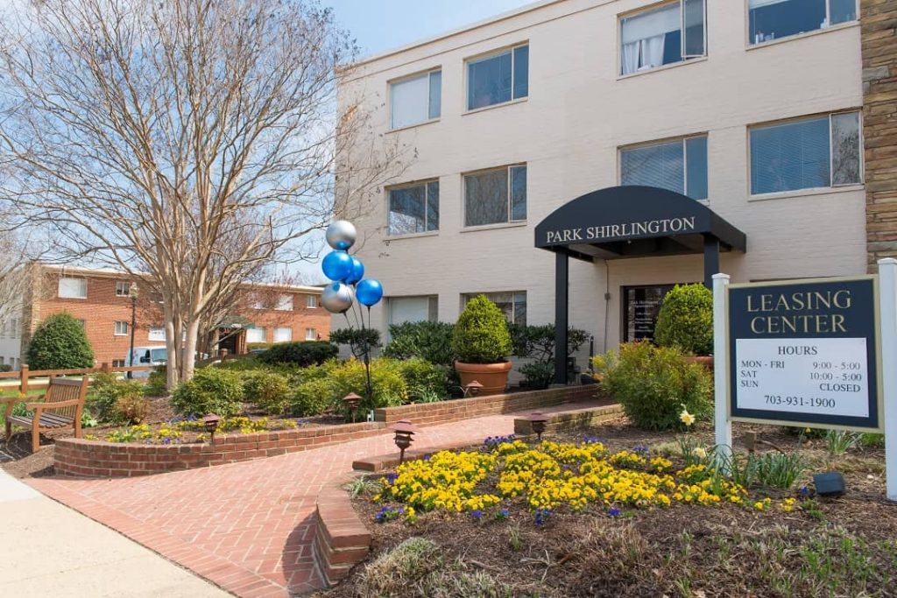
Case Study: VA Park Shirlington
Project Overview
Project Type | Acq/Rehab
Mortgage Lender | National Bank
Issuer | IDA of Arlington County
Location | Arlington, Virginia
Tax-Exempt Allocation | $75,800,000
Maturity Date | 30 Months
Units | 294

Slide 26
VA Park Shirlington
  Under the typical short-term bond structure, pricing would have been:
Tax-Exempt Proceeds: | $75,800,000
Term Length: | 30 Months
Short Term Bond Yield: | 3.40%
  Current market yields would generate roughly $675,000 in positive arbitrage, which under the traditional short-term structure would need to be returned to the IRS:
Tax-Exempt Bond Yield: | 3.40%
Reinvestment Yield: | 3.75%
Est. Excess Earnings: | $675,000
Est. Retainable Earnings: | $0

Slide 27
VA Park Shirlington
  Instead of using 100% of the bond allocation as tax-exempt short-term bonds,
  $6mm was recategorized as a long-term tax-exempt seller note:
 | Short Term Bonds | Tax-Exempt Seller Note
Tax-Exempt Amount: | $69,800,000 | $6,000,000
Term Length: | 30 Months | 42 Years
Yield: | 3.40% | 5.00%
  By recategorizing a portion of the tax-exempt debt, the blended bond yield increases to 4.00%. This now exceeds the investment yield, so excess earnings in the amount of $650,000 can be retained.
 | Original Structure | With Seller Note
Tax-Exempt Bond Yield | 3.40% | 4.00%
Reinvestment Yield: | 3.75% | 3.75%
Est. Excess Earnings: | $675,000 | $650,000
Est. Retainable Earnings: | $0 | $650,000

Slide 28

Creative Financing for Affordable Multifamily Housing
Fannie Mae Taxable MTMB

Slide 29
Fannie Mae Taxable MTMB
  9% Transactions / Workforce Housing
  Taxable MBS Loan that can be used for current financing and/or acquisition
  Favorable underwriting criteria, including the potential for 40-year amortization 20+ year loan terms
  Competitive mortgage rates available
  Ideal for projects in years 10-14 of tax credit compliance
  *Subject to bond counsel approval

Slide 30



Fannie Mae Taxable Forward MTMB
Upon Conversion
Borrower
MBS Pass Through Payment
Trustee
Mortgage
Payments
Bond Payments
Taxable Bonds
Lender
Funds
MBS Delivery
Permanent Lender
Bond Proceeds
Bond
Proceeds
Bond/MBS Holder
Construction Lender
Equity Investor

Slide 31

Creative Financing for Affordable Multifamily Housing
Issues We Are Watching:
        Community Reinvestment Act Reform
        Insurance Costs
        Affordable Housing Credit Improvement Act

Slide 32
Questions?

Slide 33
Contact Information
David Bennett
Centrant Community Capital
david@centrant.org
Allison King, Esq.
Tiber Hudson
allison@tiberhudson.com
Rasheca Barrow
Fifth Third Bank
rasheca.barrow@53.com
David Kautter
Wells Fargo
david.w.kautter@wellsfargo.com
Moderator
Notes:
33

