Slide 1
THE INTERSECTION OF
LAND USE & AFFORDABLE HOUSING
OCTOBER 23, 2023
NC HOUSING WORKS

Slide 2
OBJECTIVES
Showcase how North Carolina communities at various stages of growth are working at the nexus of land use and affordable housing.
Hear from land use and affordable housing experts across the state about how they believe land use could be leveraged to facilitate affordable housing in different contexts (rural, urban, and suburban areas) and the key differences between them.
Explore how state level policy and legislation has impacted communities across the state especially their land use + affordable housing efforts.
OCTOBER 23, 2023 NC HOUSING WORKS

Slide 3
Our Panel
Chris Whitenhill, AICP
Affordable Housing Planner
Wake County
Jason Sullivan
Planning & Community Development Director
Chatham County
Sasha Vrtunski
Affordable Housing Officer
City of Asheville
Rachel LaCoe
New Hanover County

Slide 4
City of Asheville
City Population - 94,000
11 to 12 million visitors per year
No involuntary annexation allowed by Asheville

Slide 5
City of Asheville
Residential Zoning
24,491.63 Acres Total
(no ROW or Rivers)
18,397 Acres zoned Residential (75% of all property in the city)
12,592 Acres for Single Family Residential
(50% of all property in the city)

Slide 6
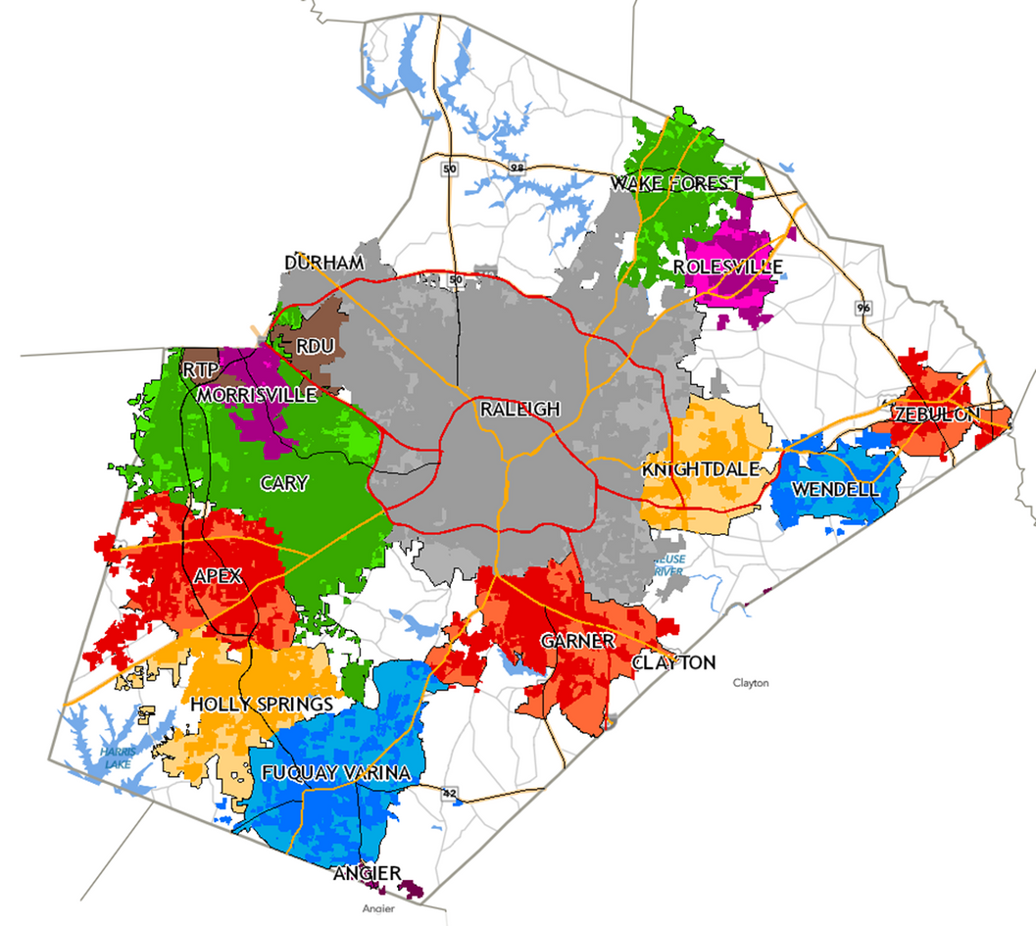
Wake County
Median Family Income FY 2023: $117,000 - HUD User Median Home Price Sept. 2023: $469,112 - Redfin
Wake County engages 12 municipalities to increase and preserve affordable housing units
FOCUS:
Affordable Housing in Municipal Plans
Following Municipal Plan Processes
Opportunities to support towns
Municipal Funding Opportunities
Municipal Planning Capacity

Slide 7
Chatham County
Population – 79,864
Median Household Income - $76,791
Median Home Value – $396,700
Poverty Rate – 12.2%
Cost Burden – 25%
(7,351) of households
(47% renters/20% homeowners)
Economic Development:
Vinfast and Wolfspeed
Carolina Core/Future I-685
Housing Trust Fund
Unified Development Ordinance and Moncure Small Area Plan - www.recodechathamnc.org
Sources:
2022 US Census
2023 NC Housing Coalition County Profile

Slide 8
NEW HANOVER COUNTY

Slide 9
NEW HANOVER COUNTY

Slide 10
Our Panel
Chris Whitenhill, AICP
Affordable Housing Planner
Wake County
Jason Sullivan
Planning & Community Development Director
Chatham County
Sasha Vrtunski
Affordable Housing Officer
City of Asheville
Rachel LaCoe
New Hanover County

Slide 11
STAY TUNED
WEBINAR
INTERSECTION OF
LAND USE & AFFORDABLE HOUSING
PART 2
DEEPER DIVE
Hosted by the NC Housing Coalition

Slide 12
THANK YOU!
Q&A
Sasha Vrtunski, AICP
Affordable Housing Officer
City of Asheville
Rachel LaCoe
Senior Long Range Planner
New Hanover County - Planning & Land Use
Jason Sullivan
Planning Director
Chatham County Planning & Community Development Department
Chris Whitenhill, AICP
Affordable Housing Planner
Wake County Department of Housing Affordability & Community Development

