Slide 1
Hot Topics in
Housing Compliance
&
More
Presented By
Steven James, Senior Compliance Monitor
North Carolina Housing Finance Agency
spjames@nchfa.com

Slide 2
Agenda
Updates and Reminders
Management Company Report Cards
Income Averaging
NSPIRE
HOTMA
NCHFA Public Training
Questions
Updates & Reminders
Income Averaging
NSPIRE
HOTMA

Slide 3
Hot Topics in
Housing Compliance
Agenda
Updates and Reminders
Management Company Report Cards
Income Averaging
NSPIRE
HOTMA
NCHFA Public Training
Questions
Updates & Reminders
Income Averaging
NSPIRE
HOTMA

Slide 4
The policy/information contained in this presentation was prepared and related handouts are accurate at the time of this presentation
Upon further release of guidance from the Internal Revenue Service (IRS) and US Department of Housing and Development (HUD) or NCHFA Leadership, additional updates to our policies may be necessary and will be communicated by the North Carolina Housing Finance Agency

Slide 5
2023 Income Limits Released and RCRS Updated
If you moved a household in between 5/15/2023 and 5/31/2023 using the originally published limits, place a copy of this email in the file!

Slide 6
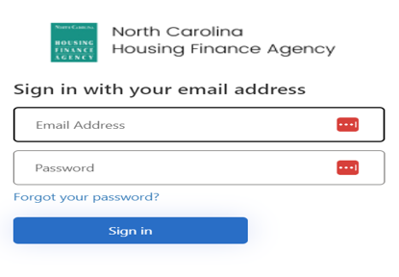
Rents and Lease-ups
Be sure rents are updated in RCRS before you start lease-up
If the property opens with rents that are too low, this will cause cash flow issues throughout the life of the property

Slide 7
Rents and Lease-ups
Be sure rents are updated in RCRS before you start lease-up
If the property opens with rents that are too low, this will cause cash flow issues throughout the life of the property

Slide 8
Rents and Lease-ups
Be sure rents are updated in RCRS before you start lease-up
If the property opens with rents that are too low, this will cause cash flow issues throughout the life of the property

Slide 9
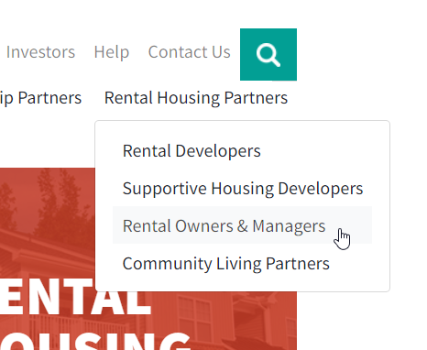
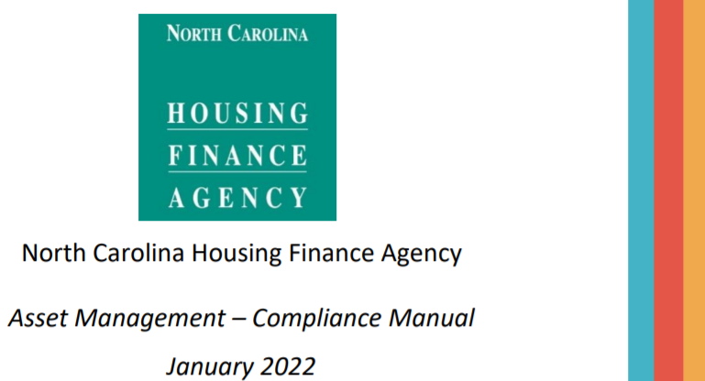
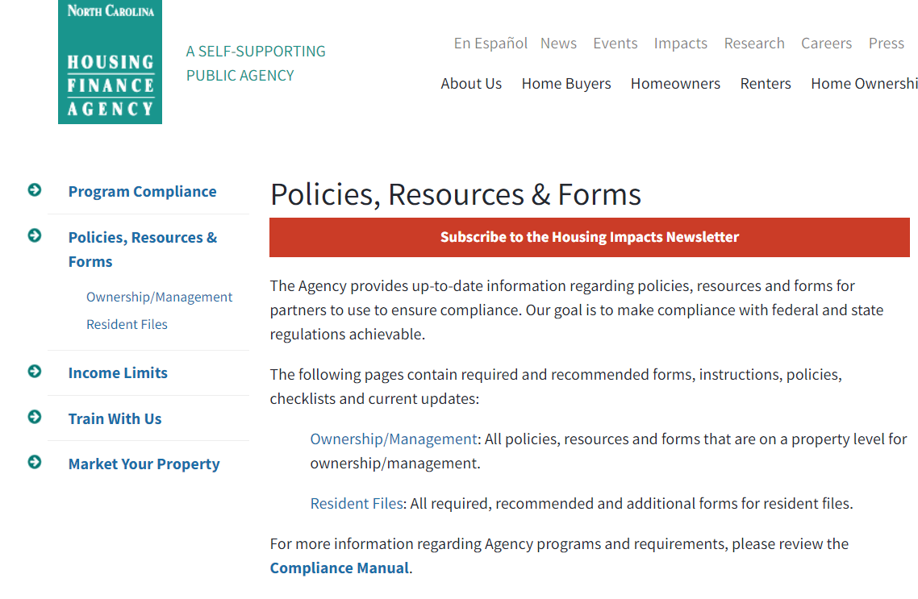
NCHFA Asset Management - Compliance Manual
Revision Coming
Expected 1/1/2024

Slide 10
VAWA Revisions – Effective January 1, 2024

Slide 11
New Key Assistance Payment Tiers
Effective October 1, 2023

Slide 12
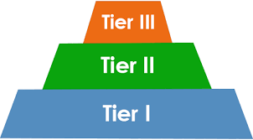
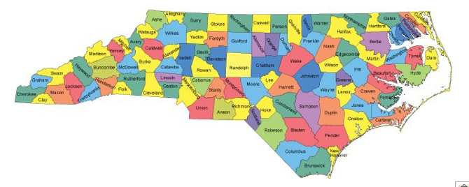
Key Payment Standard Update
Effective October 1, 2023
Implementing three new tiers of Key payment standards in addition to the current Key payment standard
Following a thorough analysis of how to ensure equitable Key payments across the state, the Agency will assign properties to one of four tiers of Key payment standards
The tiers were determined by grouping counties with similar rent limits

Slide 13
Key Payment Standard Update
Effective October 1, 2023
Implementing three new tiers of Key payment standards in addition to the current Key payment standard
Following a thorough analysis of how to ensure equitable Key payments across the state, the Agency will assign properties to one of four tiers of Key payment standards
The tiers were determined by grouping counties with similar rent limits

Slide 14
Key Payment Standard Update
Effective October 1, 2023
Implementing three new tiers of Key payment standards in addition to the current Key payment standard
Following a thorough analysis of how to ensure equitable Key payments across the state, the Agency will assign properties to one of four tiers of Key payment standards
The tiers were determined by grouping counties with similar rent limits

Slide 15
Key Payment Standard Update
Effective October 1, 2023
Implementing three new tiers of Key payment standards in addition to the current Key payment standard
Following a thorough analysis of how to ensure equitable Key payments across the state, the Agency will assign properties to one of four tiers of Key payment standards
The tiers were determined by grouping counties with similar rent limits

Slide 16
Key Payment Standard Update
Effective October 1, 2023
Implementing three new tiers of Key payment standards in addition to the current Key payment standard
Following a thorough analysis of how to ensure equitable Key payments across the state, the Agency will assign properties to one of four tiers of Key payment standards
The tiers were determined by grouping counties with similar rent limits

Slide 17
New Key Assistance Payment Tiers
Based on the LIHTC income and rent limits effective on 5/15/2023, eighty-six counties will remain at the current Key payment standard (tier 1) and will continue using the current Key subsidy and calculation worksheet.
Properties in fourteen counties will be assigned to one of the three new Key payment standards (tiers 2, 3 and 4).

Slide 18
Key Payment Standards Tiers 2, 3 & 4 Counties
Agency staff will contact owner representatives of properties in Tier 2, 3 and 4 counties prior to September 1, 2023 to provide the new Key Subsidy and Calculation Worksheets
Tier 2, 3 and 4 are located in: Brunswick, Cabarrus, Chatham, Currituck, Durham, Franklin, Gaston, Johnston, Mecklenburg, Moore, New Hanover, Orange, Union and Wake counties

Slide 19
Key Payment Standards Tiers 2, 3 & 4 Counties
Agency staff will contact owner representatives of properties in Tier 2, 3 and 4 counties prior to September 1, 2023 to provide the new Key Subsidy and Calculation Worksheets
Tier 2, 3 and 4 are located in: Brunswick, Cabarrus, Chatham, Currituck, Durham, Franklin, Gaston, Johnston, Mecklenburg, Moore, New Hanover, Orange, Union and Wake counties

Slide 20
Key Payment Standards Tiers 2, 3 & 4 Counties
Agency staff will contact owner representatives of properties in Tier 2, 3 and 4 counties prior to September 1, 2023 to provide the new Key Subsidy and Calculation Worksheets
Tier 2, 3 and 4 are located in: Brunswick, Cabarrus, Chatham, Currituck, Durham, Franklin, Gaston, Johnston, Mecklenburg, Moore, New Hanover, Orange, Union and Wake counties

Slide 21
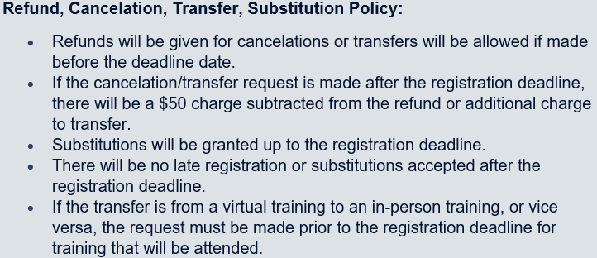
NCHFA
Public Training
Reminders
Registration for classes closes the two Thursdays before the week of training
Example: 11/5/2024 & 11/6/2024 Compliance 101 and Advanced closes 10/24/2024, 12am
Exciting Changes for 2024 Training!

Slide 22
Upcoming Compliance 101 and Advanced Training Dates
Compliance 101 Training Dates
November 15, 2023 In-person - Mountain Horticultural Research Center, Mills River
Registration closes 11/2/2023, 8am
February 14, 2024 In-person and Virtual – McKimmon Center, NC State University, Raleigh
April 23, 2024 In-person – New Hanover County Cooperative Extension Agency, Wilmington
August 14, 2024 In-person Mountain Horticultural Research Center, Mills River
September 4, 2024 In-person and Virtual – McKimmon Center, NC State University, Raleigh
November 5, 2024, In-person – Bradford Creek Public Golf Course, Greenville
Advanced Compliance Training Dates
November 16, 2023 In-person - Mountain Horticultural Research Center, Mills River
Registration closes 11/2/2023, 8am
February 15, 2024 In-person and Virtual – Raleigh
April 24, 2024 In-person – Wilmington
August 14, 2024 – In-person – Mills River
September 5, 2024 – In-person and Virtual – Raleigh
November 6, 2024 – In-person – Greenville
Advanced Compliance
2024 Registration will open by 1/1/ 2024

Slide 23
Upcoming DHHS & NCHFA Targeting/Key Training Dates
Training Dates
March 5, 2024 In-person and Virtual – NCSU McKimmon Center, Raleigh
May 7, 2024 In-person – Mountain Horticultural Research Center, Mills River
July 23, 2024 In-person – Duplin County Cooperative Extension Agency, Kenansville
August 20, 2024 In-person – Iredell County Cooperative Extension Agency, Statesville
October 15, 2024 In-person and Virtual – NCSU McKimmon Center, Raleigh
2024 Registration will open by 1/1/ 2024

Slide 24
Upcoming Supportive Housing Training Dates
Supportive Housing training is for emergency and temporary housing providers such as shelters, group homes, hospice care centers, transitional housing, etc.
Training Dates
October 24, 2023 In-person - Mountain Horticultural Research Center, Mills River
Registration closes 10/10/2023, 12am
March 27, 2024 In-person – New Hanover County Cooperative Extension Agency, Wilmington
May 21, 2024 In-person and Virtual – NCSU McKimmon Center, Raleigh
July 24, 2024 – In-person – Iredell County Cooperative Extension Agency, Statesville
October 23, 2024 In-person – Mountain Horticultural Research Center, Mills River
Supportive
Housing
Program
2024 Registration will open by 1/1/ 2024

Slide 25
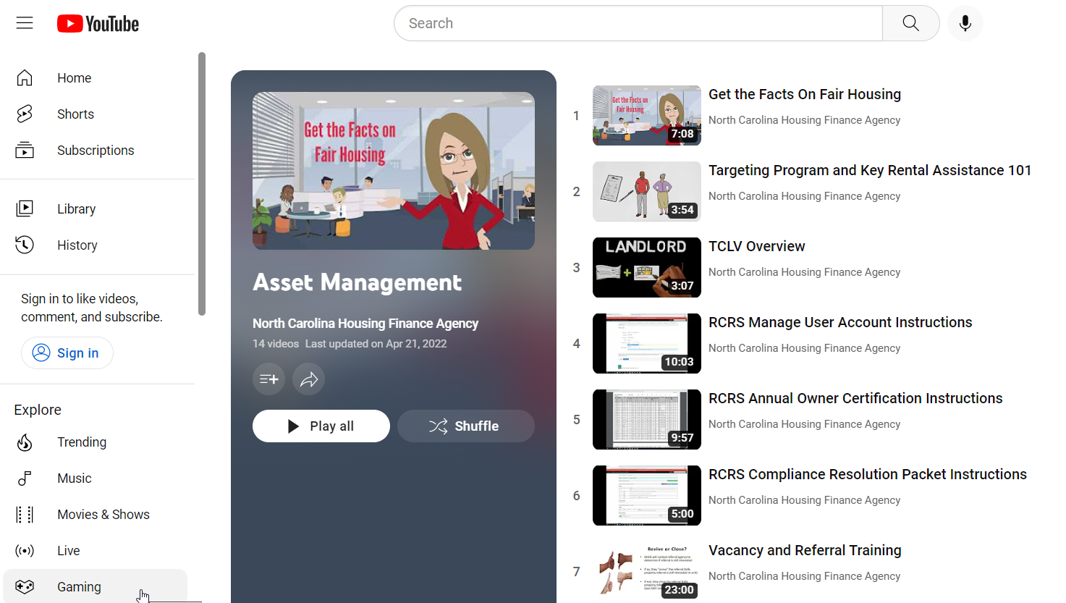
Short Training Video Clips on YouTube
Check Back Often For Added Videos!
Targeting & Key, RCRS, Reporting/Approval Instructions, Requirements, etc.

Slide 26
Report Cards For
NCHFA Approved Management Companies

Slide 27
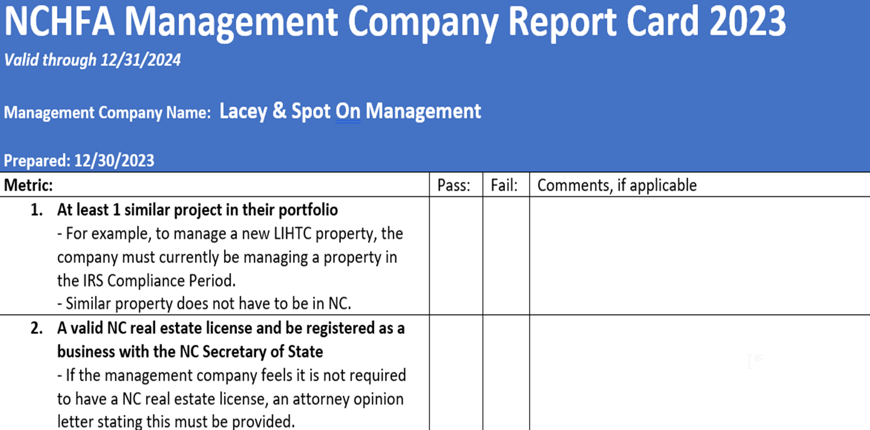

Slide 28
Targeting Program related emails are sent out quarterly for those with issues

Slide 29
Approved Management Company List Criteria Revision - RCRS
All unit events updated in RCRS within 30-days of unit event: Move-in/out, Annual Updates (recerts), etc.
All unit types: LIHTC, HOME, Market, Employee, etc.
Move-in documents
Revision Include:
2022 allowance of 50% as transitioned to 15%
Effective January 1, 2023
New threshold: 15% Discrepancies
Below 15% discrepancies will result in the management company being removed from the approved list for a minimum of one year

Slide 30
Approved Management Company List Criteria Revision - RCRS
All unit events updated in RCRS within 30-days of unit event: Move-in/out, Annual Updates (recerts), etc.
All unit types: LIHTC, HOME, Market, Employee, etc.
Move-in documents
Revision Include:
2022 allowance of 50% as transitioned to 15%
Effective January 1, 2023
New threshold: 15% Discrepancies
Below 15% discrepancies will result in the management company being removed from the approved list for a minimum of one year

Slide 31
Approved Management Company List Criteria Revision - RCRS
All unit events updated in RCRS within 30-days of unit event: Move-in/out, Annual Updates (recerts), etc.
All unit types: LIHTC, HOME, Market, Employee, etc.
Move-in documents
Revision Include:
2022 allowance of 50% as transitioned to 15%
Effective January 1, 2023
New threshold: 15% Discrepancies
Below 15% discrepancies will result in the management company being removed from the approved list for a minimum of one year

Slide 32
Approved Management Company List Criteria Revision - RCRS
All unit events updated in RCRS within 30-days of unit event: Move-in/out, Annual Updates (recerts), etc.
All unit types: LIHTC, HOME, Market, Employee, etc.
Move-in documents
Revision Include:
2022 allowance of 50% as transitioned to 15%
Effective January 1, 2023
New threshold: 15% Discrepancies
Below 15% discrepancies will result in the management company being removed from the approved list for a minimum of one year

Slide 33
Approved Management Company List Criteria Revision - RCRS
All unit events updated in RCRS within 30-days of unit event: Move-in/out, Annual Updates (recerts), etc.
All unit types: LIHTC, HOME, Market, Employee, etc.
Move-in documents
Revision Include:
2022 allowance of 50% as transitioned to 15%
Effective January 1, 2023
New threshold: 15% Discrepancies
Below 15% discrepancies will result in the management company being removed from the approved list for a minimum of one year

Slide 34
Approved Management Company List Criteria Revision - RCRS
All unit events updated in RCRS within 30-days of unit event: Move-in/out, Annual Updates (recerts), etc.
All unit types: LIHTC, HOME, Market, Employee, etc.
Move-in documents
Revision Include:
2022 allowance of 50% as transitioned to 15%
Effective January 1, 2023
New threshold: 15% Discrepancies
Below 15% discrepancies will result in the management company being removed from the approved list for a minimum of one year

Slide 35
RCRS Reporting - file review/physical inspection response letters & AOC How management self-tracks compliance in this area of the report card
Training – reminder emails sent mid/late August

Slide 36
Uncorrected noncompliance – management must track

Slide 37
Rent increase implemented without approval
Notice given POST APPROVAL via RCRS or file reviews

Slide 38
Report Cards For NCHFA Approved Management Companies Interim Progress Report Schedule Reminders
When are progress reports sent through the year?
Can you self-check your progress?
RCRS Reporting
File review/physical inspection results letters and AOC Review
RCRS
Targeting & Key Assistance Program
Targeting Program Related (quarterly)
Uncorrected Noncompliance management must track and submit Compliance Resolution Packets
Rent increase implemented without approval included in our POST APPROVAL via RCRS or file reviews results letter
Training – reminder emails sent in August

Slide 39
Report Cards For NCHFA Approved Management Companies Interim Progress Report Schedule Reminders
When are progress reports sent through the year?
Can you self-check your progress?
RCRS Reporting
File review/physical inspection results letters and AOC Review
RCRS
Targeting & Key Assistance Program
Targeting Program Related (quarterly)
Uncorrected Noncompliance management must track and submit Compliance Resolution Packets
Rent increase implemented without approval included in our POST APPROVAL via RCRS or file reviews results letter
Training – reminder emails sent in August

Slide 40
Report Cards For NCHFA Approved Management Companies Interim Progress Report Schedule Reminders
When are progress reports sent through the year?
Can you self-check your progress?
RCRS Reporting
File review/physical inspection results letters and AOC Review
RCRS
Targeting & Key Assistance Program
Targeting Program Related (quarterly)
Uncorrected Noncompliance management must track and submit Compliance Resolution Packets
Rent increase implemented without approval included in our POST APPROVAL via RCRS or file reviews results letter
Training – reminder emails sent in August

Slide 41
Report Cards For NCHFA Approved Management Companies Interim Progress Report Schedule Reminders
When are progress reports sent through the year?
Can you self-check your progress?
RCRS Reporting
File review/physical inspection results letters and AOC Review
RCRS
Targeting & Key Assistance Program
Targeting Program Related (quarterly)
Uncorrected Noncompliance management must track and submit Compliance Resolution Packets
Rent increase implemented without approval included in our POST APPROVAL via RCRS or file reviews results letter
Training – reminder emails sent in August

Slide 42
Report Cards For NCHFA Approved Management Companies Interim Progress Report Schedule Reminders
When are progress reports sent through the year?
Can you self-check your progress?
RCRS Reporting
File review/physical inspection results letters and AOC Review
RCRS
Targeting & Key Assistance Program
Targeting Program Related (quarterly)
Uncorrected Noncompliance management must track and submit Compliance Resolution Packets
Rent increase implemented without approval included in our POST APPROVAL via RCRS or file reviews results letter
Training – reminder emails sent in August

Slide 43
Report Cards For NCHFA Approved Management Companies Interim Progress Report Schedule Reminders
When are progress reports sent through the year?
Can you self-check your progress?
RCRS Reporting
File review/physical inspection results letters and AOC Review
RCRS
Targeting & Key Assistance Program
Targeting Program Related (quarterly)
Uncorrected Noncompliance management must track and submit Compliance Resolution Packets
Rent increase implemented without approval included in our POST APPROVAL via RCRS or file reviews results letter
Training – reminder emails sent in August

Slide 44
Report Cards For NCHFA Approved Management Companies Interim Progress Report Schedule Reminders
When you receive your Progress Report Emails for Targeting and Key Assistance…
Follow Up With Us!
Late submissions due to Evictions
Resident not cooperating with recertification process and DHHS is aware
Change in management company/Issues
Any other issues we need to be aware of

Slide 45
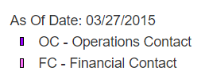
Report Cards For NCHFA Approved Management Companies Who Receives The Interim Progress Report Notifications
Address: 123 Treat Blvd.
Youngsville, NC 27834
Phone: 1-800-PETSMART
Contact: Lacey Harris
Email: LH@LaceyandSpotOnManagement.com
Tax ID: 56-22334444
Spot James
Tittle: Operations Contact
Phone: 1-800-PetcoRS Fax: N/A
Email: SJ@LaceyandSpotonManagement.com
Authorized Official
from ownership entity
Operations Contact
from management company

Slide 46
Specific to
North
Carolina
Income Averaging
Income Averaging

Slide 47
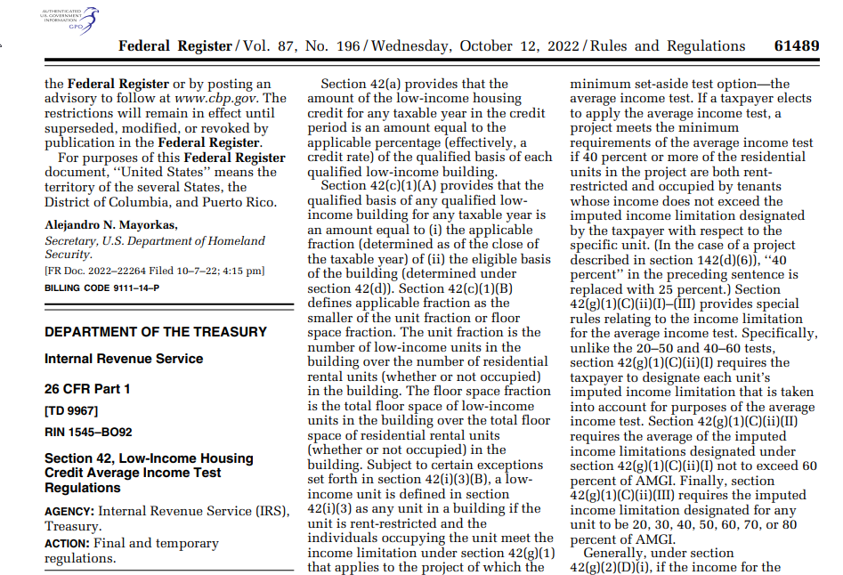
Income Averaging Update Released 10/12/2022

Slide 48
Under the Old Average Income Regulation Cliff Test – Potential Loss of All Credits

Slide 49
Under the New Average Income Regulations There is no Cliff Test – Only Potential Partial Loss of Credits

Slide 50
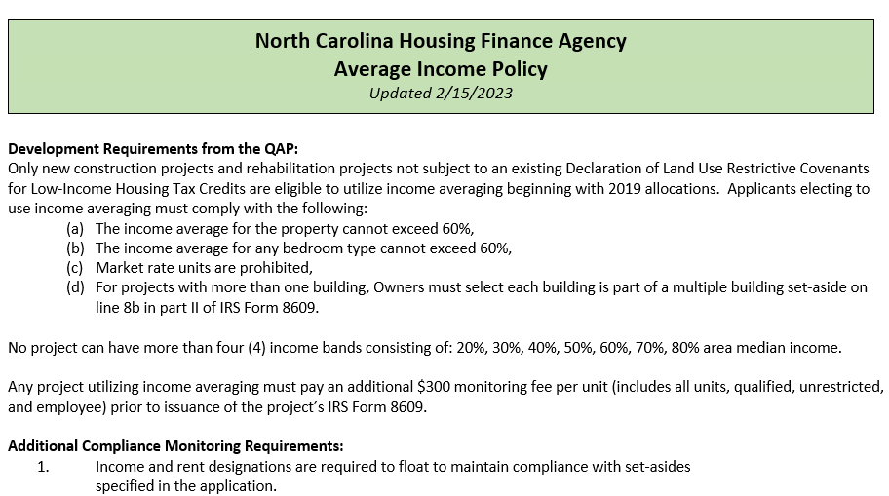
Coming to our website soon!

Slide 51
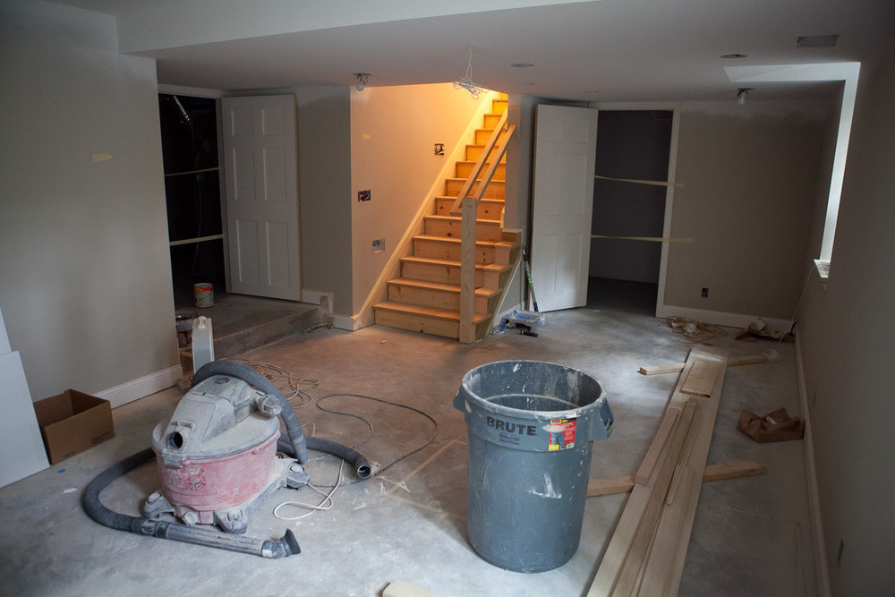
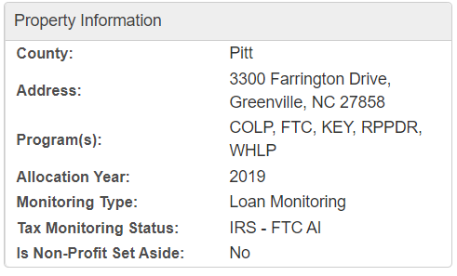
Income Averaging Policy
Only new construction projects and rehabilitation projects not subject to an existing Declaration of Land Use Restrictive Covenants for Low-Income Housing Tax Credits are eligible to utilize income averaging beginning with 2019 allocations

Slide 52
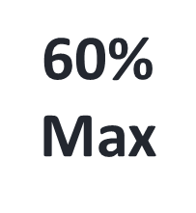
Income Averaging Policy
Applicants electing to use income averaging must comply with the following:
(a) The income average for the property cannot exceed 60%
(b) The income average for any bedroom type cannot exceed 60%
(c) Market rate units are prohibited
(d) For projects with more than one building, Owners must select each building as part of a multiple building set-aside on line 8b in part II of IRS Form 8609
60%
Max
NO
Market Rate
Units

Slide 53
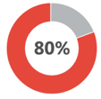
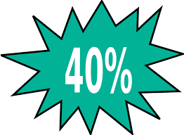
Income Averaging Policy
No project can have more than four (4) income bands consisting of: 20%, 30%, 40%, 50%, 60%, 70%, 80% area median income
Any project utilizing income averaging will pay a higher monitoring fee per unit (includes all units, qualified, unrestricted, and employee) prior to issuance of the project’s IRS Form 8609
Maximum of 4
Income Bands
Increase

Slide 54
Additional Compliance Monitoring Requirements:
1. Income and rent designations are required to float to maintain compliance with set-asides specified in the application

Slide 55
Additional Compliance Monitoring Requirements:
2. All households must be certified annually in accordance with B(1)(vi) to confirm the appropriate unit set-aside. No exception is allowed for one hundred percent (100%) low income projects using Average Income as the minimum set-aside
If household income has increased above 140% of the current set-aside limit, the next available unit of comparable or smaller size must be rented to a household at the lower set-aside until the appropriate unit mix is restored
If household income decreases, it is acceptable to move the unit to the lower set-aside if a slot is available, but this is not mandatory

Slide 56
Additional Compliance Monitoring Requirements:
3. Low-income certification review frequency under C(2)(ii) will be increased to annual review to monitor compliance with this set-aside

Slide 57
Additional Compliance Monitoring Requirements:
4. Lower set-asides must follow the Multifamily Tax Subsidy Program (MTSP) income and Rent limits as published by HUD annually
Any units where income or rent exceeds the limit for the set-aside specified on the low-income certification will be reported to the IRS.
MTSP Income and Rent Limits

Slide 58
Additional Compliance Monitoring Requirements:
5. As part of the annual review of the certification required under C(1), the Agency will test compliance with the Average Income requirements. If the average income designation of at least 40% of compliant units is at or below sixty percent (60%) Area Median Income (AMI), there will be no impact to the minimum set-aside
The grouping of compliant units is expected to shift to help achieve compliance. If the minimum number of compliant units falls below forty percent (40%), or if the average income designation of the most advantageous grouping of 40% of compliant units is above sixty percent (60%) Area Median Income (AMI), the entire project will fail to meet the required minimum set-aside and will be reported to the IRS
The unit designation is determined by the owner as reported on the most recent unit event in RCRS. Units out of compliance at year end, regardless of whether attributable to a low-income certification issue or a physical inspection issue, will not be included in the grouping to determine whether the Average Income is acceptable and meets program requirements
Further, individual units that are out of compliance will be reported to the IRS, even if the minimum set-aside is not affected. Any unit out of compliance will cause the applicable fraction to be less than the required 100%.

Slide 59
Additional Compliance Monitoring Requirements: 6. There are 5 allowable reasons to change the designation of a unit:
1. Federally permitted changes: As contained in IRS forms, instructions or guidance published in the Internal Revenue Bulletin
2. Agency-permitted (or Agency-required) changes: As described in written public guidance

Slide 60
Additional Compliance Monitoring Requirements: 6. There are 5 allowable reasons to change the designation of a unit:
3. Certain laws: As required or appropriate to enhance protections under The Americans with Disabilities Act, The Fair Housing Act, The Violence Against Women Act, The Rehabilitation Act of 1973 or any other state, federal or local law or program that protects tenants.
4. Tenant movement: When a current income-qualified tenant transfers to a different unit in the same project, the units “swap” status.

Slide 61
Additional Compliance Monitoring Requirements: 6. There are 5 allowable reasons to change the designation of a unit:
5. Restoring compliance with the average income requirements: As needed for purposes of identifying a qualified group of units, either for purposes of satisfying the AIT set-aside or for purposes of identifying the units to be used in computing applicable fraction(s).
Restoring

Slide 62
Short Training Video Clips on YouTube
This Photo by Unknown Author is licensed under CC BY
Detailed Video on Income Averaging & Examples!

Slide 64
HOTMA
Housing Opportunities Through Modernization Act
Specific to NC

