Slide 1
NCORR Community Development
Tracey Colores
Community Development Director
NC Office of Recovery and Resiliency

Slide 2
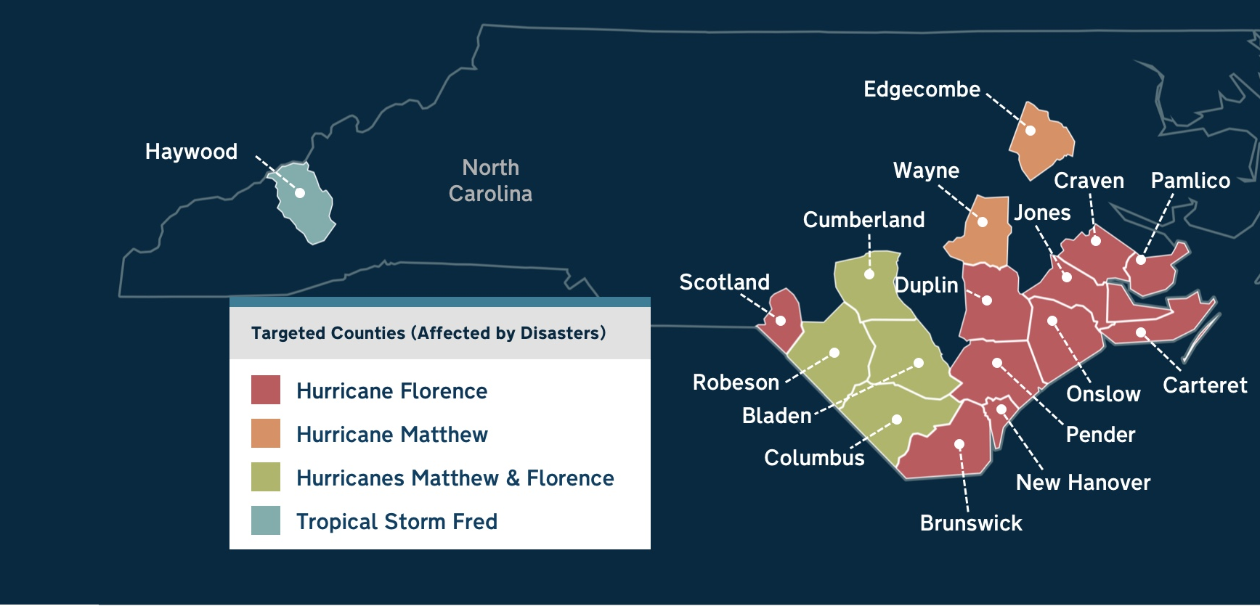
Office established after Hurricane Florence (2018) in Dept. of Public Safety
Assists with disaster recovery, mitigation, community development and resiliency
Manages roughly $1 billion in HUD CDBG-Disaster Recovery grants

Slide 3
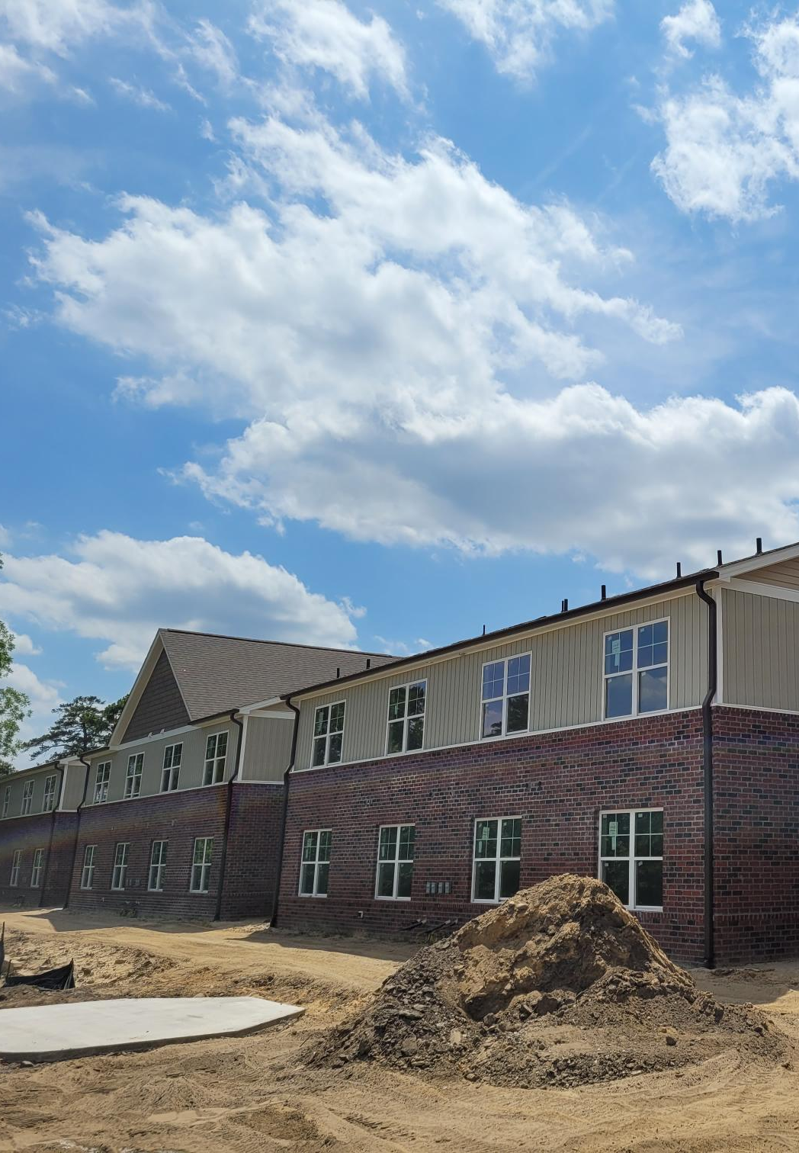
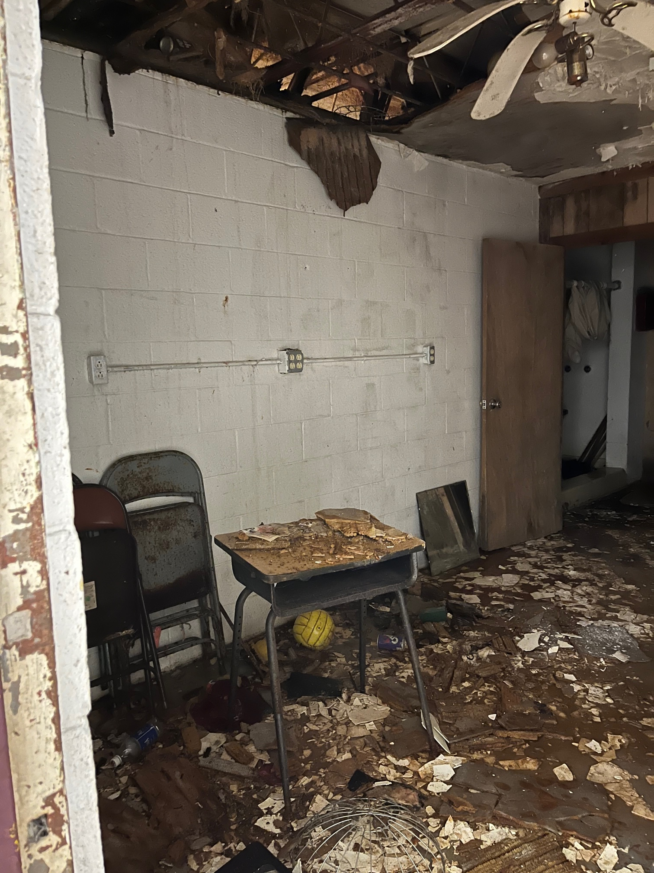
Community Development
Beyond the Homeowner
Partnering with NCHFA, FEMA, NCEM, UNC, NCSU, local governments, others
Providing funding for ~$200m in affordable housing and public infrastructure projects
Creating new multi- and single family housing with extended affordability
Development outside 100-year floodplain for low-mod households in targeted areas
Engelhard Community Center – Hyde County
Wind Crest – Lumberton

Slide 4
Status To Date
DPA
$3.0m
NCHFA largest recipient of funds
68% of committed dollars to date in LIHTC projects
1821 total units of affordable housing so far
Three programs totaling $61m still in process
Infras-tructure
$18.0m

Slide 5
Lessons Learned – Funding Critical
Affordability, supply and quality: Biggest housing issues facing low-income households in target areas
Barriers to traditional LIHTC in many communities of interest
Lack of consistent funding a significant impediment for local governments, developers
Result: To date no housing development in 6 of 16 target areas
Sources: Development Finance Initiative report; NCHFA website; 10 listening sessions in Eastern counties ‘20-’21
Notes:
-In the wake of Hurricane Florence (2018), Governor Roy Cooper established the North Carolina Office of Recovery and Resiliency (NCORR) to lead the state’s efforts in rebuilding smarter and stronger.
- NCORR focuses on long term disaster recovery.
-At that time, many eastern North Carolina counties had been hit hard by two devastating storms in just two years.
-NCORR manages nearly a billion dollars in U.S. Department of Housing and Urban Development (HUD) funding in two grant types, Community Development Block Grant – Disaster Recovery (CDBG-DR) funds and Community Development Block Grant – Mitigation (CDBG-MIT).
-Additional funding is provided through the State Disaster Recovery Acts of 2017 and 2018, and the Storm Recovery Act of 2019.

Slide 6
Lessons Learned – Senior Housing Need
40%-50+%
Lower income renters who are seniors in eastern target areas*
No Senior LIHTC awards since 2012 in half the counties
Per NCHFA website no record of Senior LIHTC award in Jones, Pender
Average time since Senior LIHTC award in remaining counties is 17+ years
Percentage of 2023 QAP 9% applications for senior projects in these counties*
15%
* Bladen, Brunswick, Carteret, Columbus, Craven, Cumberland, Duplin, Edgecombe, Jones, N. Hanover, Onslow, Pamlico, Pender, Robeson, Scotland, Wayne
Notes:
-In the wake of Hurricane Florence (2018), Governor Roy Cooper established the North Carolina Office of Recovery and Resiliency (NCORR) to lead the state’s efforts in rebuilding smarter and stronger.
- NCORR focuses on long term disaster recovery.
-At that time, many eastern North Carolina counties had been hit hard by two devastating storms in just two years.
-NCORR manages nearly a billion dollars in U.S. Department of Housing and Urban Development (HUD) funding in two grant types, Community Development Block Grant – Disaster Recovery (CDBG-DR) funds and Community Development Block Grant – Mitigation (CDBG-MIT).
-Additional funding is provided through the State Disaster Recovery Acts of 2017 and 2018, and the Storm Recovery Act of 2019.

Slide 7
Looking Ahead
Remaining housing development funding open to non-LIHTC projects
Advocating for funding to support increasing supply of Senior affordable housing
$4m+ in downpayment and closing cost assistance for home-ready renters
$47m in Eastern NC | $10m in Haywood County
Homebuyer education | First gen higher awards
Notes:
-In the wake of Hurricane Florence (2018), Governor Roy Cooper established the North Carolina Office of Recovery and Resiliency (NCORR) to lead the state’s efforts in rebuilding smarter and stronger.
- NCORR focuses on long term disaster recovery.
-At that time, many eastern North Carolina counties had been hit hard by two devastating storms in just two years.
-NCORR manages nearly a billion dollars in U.S. Department of Housing and Urban Development (HUD) funding in two grant types, Community Development Block Grant – Disaster Recovery (CDBG-DR) funds and Community Development Block Grant – Mitigation (CDBG-MIT).
-Additional funding is provided through the State Disaster Recovery Acts of 2017 and 2018, and the Storm Recovery Act of 2019.

Slide 8
Guideposts
Input, involvement from local government, developers, other community stakeholders
Research, data on housing market: demand/supply, history, regulatory environment, cultural factors
Transparent, competitive project selection process
Capacity building, empowering local leaders while supporting compliance
Addressing complexity of programs with qualified staffing, industry expertise

Slide 9
Thank you
Tracey Colores
Community Development Director
tracey.colores@ncdps.gov

