Slide 1
October 2023
City of Raleigh Homebuyer Assistance Programs
Erika Brandt
Housing Programs Administrator

Slide 2
Roadmap
City of Raleigh Homebuyer Programs
Steps for Buying
Layering with Other Financing

Slide 3
City of Raleigh Homebuyer Programs

Slide 4
City of Raleigh Homebuyer Programs
The City of Raleigh now offers two programs for first-time homebuyers
The citywide Homebuyer Assistance Program offers up to $45,000 in down payment assistance
The Enhanced Homebuyer Assistance Program offers up to $60,000 (only homes in certain geographic areas are eligible)

Slide 5
Citywide Program
0% interest loans up to $45,000 to help with down payment, closing costs, or gaps in financing
Loans are deferred – no payments are due for 20 years (unless home is sold)
If owner stays in the home an additional 10 years (30 years total), loan is forgiven

Slide 6
Program Overview
Eligible Applicants | First-time buyers Earn no more than 80% AMI
Eligible Properties | Single-family homes, townhomes, condos Within City limits
Max Assistance | Up to $45,000
Max Purchase Price | Up to $371,000
Loan Terms | 0% interest Deferred 20 yrs, forgiven over next 10 yrs

Slide 7
Enhanced Program
Homes must be in eligible areas
0% interest loans up to $60,000 to help with down payment, closing costs, or gaps in financing
Loans are deferred – no payments are due for 30 years (unless home is sold)
Half of the loan is forgiven after the first 10 years; remainder is due at maturity (30 years)

Slide 8
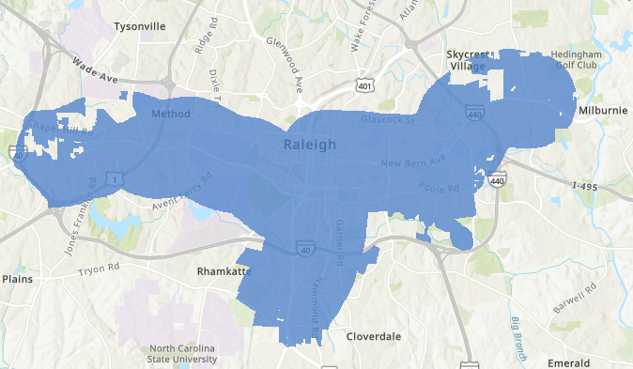
Enhanced Program Eligible Areas
Online map at raleighnc.gov (search “homebuyer assistance”)

Slide 9
Program Overview
Eligible Applicants | First-time buyers Earn no more than 80% AMI
Eligible Properties | Single-family homes, townhomes, condos Eligible geographic areas
Max Assistance | Up to $60,000
Max Purchase Price | Up to $450,000
Loan Terms | 0% interest Deferred 30 yrs; half of principal forgiven after 10 yrs, remainder due at 30 yrs

Slide 10
Steps for Buying

Slide 11
Steps for Buying
Determine if you qualify. Are you a first-time homebuyer? Is your income under the limit?
Take Homebuyer Education class. Contact DHIC at (919) 832-4345.
Find a lender. Our program works with a network of approved lenders, who provide the first mortgage.
Find a home. Must be within City limits (and within eligible geographic area for Enhanced program).

Slide 12
Current Income Limits (80% AMI)
Family of 1 | $63,500
Family of 2 | $72,550
Family of 3 | $81,600
Family of 4 | $90,650
Family of 5 | $97,950
Family of 6 | $105,200
Family of 7 | $112,450
Family of 8 | $119,700

Slide 13
Layering with Other Financing

Slide 14
Layering with Other Financing
Both the Citywide and Enhanced Homebuyer Assistance Program can be layered with NCHFA down payment programs
CPLP
1st Home Advantage Down Payment
Notes:
CPLP has same income limits (80% AMI), maximum sales price ($371,000 – although Enhanced program allows higher sales price), front/back-end ratios (32/45), and homebuyer counseling requirements
1st Home has complementary income limits (1st Home is higher), City’s max sales prices are below 1st Home ($480k), same back-end ratio (45) – no front-end for 1st Home, complementary homebuyer counseling requirements

Slide 15
Layering with Other Financing
Both City of Raleigh programs can be layered with other sources of subsidy as well, including:
Federal Home Loan Bank
LIFT (NeighborWorks)
Funding through local organizations (e.g., DHIC)

Slide 16
Thank You!

