Slide 1
ECONOMIC SITUATION AND OUTLOOK WITH IMPLICATIONS FOR HOUSING
Dr. Michael L. Walden, Reynolds Distinguished Professor Emeritus
North Carolina State University

Slide 2
THE COVID RECESSION WAS BIG
RESULTED FROM NATIONWIDE SHUT-DOWN POLICIES
14% UNEMPLOYMENT
ECONOMY (GDP) DROPPED 33% ON ANNUALIZED BASIS
GOOD NEWS – SHORT LIVED – REBOUND BEGAN IN MAY 2020

Slide 3
BUT THE ECONOMY IS BACK: GDP GROWTH

Slide 4
EMPLOYMENT IS BACK NC JOB GROWTH HAS BEEN TWICE NATIONAL GROWTH

Slide 5
LABOR FORCE PARTICIPATION IS COMING BACK

Slide 6
ONE EXCEPTION – WORKER “REAL” EARNINGS
* REAL EARNINGS: EARNINGS ADJUSTED FOR INFLATION (PURCHASING POWER)
* DOWN 9% FROM SPRING 2020 TO SPRING 2022
* UP 1.7% IN LATEST YEAR
* IMPLIES WILL TAKE 4 MORE YEARS TO TOTALLY RECOVER
* INTERESTINGLY, LOWER-PAYING JOBS HAVE RECEIVED THE HIGHEST RAISES

Slide 7
INFLATION RATE IS MODERATING

Slide 8
WHAT’S THE FED DOING?
TAKING THE PUNCH BOWL AWAY
CONTROL OVER INTEREST RATES
DURING COVID, PUSHED INTEREST RATES TO RECORD LOWS TO ENCOURAGE SPENGING
NOW, FED HAS PUSHED INTEREST RATES UP TO SLOW SPENDING AND TAKE PRESSURE OFF PRICES

Slide 9
FEDERAL FUNDS RATE, 1955-2023

Slide 10
FED IS ALSO REDUCING THE MONEY SUPPLY (M2 MONEY SUPPLY ADJUSTED FOR INFLATION)

Slide 11
WHAT’S THE WORRY?
THAT FED’S EFFORTS WILL CAUSE A RECESSION
RECESSION IS A “BROAD BASED DECLINE IN ECONOMIC ACTIVITY FOR A SUSTAINED PERIOD OF TIME”
RECESSIONS ARE COMMON WHEN FED RAISES INTEREST RATES

Slide 12
FED’S GOAL IS A “SOFT LANDING”

Slide 13
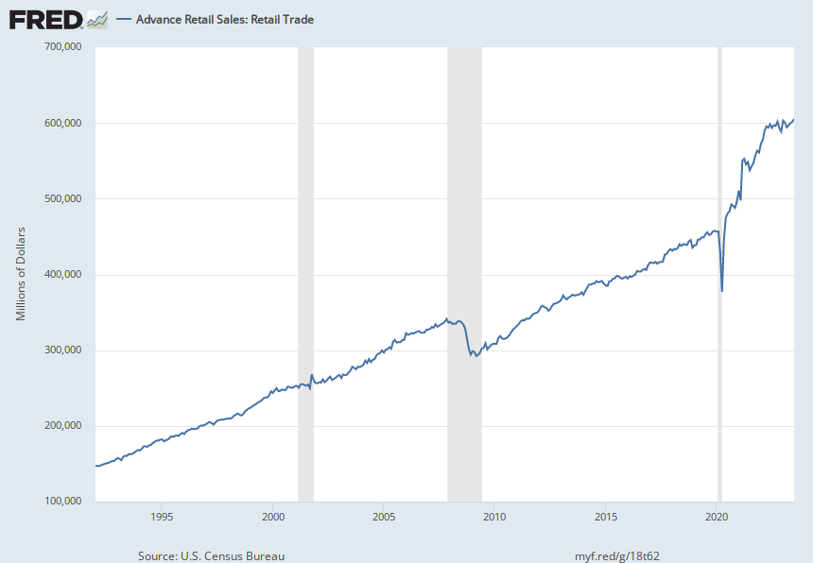
CONSUMER SPENDING IS STILL STRONG, BUT SLOWING

Slide 14
JOBS ARE STILL BEING ADDED, BUT GROWTH IS MODERATING
AVERAGE MONTHLY NET JOB GAIN
2ND HALF, 2020: 1,346,000
2021: 667,000
2022: 369,000
2023 , JAN-SEPT: 204,000

Slide 15
FOCUS ON THE HOUSING MARKET * MORTGAGE RATES *

Slide 16
CASE-SHILLER HOME PRICE INDEX

Slide 17
HOME PRICE INDEX FOR NORTH CAROLINA

Slide 18
NC BUILDING PERMITS HAVE BEEN STRONG

Slide 19
HOME SALES
NEW HOME SALES HAVE OUTPACED EXISTING HOME SALES

Slide 20
WALDEN’S FORECASTS
FED WILL BEGIN LOWERING INTEREST RATES IN MID-2024
INFLATION RATE WILL CONTINUE TO MODERATE AND REACH 2.5% IN LATE 2024
“REAL” INTEREST RATES WILL RISE IN EARLY 2024, PROMPTING SLOWER GROWTH
LOOK FOR ”NEGATIVE GROWTH” AND 4.5% JOBLESS RATE IN MID-2024
BY LATE 2024, INFLATION RATE IS 2.5% AND JOBLESS RATE IS UNDER 4%
30-YEAR FIXED MORTAGE RATE NEAR 5% IN LATE 2024
NEW “WILD CARD” – IMPACT OF MIDEAST WAR ON OIL PRICES

